Slide 1
Heavy-duty Battery Electric Vehicles
December 6, 2023
Keith Leech
President
kleech@cleancitiessacramento.org
Tim Taylor,Co- Director
Sacramento Clean Cities Coalition
(916) 206-2911
ttaylor@cleancitiessacramento.org
Gina O’Neal, Co-Director
Sacramento Clean Cities Coalition
Associate Planner, Sac Metro Air District
(916) 622-8433
goneal@airquality.org

Slide 2
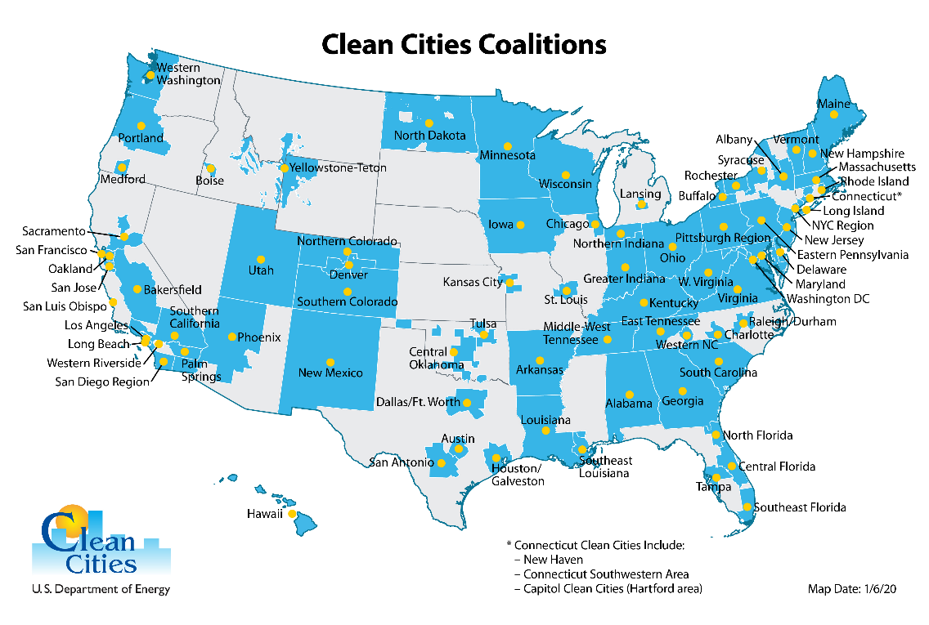
Clean Cities Mission: Reduce Fossil Petroleum in Transportation and Energy
Fleet Education – Regulations, Grants
Workforce Development
Grant Development
Evaluate Transportation Needs and energy choices to determine the most impactful and cost-effective vehicle options, fuels, technologies, and best practices that make sense for specific stakeholder applications;
Decarbonize Transportation Sector by shifting to vehicles, fuels, and technologies that reduce transportation greenhouse gas emissions;
Reduce Transportation Emissions that contribute to air pollution and harm public health;
Advance Environmental Justice priorities by maximizing project benefits that flow to underserved communities and minimize project burdens that affect underserved communities; and
Promote Higher MPG Vehicles
Promote Reduced Idling

Slide 3
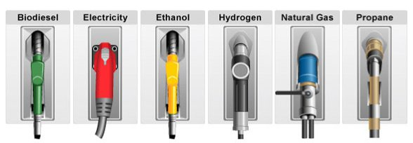
Alternative Fuels
Carbon Intensity of Fuels (units = gCO2e/mj)
Fuel Type | CI | Company (ID)
Renewable Diesel | 16.21 | Neste Singapore Pte Ltd
Renewable Gasoline | 38.86 | PHILLIPS 66 COMPANY
Renewable Propane | 20.5 | REG (Chevron)
Renewable Electricity | 0 | Wind or Solar
Renewable Natural Gas | -532.74 | Various Providers
California Grid | 76.73 | Utility Companies

Slide 4
2023 Outreach & Education
23-01-11_La Familia Workgroup
23-01-12_Phillips 66 Renewable Fuels
23-01-25_CA Auto Business Council
23-02-14_Canoo EV Pickup & Van
23-02-21_PEV & Trans Hub
23-03-01_Microtransit Listening Session
23-03-06_La Familia Microtransit & Job Training
23-03-06_La Familia Workforce Development
23-03-09_Trainee Cohort Two SMUD Sites
23-03-21_Nikola Heavy-duty ZEV
23-04-23_Earth Day
23-04-27_BAR Advisory Group
23-05-11 or 12_EV Power Pod
23-06-01_Coast-to-Coast EV
23-06-11 to 14_EVS36
23-06-12_GiddyUp_SacRT_Power Inn
23-06-19 & 20_H2 Business Council
23-08-22-24_GTSE Tacoma, WA
23-8-31_Tour of Fuel Cell Energy - Long Beach
23-9-29_Lake Tahoe Electrification Presentation
23-10-4_Mobility Hub Tour
23-10-19_ZEV Transition Strategies Conference
23-11-2_Clean Start ZEV Presentation
23-11-8_Microgrids Strategy
23-11-9_Four Agency Board ZEV Equipment Display
23-11-16_ACT/ACF Presentation to Recology
23-12-4_Ford ZEV Technician Training

Slide 5
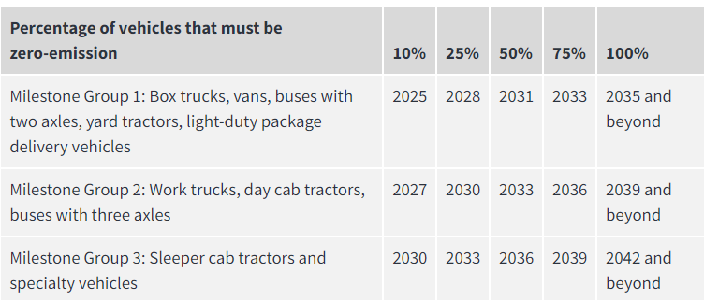
Advanced Clean Fleet Regulation
Two Compliance Paths
State & Local Government Agencies
50% of all vehicles acquired over 8.500lb GVWR must be ZEV beginning in 2024
100% of all vehicles acquired over 8,500lb GVWR must be ZEV beginning in 2027
Private Companies with more than 50 vehicles over 8.500lb GVWR or with $50M in annual revenue
Same compliance requirements, or
Fleets must meet a fleet average percent of ZEVs

Slide 6
Parting Thoughts - Infrastructure
Large EV Fleet Requirements in Perspective
* Varies Between 350 – 750 Homes per MW Depending on Location in U.S. and Size of Home

Slide 7
Regulatory Language and Reference Documentation
•Main website
•https://ww2.arb.ca.gov/our-work/programs/advanced-clean-fleets
•Final Regulation Order: State and Local Government Agency Fleet Requirements Document
•https://ww2.arb.ca.gov/sites/default/files/barcu/regact/2022/acf22/acffroa1.pdf
•Final Regulation Order: High Priority and Federal Fleet Requirements
•https://ww2.arb.ca.gov/sites/default/files/barcu/regact/2022/acf22/acffroa2.pdf
Five-part On-line Regulation Presentation
https://www.youtube.com/watch?v=ybPBAoXZRfw&list=PLz9MgMTO5IJKLJ70dsC_FZnbEjBDI5tXn

