Slide 1


ZEV Infrastructure for Vehicles and Facilities
Presented By David M. Renschler, CPFP
Fleet Division Manager
City of Fairfield

Slide 2
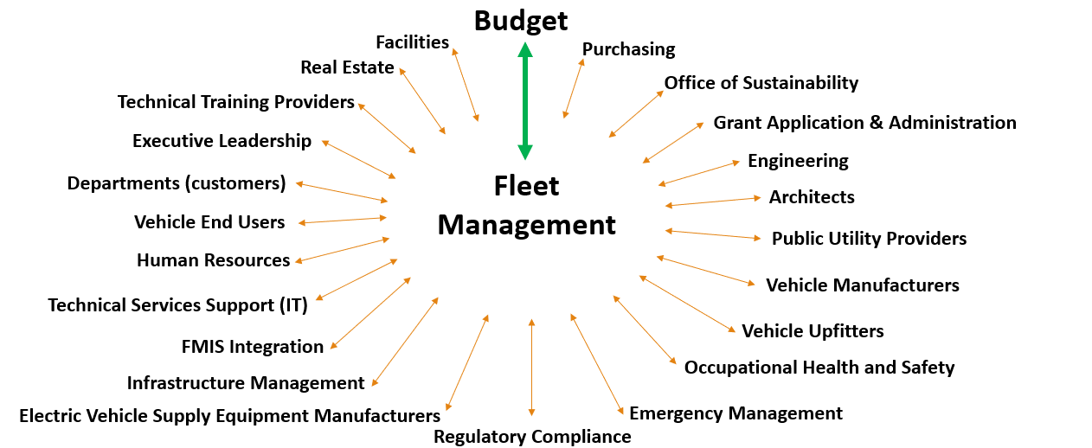
Internal and External Group Collaboration Required

Slide 3

Gather Data
What do you use now?
How much do you use that vehicle/equipment now?
What is on the market that is similar and will do the job?
Where does it reside at night?
Does it have aux equipment?
Is it a take home?
How much dwell time is available?

Slide 4
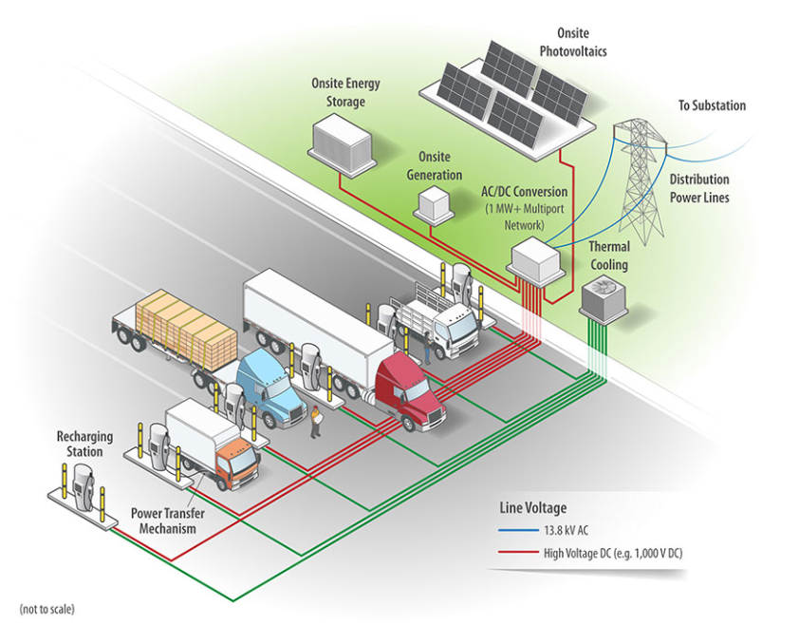
Infrastructure Planning
How to Determine How Much Power You Need
  Create a fleet vehicle inventory list
  Identify vehicles that can be replaced with EVs
  Determine battery size (kWh) from available sources
    Manufacturers, EPA Power Search (fueleconomy.gov), industry Sources, etc.
  Determine charge rate AC or DC voltage requirements
    Level 2 – 208 to 240 VAC – Charger Power 2.5 kW - 19.2 kW
    DC Fast-Charge (Level 3) – 300 to 600 VDC – Charger Power 50 kW to 350+ kW
  Determine overnight parking locations
https://www.nrel.gov/transportation/medium-heavy-duty-vehicle-charging.html

Slide 5
Fuel Energy Consumption
Fleet mileage or fuel burn per hour
Equipment ID | Equipment Description | Vehicle Location | Weight Class | Average Daily Milage (mi/day) | Proxy EV Description | Efficiency (kWh/ 100mi) | Average Daily Energy Consumption (kWh/day)
00056 | VAN - CARGO - 1 TON | PRUNEYARD | Class 2b-3 | 17.56 | Workhorse, C650 Battery Electric Step Van | 74 | 12.91
00202 | TRUCK - 1 TON - FLAT BED DUMP | CORPYARD | Class 2b-3 | 22.99 | Motiv Power Systems, Ford E-450, Flat Bed Dump | 133 | 30.59
00210 | TRUCK - 1 TON - FLAT BED DUMP | CORPYARD | Class 2b-3 | 16.57 | Motiv Power Systems, Ford E-450, Flat Bed Dump | 133 | 22.04
00307 | TRUCK - GARBAGE | CORPYARD | Class 7-8 | 18.48 | Lion Electric, All Electric Refuse Truck | 198 | 36.52
00312 | VAC-CON | CORPYARD | Class 7-8 | 10.43 | N/A, Figure 1 Estimates | 205 | 21.39
00315 | TRUCK - DUMP - 6 WH | CORPYARD | Class 7-8 | 13.72 | Kenworth, K370E Battery Electric Truck | 141 | 19.35
00325 | WATER TANKER TRUCK (WG64) | CORPYARD | Class 7-8 | 2.05 | N/A, Figure 1 Estimates | 188 | 3.87
00329 | TRUCK - 1-1/4 TON - FLAT BED - W SPRAYER | CORPYARD | Class 4-6 | 3.22 | Kenworth, 270E Battery Electric Truck | 141 | 4.53
00332 | TRUCK - DUMP - 10 WH | CORPYARD | Class 7-8 | 18.11 | Kenworth, T680E Battery Electric Truck | 264 | 47.82
00359 | TRUCK - DUMP - 6 WH - W EMULS SPRAYER | CORPYARD | Class 7-8 | 12.23 | Kenworth, K370E Battery Electric Truck | 141 | 17.25
03232 | VAN - CARGO - 1 TON | CORPYARD | Class 2b-3 | 52.38 | Workhorse, C650 Battery Electric Step Van | 74 | 38.50
07130 | PICKUP - 3/4 TON - UTIL BED - LIFT GATE | CORPYARD | Class 2b-3 | 26.57 | Motiv Power Systems, Ford E-450, Work Truck | 133 | 35.34
07231 | VAN - CARGO - 1-1/2 TON | CORPYARD | Class 4-6 | 2.36 | Motiv Power Systems, Ford E-450, Box Truck | 121 | 2.85
08098 | PICKUP - 3/4 TON - SUPER CAB | RANCHO SOLANO GC | Class 2b-3 | 12.93 | Lordstown Motors, Endurance | 45 | 5.81
08140 | PICKUP - 3/4 TON - 4X4 | WATERMAN TREATMENT | Class 2b-3 | 5.09 | Lordstown Motors, Endurance | 45 | 2.29
08207 | TRUCK - 1 TON -FLAT BED DUMP | CORPYARD | Class 2b-3 | 19.04 | Motiv Power Systems, Ford E-450, Flat Bed Dump | 133 | 25.33
08214 | TRUCK - 1-1/4 TON - UTIL BED - SIGN | CORPYARD | Class 4-6 | 31.17 | Kenworth, K270E Battery Electric Truck | 141 | 43.95
08215 | TRUCK - 1-1/4 TON - PAINT TRUCK | CORPYARD | Class 4-6 | 3.36 | Kenworth, 270E Battery Electric Truck | 141 | 4.74

Slide 6
Specification Considerations
How much is the expected cost of purchase?
What are the specs of the replacement vehicle/equipment?
How much charge can it take at Level 2 and DCFC?

Slide 7
Electrification Analysis
Vehicle Inputs required
Vehicle Type** | Proxy EV Description | Estimated Purchase Price | Usable Battery Capacity (kWh) | Efficiency (kWh/ 100mi) | L2 Max Charging Rate (kW) | DCFC Max Charging Rate (kW) | GVWR (lbs.)
10 WHEEL DUMP | Kenworth, T680E Battery Electric Truck | $259,463 | 396 | 264 | 7.2 | 120 | 82,000
6 WHEEL DUMP | Kenworth, K370E Battery Electric Truck | $174,633 | 282 | 141 | 7.2 | 120 | 33,000
BOX TRUCK | Motiv Power Systems, Ford E-450, Box Truck | $74,050 | 127 | 133 | 7.2 | 50 | 14,500
CARGO VAN | Workhorse, C650 Battery Electric Step Van | $50,399 | 70 | 74 | 7.2 | 50 | 12,500
CARGO VAN | Motiv Power Systems, Ford E-450, Box Truck | $96,550 | 127 | 121 | 7.2 | 50 | 14,500
FLAT BED | Motiv Power Systems, Ford E-450, Flat Bed | $81,684 | 127 | 121 | 19.2 | 60 | 14,500
FLAT BED | Kenworth, 270E Battery Electric Truck | $131,841 | 141 | 141 | 19.2 | 60 | 26,000
FLAT BED DUMP | Motiv Power Systems, Ford E-450, Flat Bed Dump | $58,776 | 127 | 133 | 19.2 | 60 | 14,500
FLAT BED DUMP | Kenworth, 270E Battery Electric Truck | $104,600 | 141 | 148 | 19.2 | 60 | 26,000
PASSENGER VAN | Motiv Power Systems, Ford E-450, Shuttle Bus | $49,050 | 127 | 121 | 6.6 | 80 | 14,500
PICKUP | Lordstown Motors, Endurance | 64,650 | 109 | 45 | 11.0 | 60 | N/A
REFUSE | Lion Electric, All Electric Refuse Truck | $137,900 | 336 | 198 | 7.2 | 60 | 66,000

Slide 8
Charging Vehicles
What type of chargers are you going to need and where?
Is it a standby unit or normal use?
Research efficiency and how many kWh per day each will need.
Determine what type of charger and whether it can share or must be dedicated, etc.
Check with Utility to make sure you have enough available at the site!
Use this to determine site maximum kWh needs for an “optimized” and “maximum” site.

Slide 9
Lightning Charging Times
SEW | Age in Years | Life Miles | Life Gallons | MPG | Annual Miles | Annual Gallons | Daily Miles / 234 WD | Daily Gallons | Max Battery | Battery kW/mile for F-150 | Daily kw Needed | 80 % Charge | 90 % Charge | SOC at end of day | # of days before recharge needed | Advertised charge Time/Pro | L2 Charge Hours | L2 + Charge Hours | Dual ABB 124 @60 Max 90%
15011 | 6.5 | 30469 | 1987.11 | 15.33 | 4,688 | 306 | 20.03 | 1.31 | 131 | 0.5 | 10.02 | 104.00 | 118.00 | 120.98 | 10.48 | 1.34 | 1.63 | 0.59 | 0.18
SD
15059 | 6.5 | 87675 | 5057 | 17.34 | 13,488 | 778 | 57.64 | 3.32 | 131 | 0.5 | 28.82 | 104.00 | 118.00 | 102.18 | 3.64 | 3.84 | 4.68 | 1.71 | 0.52
WAT
14004 | 7.17 | 81011 | 5154.37 | 15.72 | 11,299 | 719 | 48.28 | 3.07 | 131 | 0.5 | 24.14 | 104.00 | 118.00 | 106.86 | 4.35 | 3.22 | 3.92 | 1.43 | 0.44
18174 | 3.25 | 9416 | 743.32 | 12.67 | 2,897 | 229 | 12.38 | 0.98 | 131 | 0.5 | 6.19 | 104.00 | 118.00 | 124.81 | 16.96 | 0.83 | 1.00 | 0.37 | 0.11
18061 | 3.25 | 30829 | 3363.14 | 9.17 | 9,486 | 1,035 | 40.54 | 4.42 | 131 | 0.5 | 20.27 | 104.00 | 118.00 | 110.73 | 5.18 | 2.70 | 3.29 | 1.20 | 0.37
18043 | 3.25 | 35285 | 3135.49 | 11.25 | 10,857 | 965 | 46.40 | 4.12 | 131 | 0.5 | 23.20 | 104.00 | 118.00 | 107.80 | 4.53 | 3.09 | 3.77 | 1.37 | 0.42
18065 | 3.25 | 25498 | 2091.69 | 12.19 | 7,846 | 644 | 33.53 | 2.75 | 131 | 0.5 | 16.76 | 104.00 | 118.00 | 114.24 | 6.26 | 2.24 | 2.72 | 0.99 | 0.30
18198 | 3.25 | 30344 | 2712.73 | 11.19 | 9,337 | 835 | 39.90 | 3.57 | 131 | 0.5 | 19.95 | 104.00 | 118.00 | 111.05 | 5.26 | 2.66 | 3.24 | 1.18 | 0.36
16002 | 5.75 | 77880 | 4568.32 | 17.05 | 13,544 | 794 | 57.88 | 3.40 | 131 | 0.5 | 28.94 | 104.00 | 118.00 | 102.06 | 3.63 | 3.86 | 4.70 | 1.71 | 0.53
16124 | 5.75 | 122491 | 8447.79 | 14.50 | 21,303 | 1,469 | 91.04 | 6.28 | 131 | 0.5 | 45.52 | 104.00 | 118.00 | 85.48 | 2.31 | 6.07 | 7.39 | 2.69 | 0.83
WTM
13221 | 9.42 | 36377 | 2605.65 | 13.96 | 3,862 | 277 | 16.50 | 1.18 | 131 | 0.5 | 8.25 | 104.00 | 118.00 | 122.75 | 12.73 | 0.55 | 1.34 | 0.49 | 0.15
17491 | 4.84 | 24167 | 1951.64 | 12.38 | 4,993 | 403 | 21.34 | 1.72 | 131 | 0.5 | 10.67 | 104.00 | 118.00 | 120.33 | 9.84 | 0.71 | 1.73 | 0.63 | 0.19
CD
15173 | 6.5 | 69250 | 4185.56 | 16.54 | 10,654 | 644 | 45.53 | 2.75 | 131 | 0.5 | 22.76 | 104.00 | 118.00 | 108.24 | 4.61 | 3.04 | 3.70 | 1.35 | 0.41
15176 | 6.5 | 35998 | 2095.58 | 17.18 | 5,538 | 322 | 23.67 | 1.38 | 131 | 0.5 | 11.83 | 104.00 | 118.00 | 119.17 | 8.87 | 1.58 | 1.92 | 0.70 | 0.22
15177 | 6.42 | 70730 | 4594.82 | 15.39 | 11,017 | 716 | 47.08 | 3.06 | 131 | 0.5 | 23.54 | 104.00 | 118.00 | 107.46 | 4.46 | 3.14 | 3.82 | 1.39 | 0.43
17033 | 5.25 | 71800 | 3963.9 | 18.11 | 13,676 | 755 | 58.45 | 3.23 | 131 | 0.5 | 29.22 | 104.00 | 118.00 | 101.78 | 3.59 | 3.90 | 4.74 | 1.73 | 0.53
ENG
14169 | 7.67 | 107346 | 8042.96 | 13.35 | 13,996 | 1,049 | 59.81 | 4.48 | 131 | 0.5 | 29.91 | 104.00 | 118.00 | 101.09 | 3.51 | 3.99 | 4.85 | 1.77 | 0.54
15153 | 6.5 | 172598 | 10106.06 | 17.08 | 26,554 | 1,555 | 113.48 | 6.64 | 131 | 0.5 | 56.74 | 104.00 | 118.00 | 74.26 | 1.85 | 7.57 | 9.21 | 3.36 | 1.03

Slide 10
Charger Energy Consumption
Equipment ID | Vehicle Description | kWh/day | Daily L2 Charging Time (h:mm:ss) | Daily DCFC Charging Time (h:mm:ss) | Assigned Charger Port* | Charging Strategy
00202 | Motiv Power Systems, Ford E-450, Flat Bed Dump | 30.59 | 4:14:55 |  | 1a | DEDICATED L2 CHARGING
00210 | Motiv Power Systems, Ford E-450, Flat Bed Dump | 22.04 | 3:03:40 |  | 1b | SHARED L2 CHARGING
00307 | Lion Electric, All Electric Refuse Truck | 36.52 | 5:04:22 |  | 2a | DEDICATED L2 CHARGING
00312 | N/A, Figure 1 Estimates | 21.39 | 2:58:15 |  | 2b | SHARED L2 CHARGING
00315 | Kenworth, K370E Battery Electric Truck | 19.35 | 2:41:14 |  | 3a | SHARED L2 CHARGING
00325 | N/A, Figure 1 Estimates | 3.87 | 0:32:14 |  |  | 5-DAY CHARGING
00329 | Kenworth, 270E Battery Electric Truck | 4.53 | 0:37:47 |  |  | 5-DAY CHARGING
00332 | Kenworth, T680E Battery Electric Truck | 47.82 | 6:38:28 |  | 3b | DEDICATED L2 CHARGING
00359 | Kenworth, K370E Battery Electric Truck | 17.25 | 2:23:44 |  | 4a | SHARED L2 CHARGING
03232 | Workhorse, C650 Battery Electric Step Van | 38.50 | 5:20:50 |  | 4b | DEDICATED L2 CHARGING
07130 | Motiv Power Systems, Ford E-450, Work Truck | 35.34 | USE A DCFC | 0:41:35 | DCFC – 1 | DEDICATED DCFC
07231 | Motiv Power Systems, Ford E-450, Box Truck | 2.85 | 0:23:46 |  |  | 5-DAY CHARGING
08207 | Motiv Power Systems, Ford E-450, Flat Bed Dump | 25.33 | 3:31:03 |  | 5a | SHARED L2 CHARGING
08214 | Kenworth, K270E Battery Electric Truck | 43.95 | 6:06:15 |  | 5b | DEDICATED L2 CHARGING
Determine what type of charging fits your needs based on your energy consumption and response requirements.

Slide 11
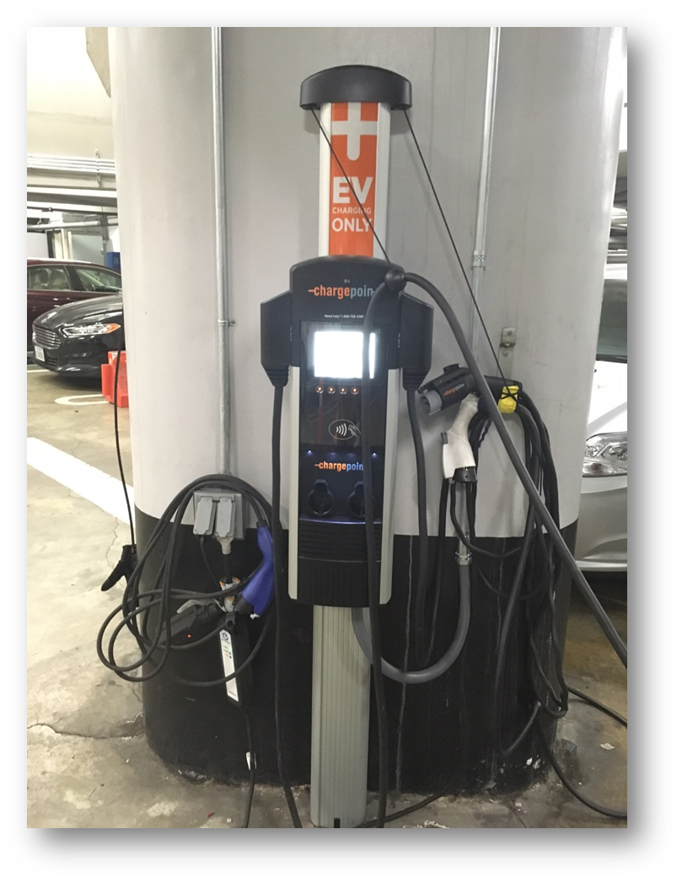
Site Assessment
  Accessibility
  Power supply
  Owned/Leased Building
  Estimated time at facility (dwell)
  Permitting requirements
  Type of use (fleet/public)

Slide 12
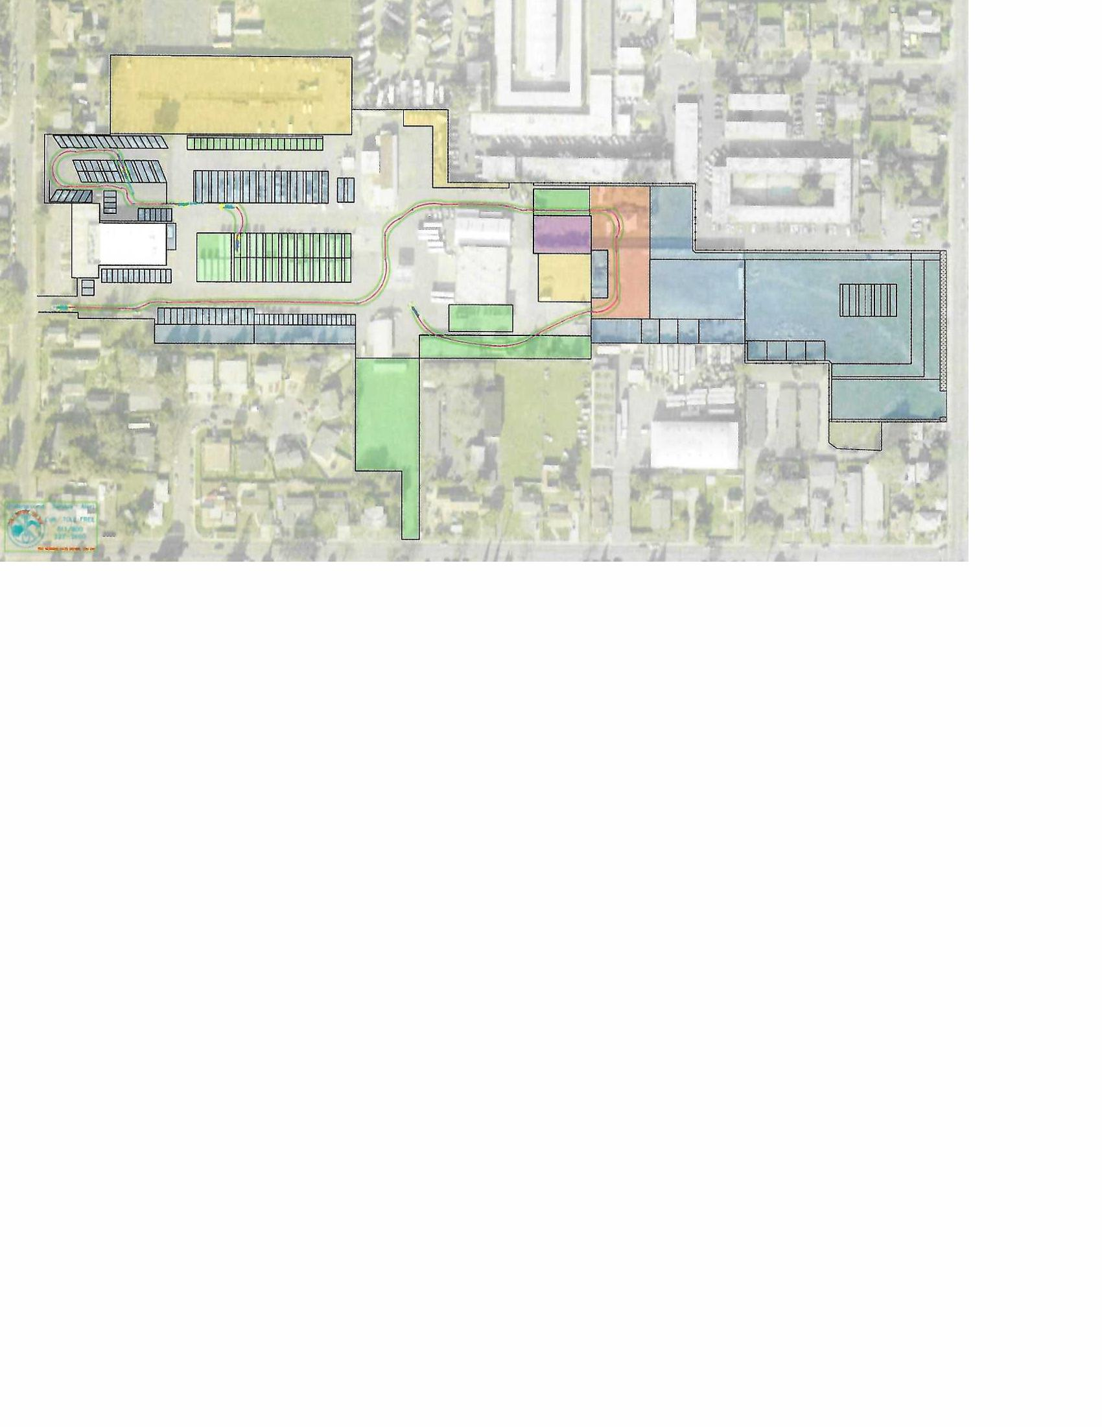
Charger Infrastructure
Once you know what type of charger, determine where the infrastructure will be best suited.

Slide 13
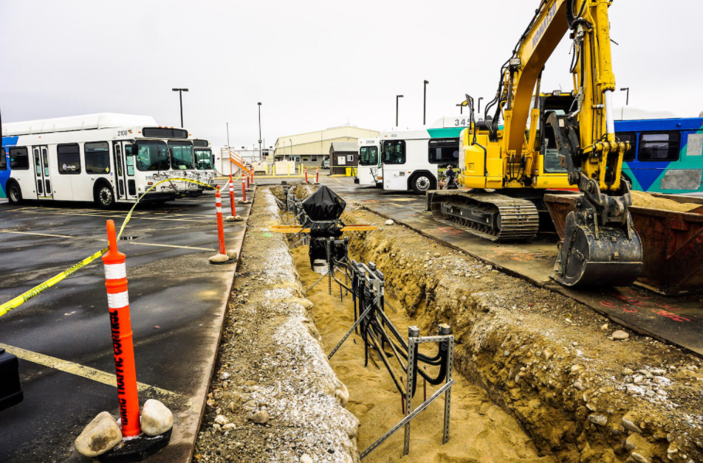
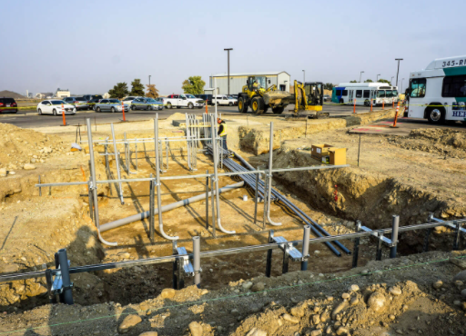
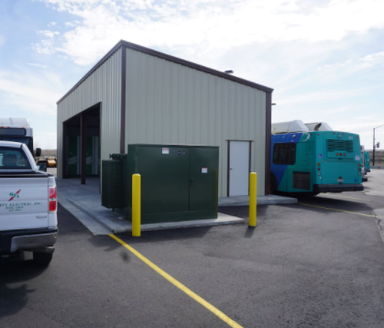
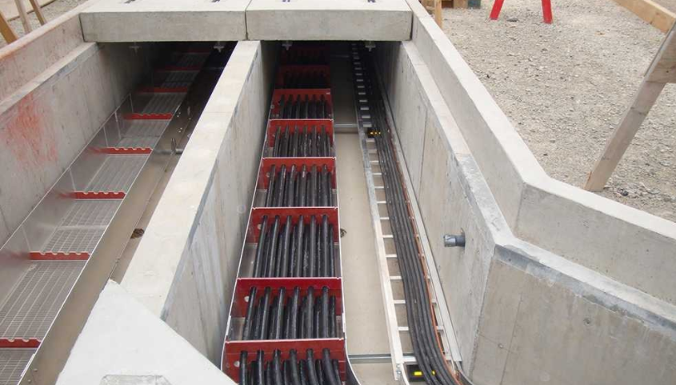
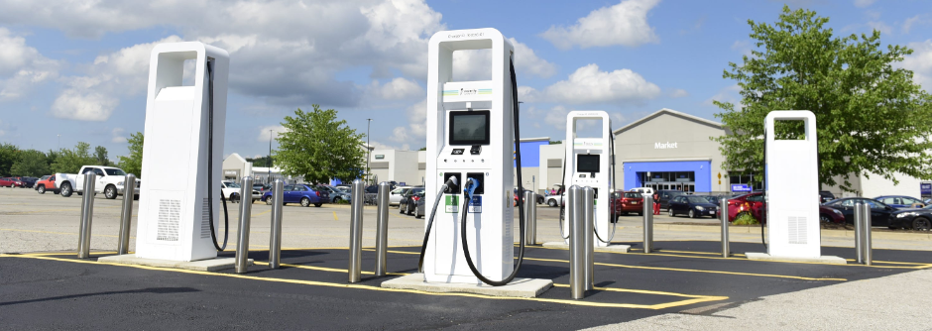
Infrastructure Challenges
Long Runs of Trenching = Expensive
Reduced Parking - During Construction
Reduce Parking – Permanent
High Voltage / Amperage Underground Vaults = Expensive
Charging Equipment Protection

Slide 14
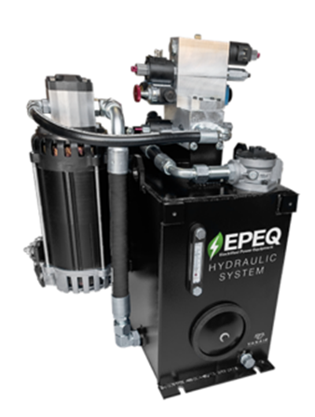
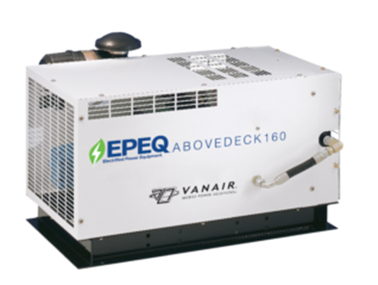
Upfitting Auxiliary Power
Self-contained auxiliary power units as an option.
  How do you charge them?
    Additional charging infrastructure needed?
      Charge the vehicle first and then charge an auxiliary power unit?
  Is the design compatible with the truck chassis?
    Where can it be mounted?
      Above, between, outside or underneath frame rails?
      Within a body compartment?

Slide 15
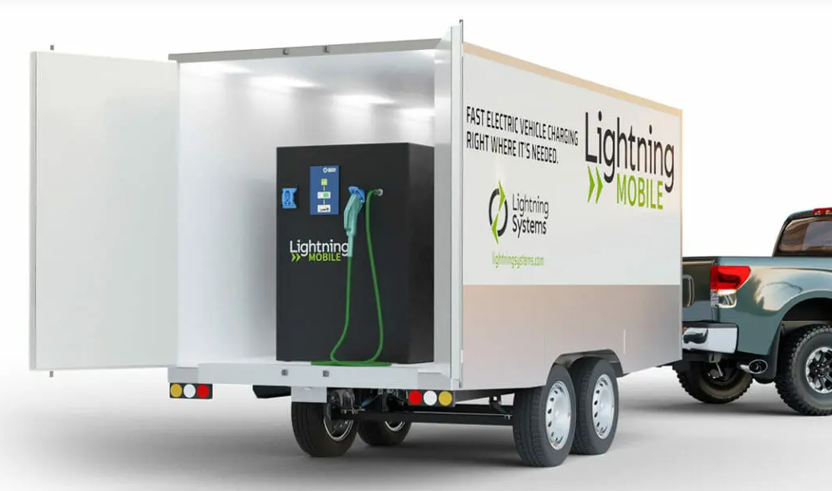
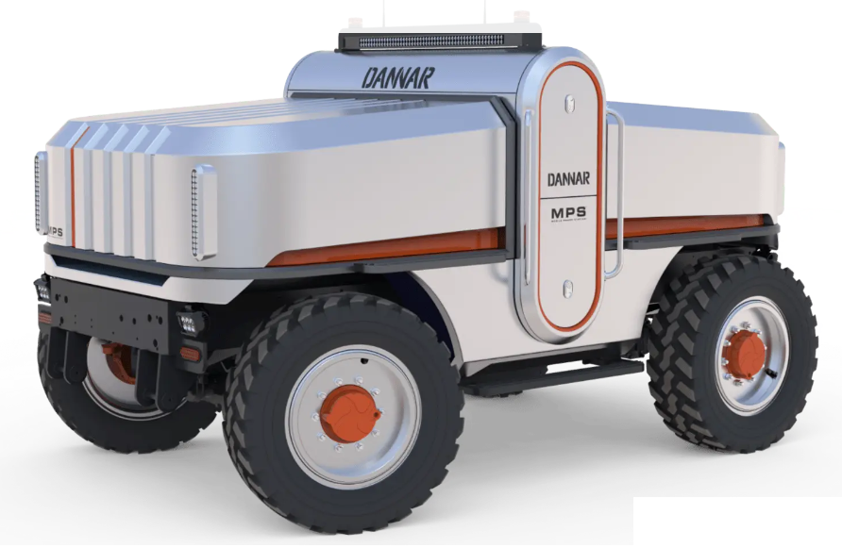
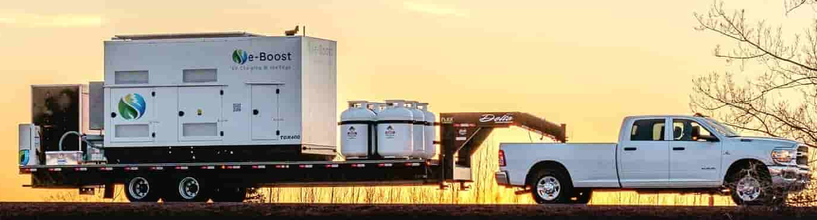
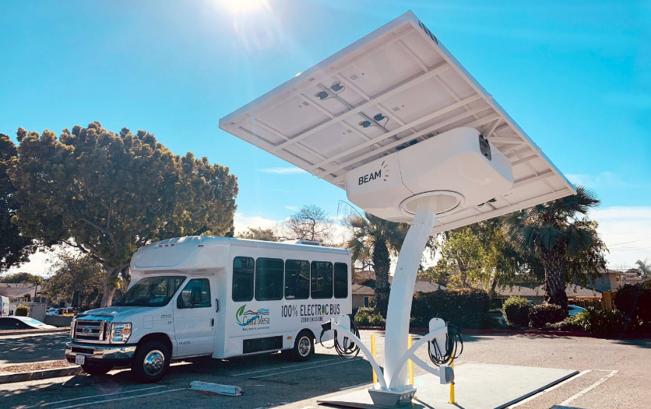
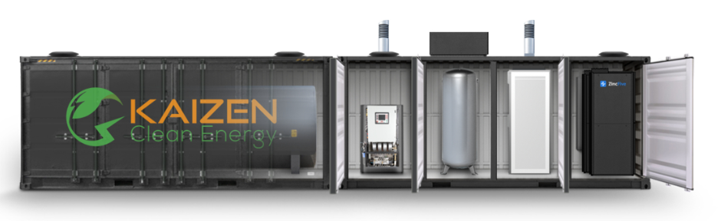
Temporary Charging and Back Up Power
Cost Ranges of $90K to $12M
Battery Trailer Charging Station
Propane Powered Generator Charging Station
Mobile Onsite Charging
Solar Powered Charging Station
Hydrogen Fuel Cell Generator Microgrid Charging Station

Slide 16
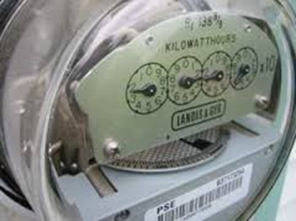
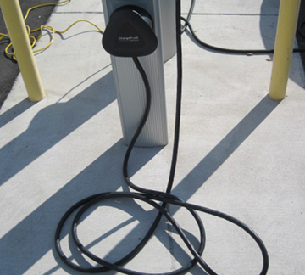
Ongoing Maintenance and Repair
  Budget for repairs to circuit breakers, electrical cord failures, and other unexpected maintenance items
  Review operational costs

Slide 17
Large EV Fleet Requirements in Perspective
* Varies between 350 and 750 homes per MW depending on location in the US and size of the homes.

Slide 18


Questions?
For more information:
David Renschler, CPFP
Fleet Manager, City of Fairfield
Tel: 707-428-7414
drenschler@fairfield.ca.gov

