Slide 1
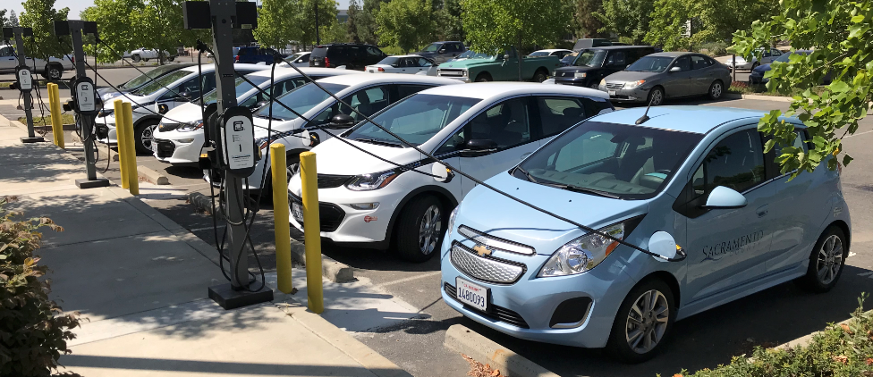
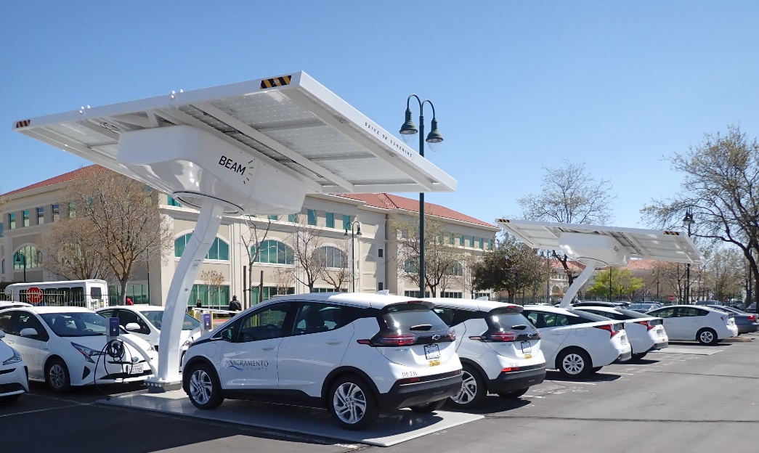
Electric Vehicle Transition Planning

Slide 2
FLEET OVERVIEW
County of Sacramento is 994 square miles with population of over 1.5 million.
Over 2,600 fleet units, 78% Light, 16% Medium and Heavy, 6% Off Road
Vehicle Miles Traveled in 2022 – 20,502,000
99 Fleet Employees
73 Automotive & Heavy Equipment Technicians

Slide 3
Accomplishments, Goals and Regulations
#2 NAFA’s The 100 Best Fleets in 2023
#9 Leading Fleets by Government Fleet 2023
Leading Public Fleet – ACT Expo 2022
HDT Top Green Fleet by Heavy Duty Trucking 2020
#1 Green Fleet in 2018 by 100 Best Fleets / Green Fleet Awards
Over 60% total fuel consumption is renewable fuels or advanced technology Hybrid/Plug In/Fuel Cell.
Over 49% Total Greenhouse Gas reduction by using Renewable, Alternative and Electric vs conventional petroleum fuels.
Goal: County Climate Action Plan requires 100% of all Fleet purchases to be ZEV by 2035 – implemented in three phases.
Regulations: CA Exec Order N-79-20, CARB Advanced Clean Fleet, CARB Off Road and PERP Regulations.

Slide 4
Disclosures and Disclaimer
All Fleets are unique. The information in this presentation has been largely developed by County of Sacramento for use in our specific fleet. It is the responsibility of each individual Fleet Professional to determine whether the tools and methods shared in this presentation are applicable to, or can benefit another individual fleet.
Data, Reports, Dashboards and Management Tools that are displayed in this presentation are each individual elements of a larger process. In most cases, no single report or data source should be used to make important fleet decisions.
Data, Reports, Dashboards and Management Tools shown in this presentation are utilized by Fleet Services for management purposes, procurement tracking and for long term planning. Dollar amounts shown are internal to fleet operations and do not represent any approved or official County of Sacramento or Fleet Services budget.
All work shown is the result of efforts of the whole Team at County of Sacramento Fleet Services Division.

Slide 5
Data Integrity
Fleet Management Information System (FMIS) -
For many Fleets – this is the largest bank of data.
Quality / Reliability of this data is completely dependent on the users of the system.
Enter complete and accurate data – even items you may not currently need.
Establish Standards - Process Manual, Policies and Procedures, Tech Specs / Category Codes, VMRS, SRT – just to name a few.
Incorporate as many Fleet processes into FMIS as practical.
Carefully set permissions and access to avoid unintended inputs / errors / changes.
Employee Training – Every Level of user! Update and retrain with changes in your system.
Back up your data, consider a redundant backup plan. Determine back up intervals to fit your fleet.
Select a provider / system that is customizable to your needs, can grow with your fleet, and integrates with other data sources.

Slide 6
Data Integrity - Continued
GPS / Telematics -
Real time, indisputable (mostly) data.
Diagnostic Code Notifications – many customizable.
Valuable tool to accurately analyze utilization, range and duty cycle.
Select a provider that integrates to your FMIS.
Understand current and future needs.
Conduct a pilot, or long term DEMO, learn software, reports and dashboards available.
Include telematics into your Transportation and Safety Policies.
Some Fleets may require RFP or RFB – be specific in your fleet’s requirements. Include installation, Training and Technical Support after the sale.
State Contracts or Co-Op Contracts may be available.
Many Safety Benefits.
For some Fleets – a great tool for building a driver rewards program!

Slide 7
Data Integrity - Continued
Fuel Transactions –
Integrate Fuel Transactions to FMIS.
Require Odometer readings – Not as crucial if Fleet has telematics.
Capture outside transactions as much as possible.
Set up and capture every fuel type. Conventional, Dual Fuel, Alternative, Renewable.
Transaction limits and controls.
Treat electricity / charging as a fuel type.
Two Factor Authentication for fuel transactions??
Miscellaneous Data –
SAP, Compass, Etc.
Asset Management Data.
Charging Provider Data.
Procurement Data.
Misc. Fleet specific reports

Slide 8
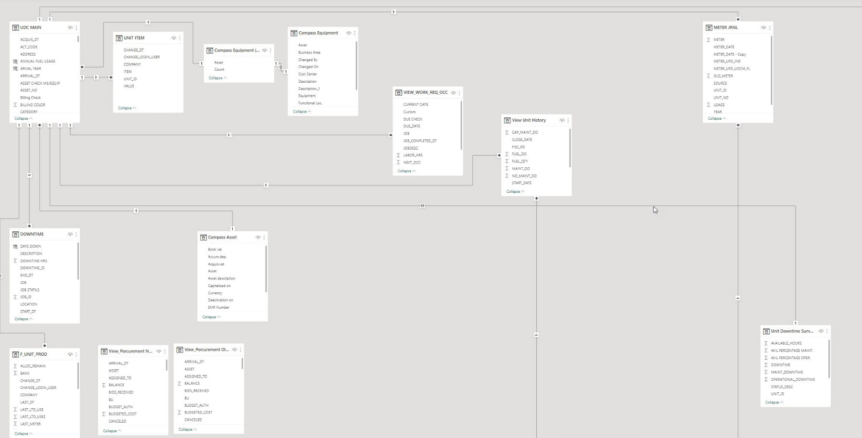
What do I do with all of this data?

Slide 9
Fleet Forecasting
Facilitates Scheduled Replacement of Vehicles.
Tool for Normalizing Budget Year to Year.
Maintains Average Fleet Age.
Minimizes Maintenance and Operating Costs.
Allows for gradual introduction of EV to Fleet to meet future goals and regulations.
Newest vehicle models offer the greatest safety, technology and efficiency.
Replace vehicles on time with cleanest technology available within your budget. Avoid deferring replacements.
Consider impact on TOTAL Fleet Fuel Consumption and impact on TOTAL GHG emissions.
The cleanest gallon of fuel is the gallon you never consume.

Slide 10
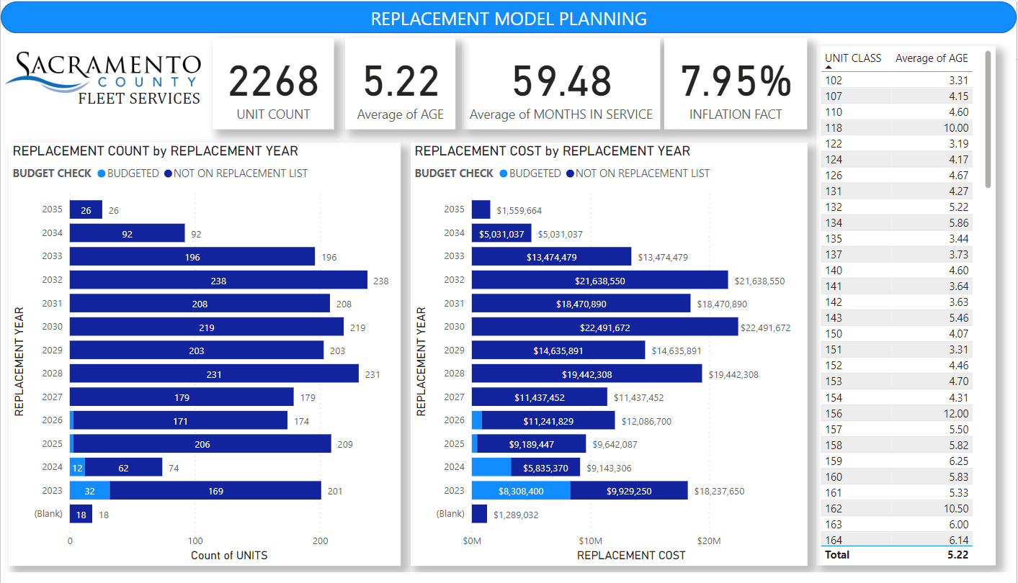

Slide 11
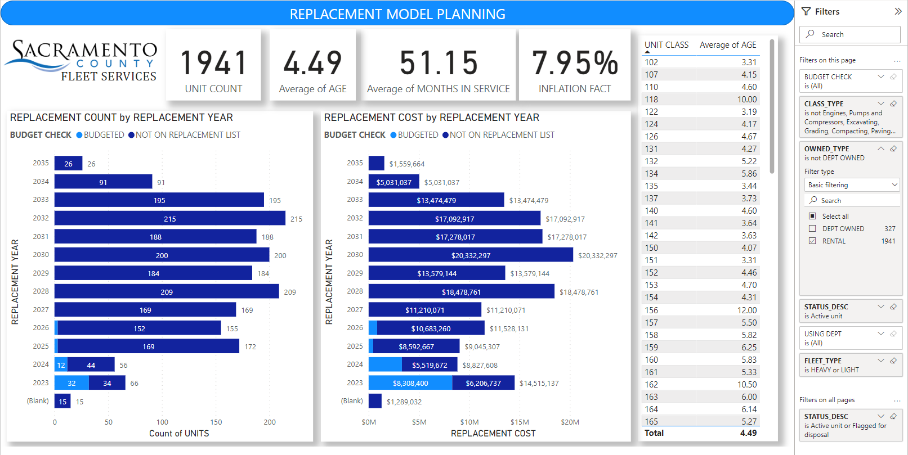

Slide 12
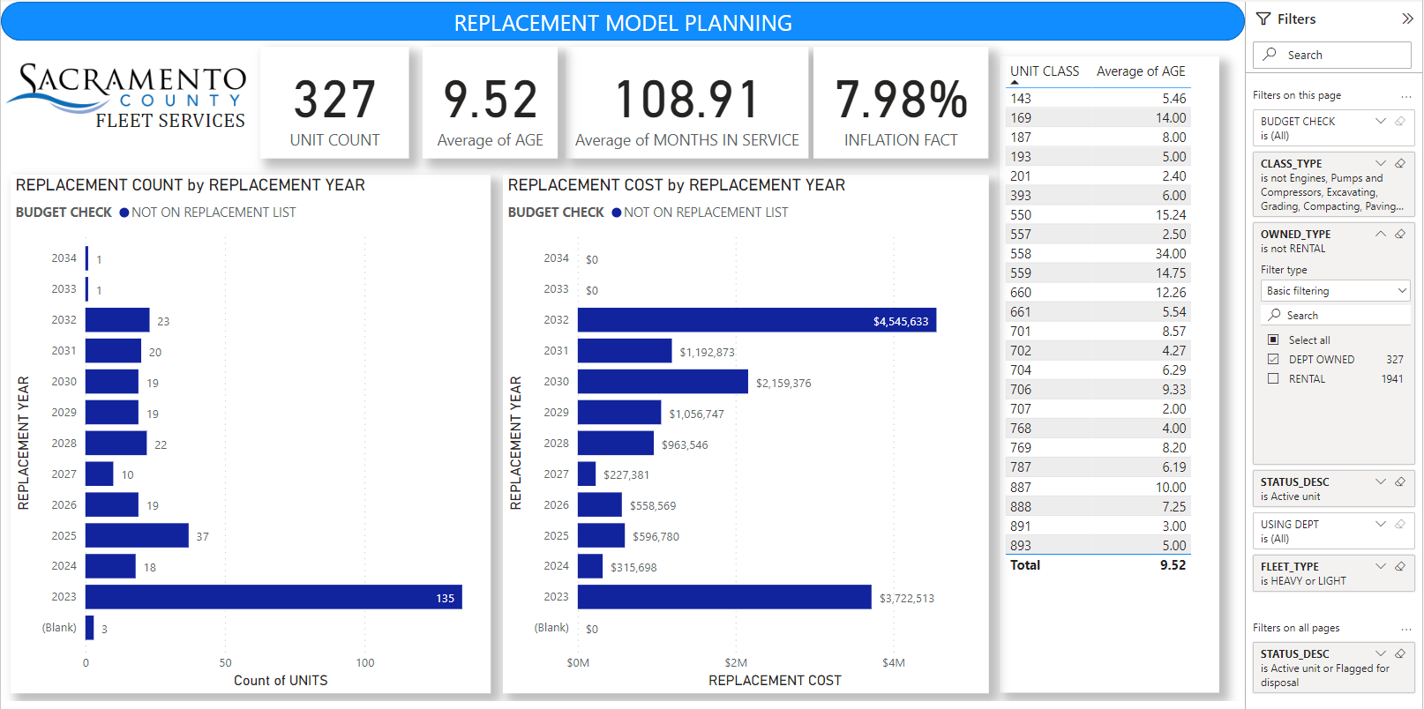

Slide 13
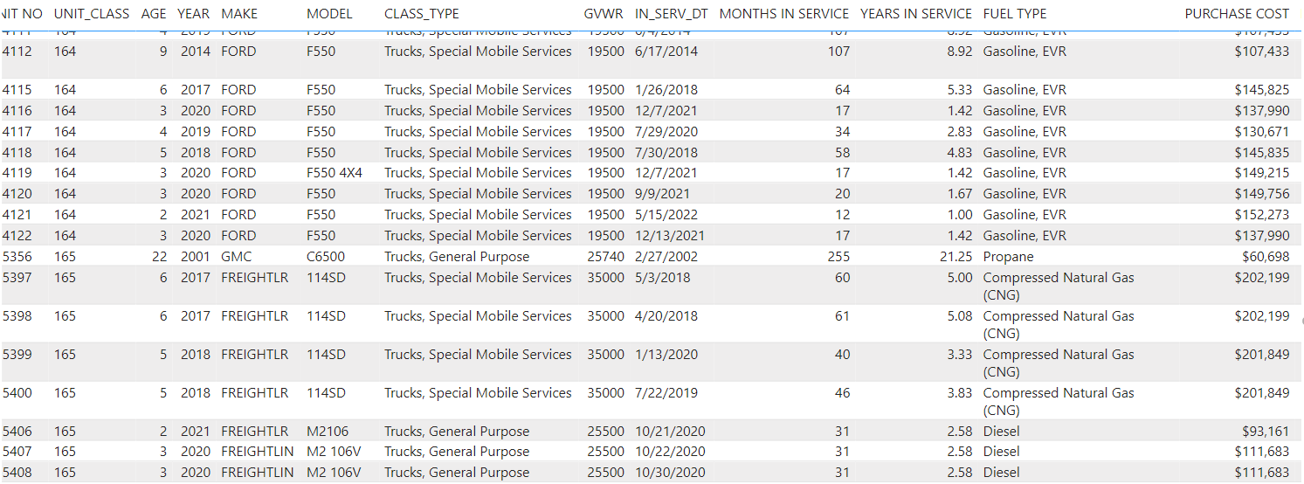

Slide 14
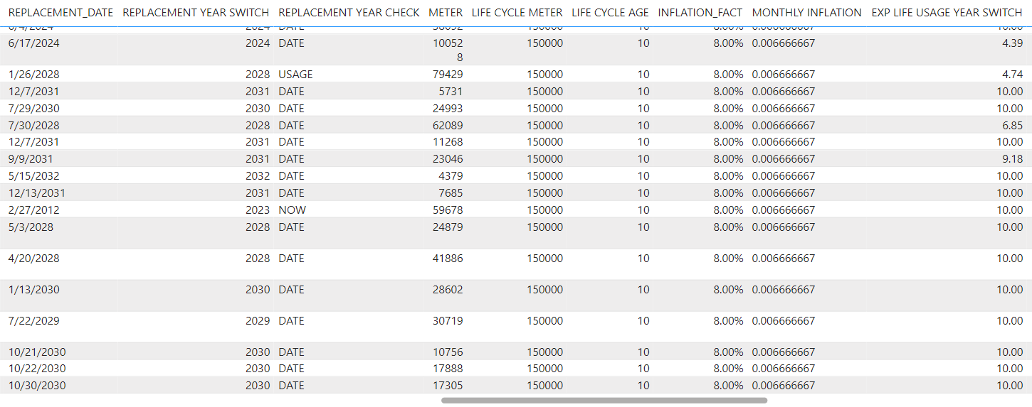

Slide 15
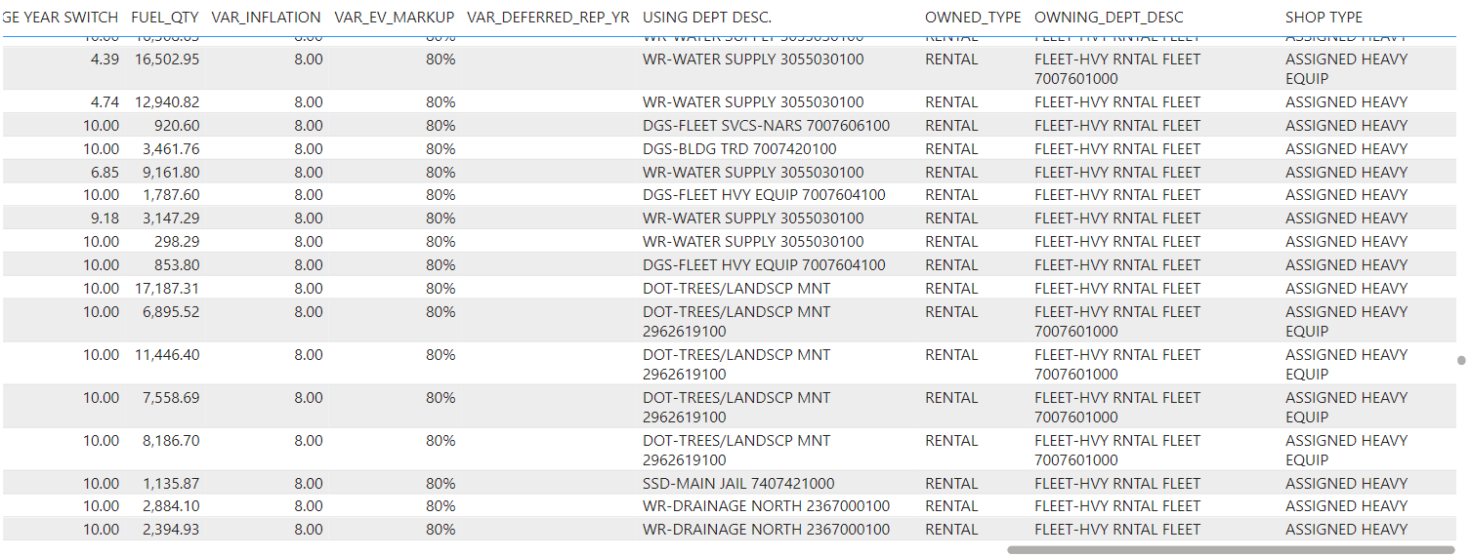

Slide 16
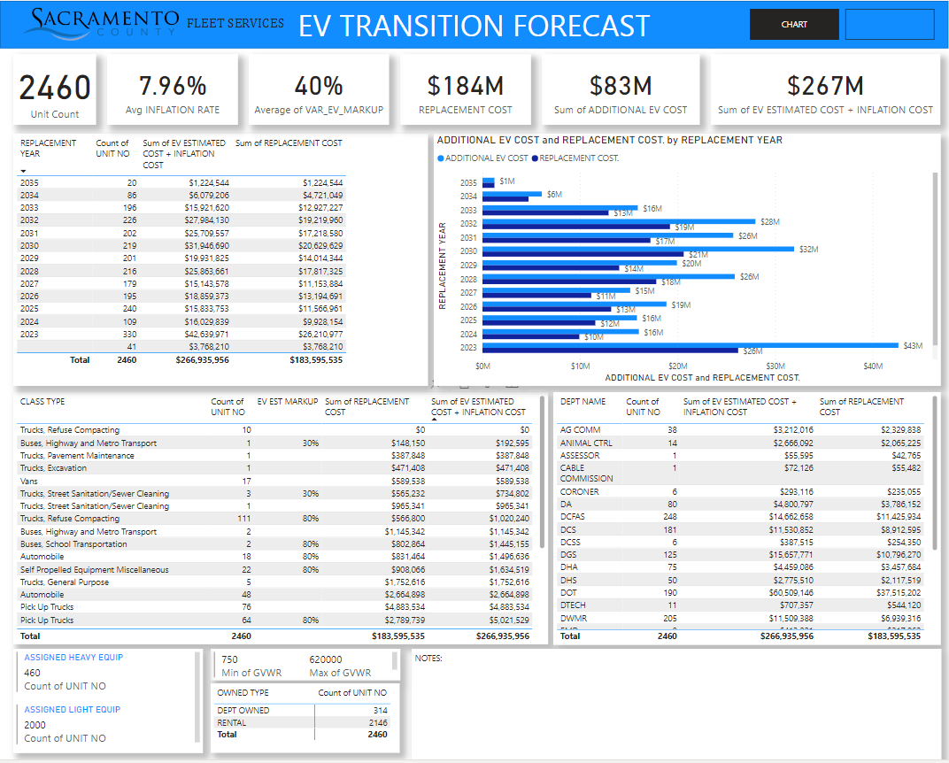
EV Transition Forecast is a tool still in development. Amounts shown are not actual allocated budget.
The tool forecasts long term cost difference –Conventional vs. EV
Additional EV cost is adjustable by unit class
Average Annual Inflation Rate Adjustable
Light Fleet additional costs are based on actual models currently available
Heavy Fleet additional costs are based on manufacturer cost projections and assumptions for added upfit of EV chassis.
Can be sorted by: Fleet Owned, Customer Owned, GVWR, Vehicle Type, User Department.
Allows endless scenarios based on user inputs and sorting.

Slide 17
Cost Estimates by Class
Passenger Cars and Light Pickups
Many passenger cars and trucks currently offered.
Retail, Wholesale, CoOp Contracts, State Contract pricing are readily available.
Estimates and Assumptions can be made based on current available models and manufacturer pricing.
Heavy Duty Trucks
Many manufacturer’s have not announced pricing.
Many aftermarket and startups – how do you choose?
Base assumptions on actual known sales if they are available.
Most heavy municipal vehicles require major upfit.
Make assumptions based on actual vehicle type or class.

Slide 18
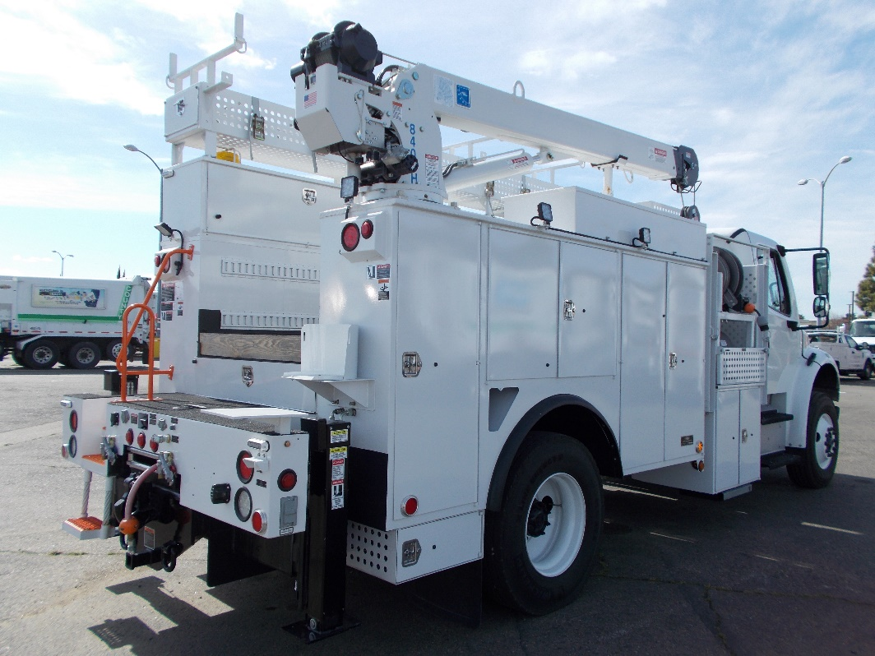
Heavy Vehicle
Cost Assumptions
County of Sacramento “160” class truck. Total cost typically is 40% chassis and 60% Body and Upfit. These cost ratios vary by class. Truck shown –
Total cost in 2018 $222,735.00
Replacement in 2028 – 8.0% Avg Inflation.
$400,923
Chassis 40% = $160,370 X 202% (Convert to EV) = $323,947
Body and Upfit 60% = $240,554 Equivalent Body and Upfit = $240,554
= $564,501
Net Increase is 40.8%

Slide 19
Procurement Tracking
Performance Measurement – Units Purchased, Budget vs. Actual Cost, Total Procurement Time, Total Percentage of Completion.
Up to Date Status for Customers and Shop Personnel.
Bolsters Credibility about Future Cost Assumptions.
Can be easily customized with commonly available software – Excel, Access, PowerBI.
A “Must Have” for Large Fleets.

Slide 20
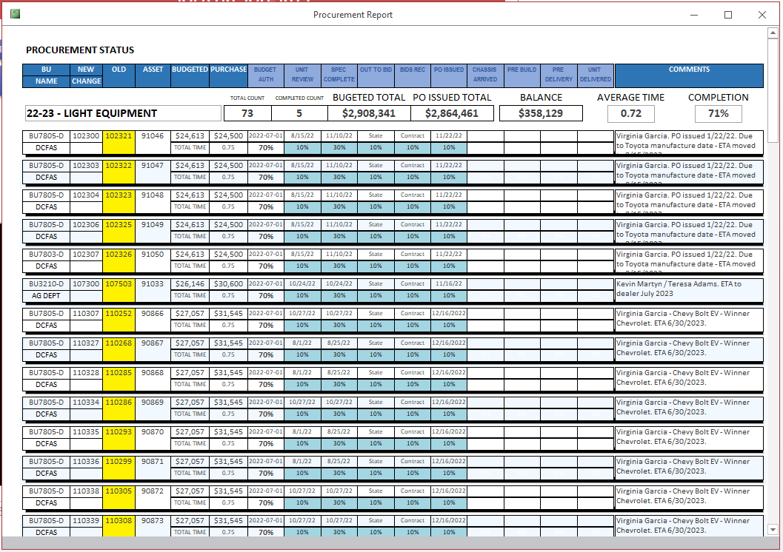

Slide 21
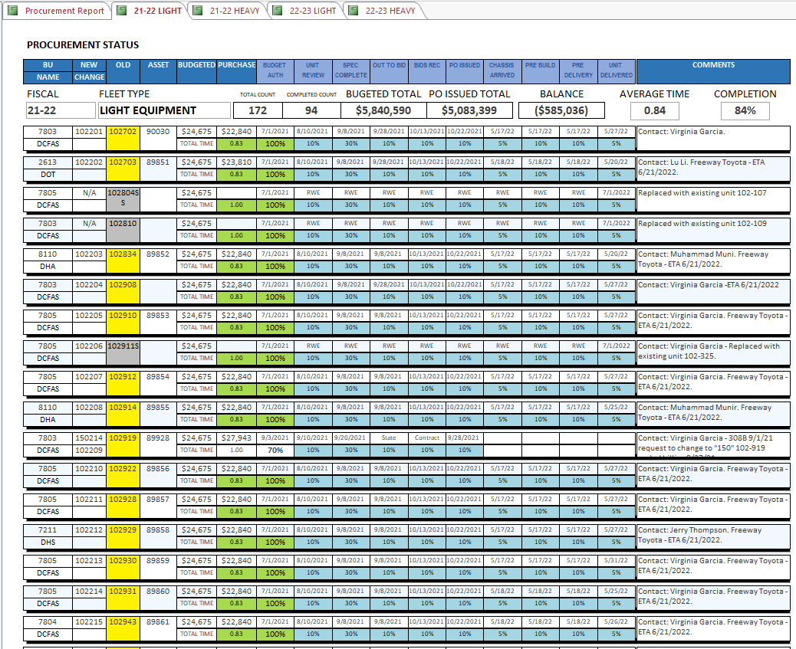

Slide 22
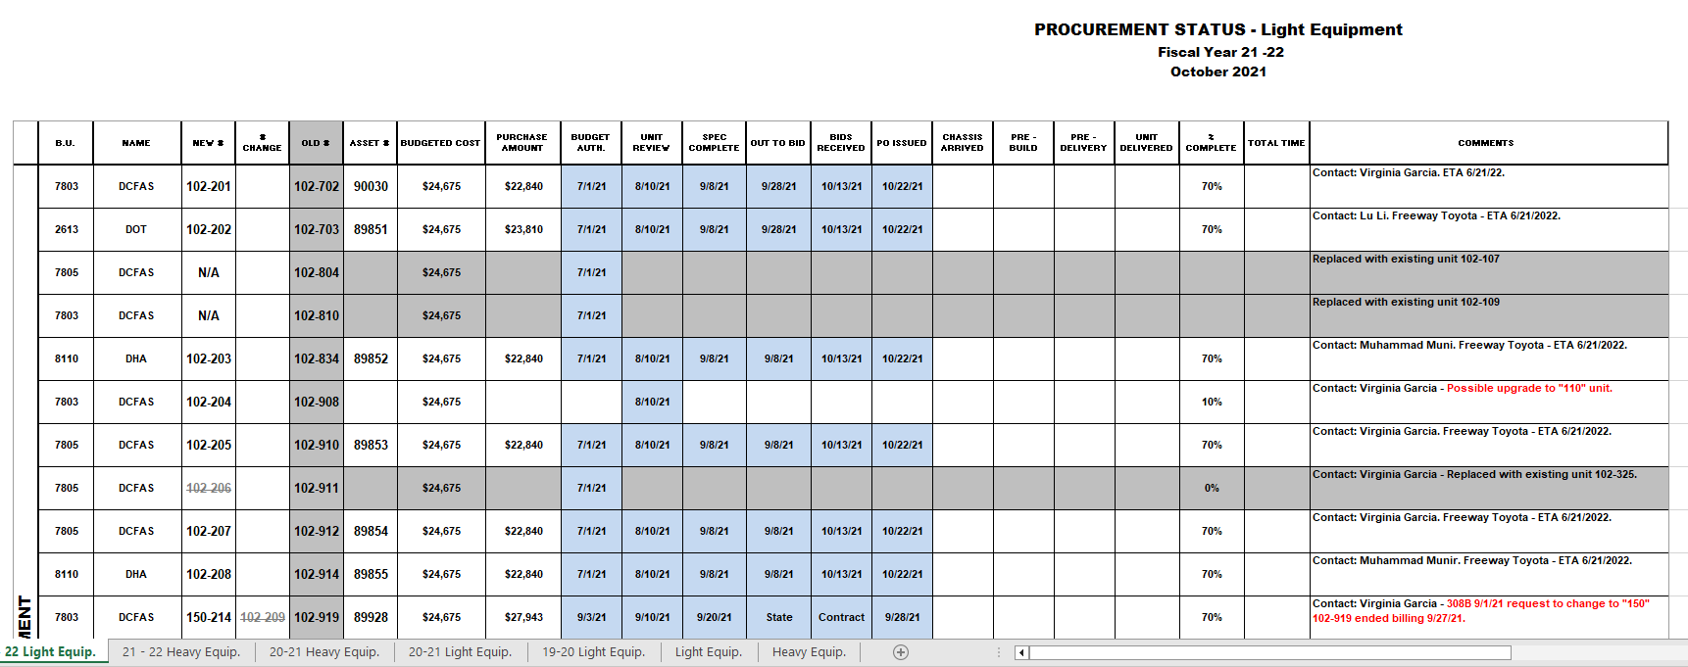
Exam
Example of Procurement Tracking using Excel

Slide 23
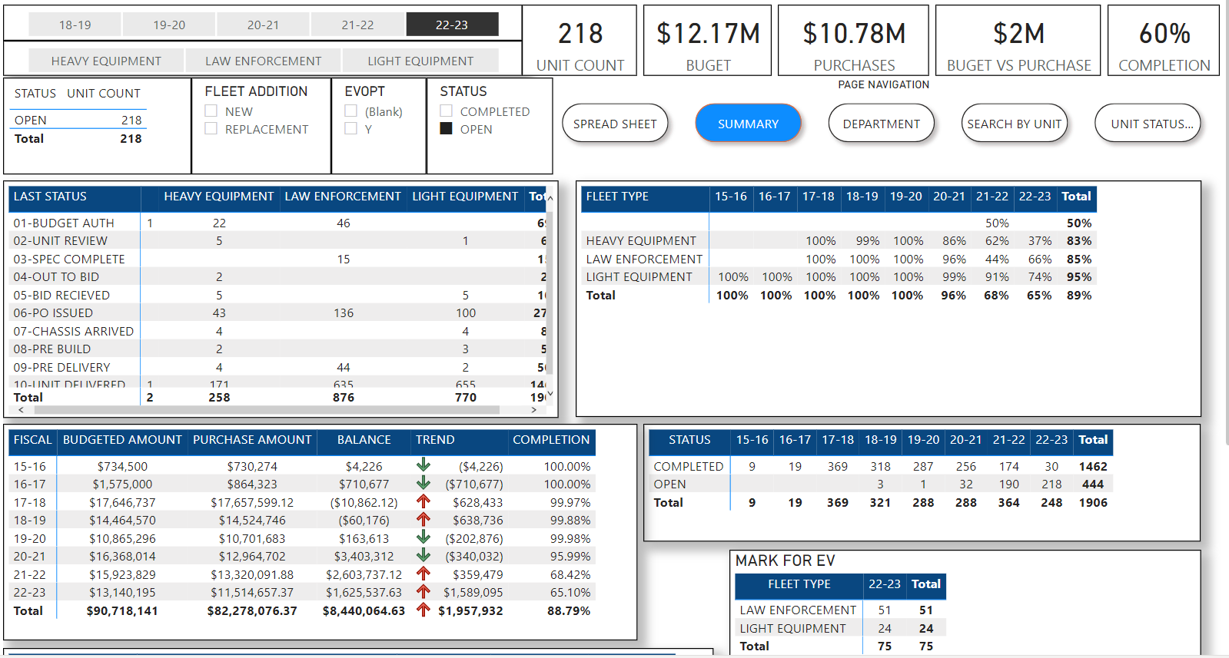

Slide 24
Telematics and Utilization
Implement Telematics into your Fleet as soon as possible.
Telematics is the best tool for tracking utilization, duty cycle and range.
Select a system that integrates to your FMIS.
Policies / Procedures including Transportation Policy should include Telematics.
After Fleet Manager’s careful selection of EV candidates - Provides assurance to driver’s with range anxiety.
You may find only a portion of vehicles need to be replaced.

Slide 25
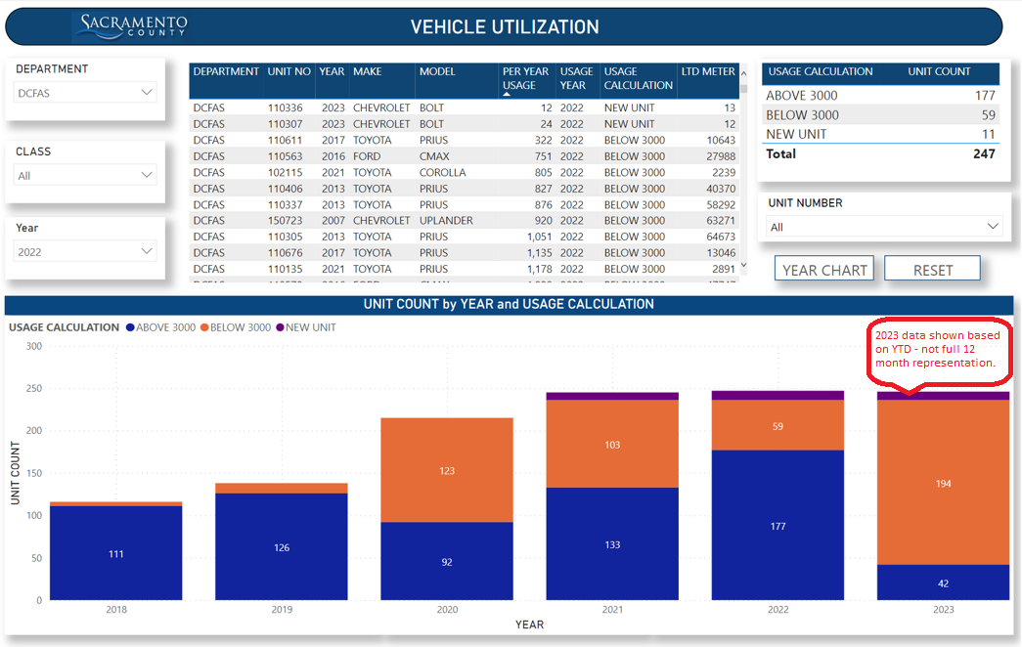

Slide 26
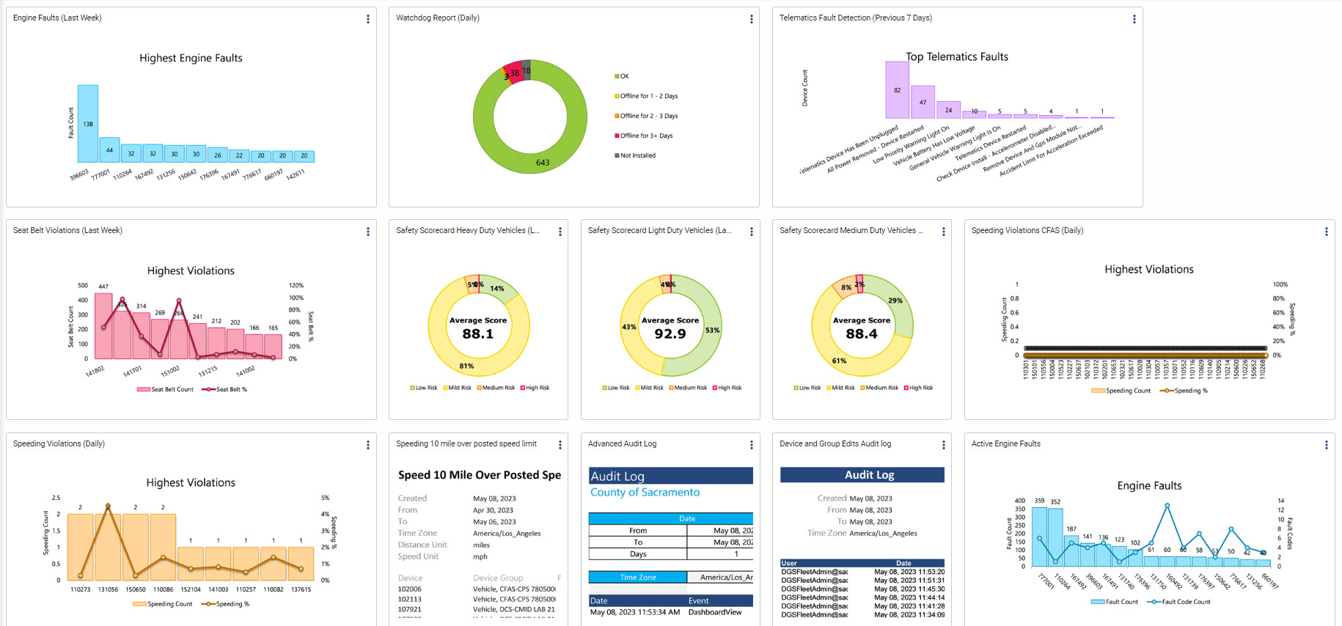
GeoTab Telematics Dash Board

Slide 27
Partnerships and Collaboration
Sacramento Clean Cities Coalition – or your local coalition.
Sacramento Metro Air Quality Management District – or your local district.
Sacramento Municipal Utility District or Local Power Provider.
Municipal Equipment Manager’s Association.
Public and Private Fleet Associations.
Other Local Fleets.

Slide 28
Items To Do
Contact your power utility to discuss you current and future needs and discuss programs, tools, grants or incentives. County of Sacramento partnered with SMUD for an EV suitability study and a survey of County facilities.
Contact your Facilities Management to plan for charging infrastructure.
Review your organization’s Policies and Procedures.
Study current and future regulations that will affect your Fleet.
Outreach to Customer Departments and Drivers.
Utilization Study - including Range, Duty Cycle, Parking Locations, possible charging times.
Forecast your transition from start to finish – collect data to corroborate your plan.
Inform Budget and Finance of future incremental vehicle and infrastructure costs.

Slide 29
Contact
Ronald Wirth
Fleet Advance Planning and Sustainability Manager
County of Sacramento, Fleet Services Division
(916) 875-4783
WirthR@SacCounty.gov

