Slide 2
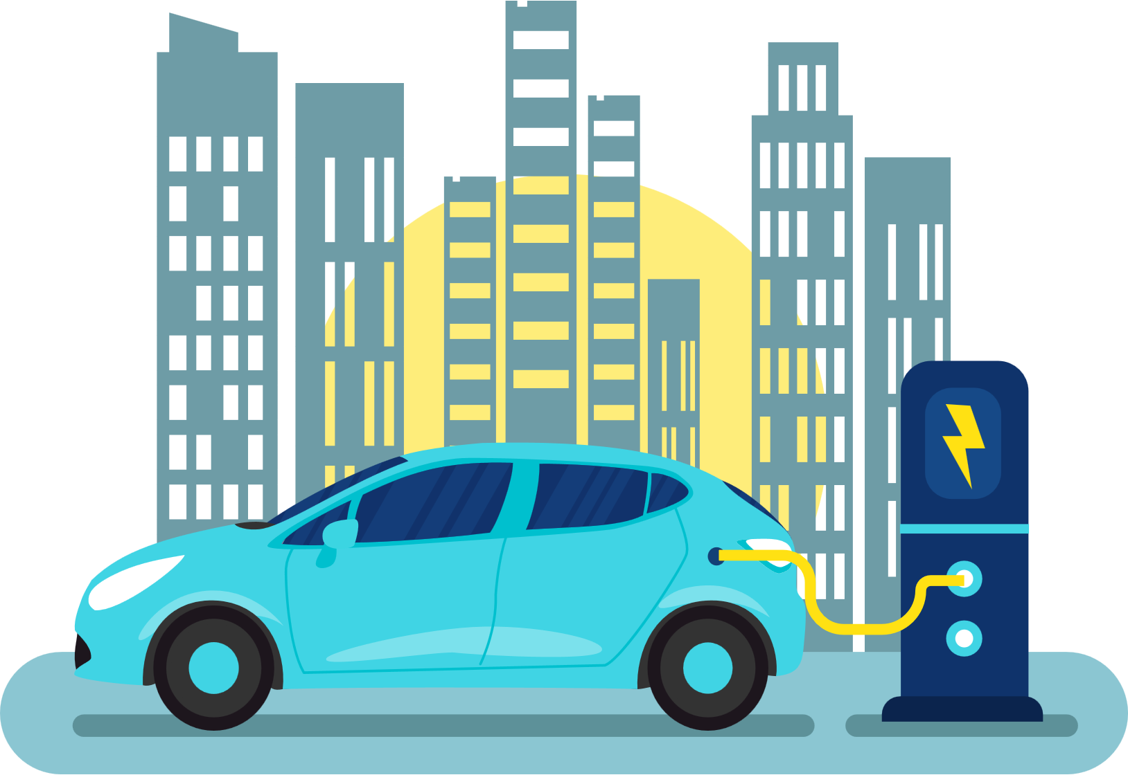
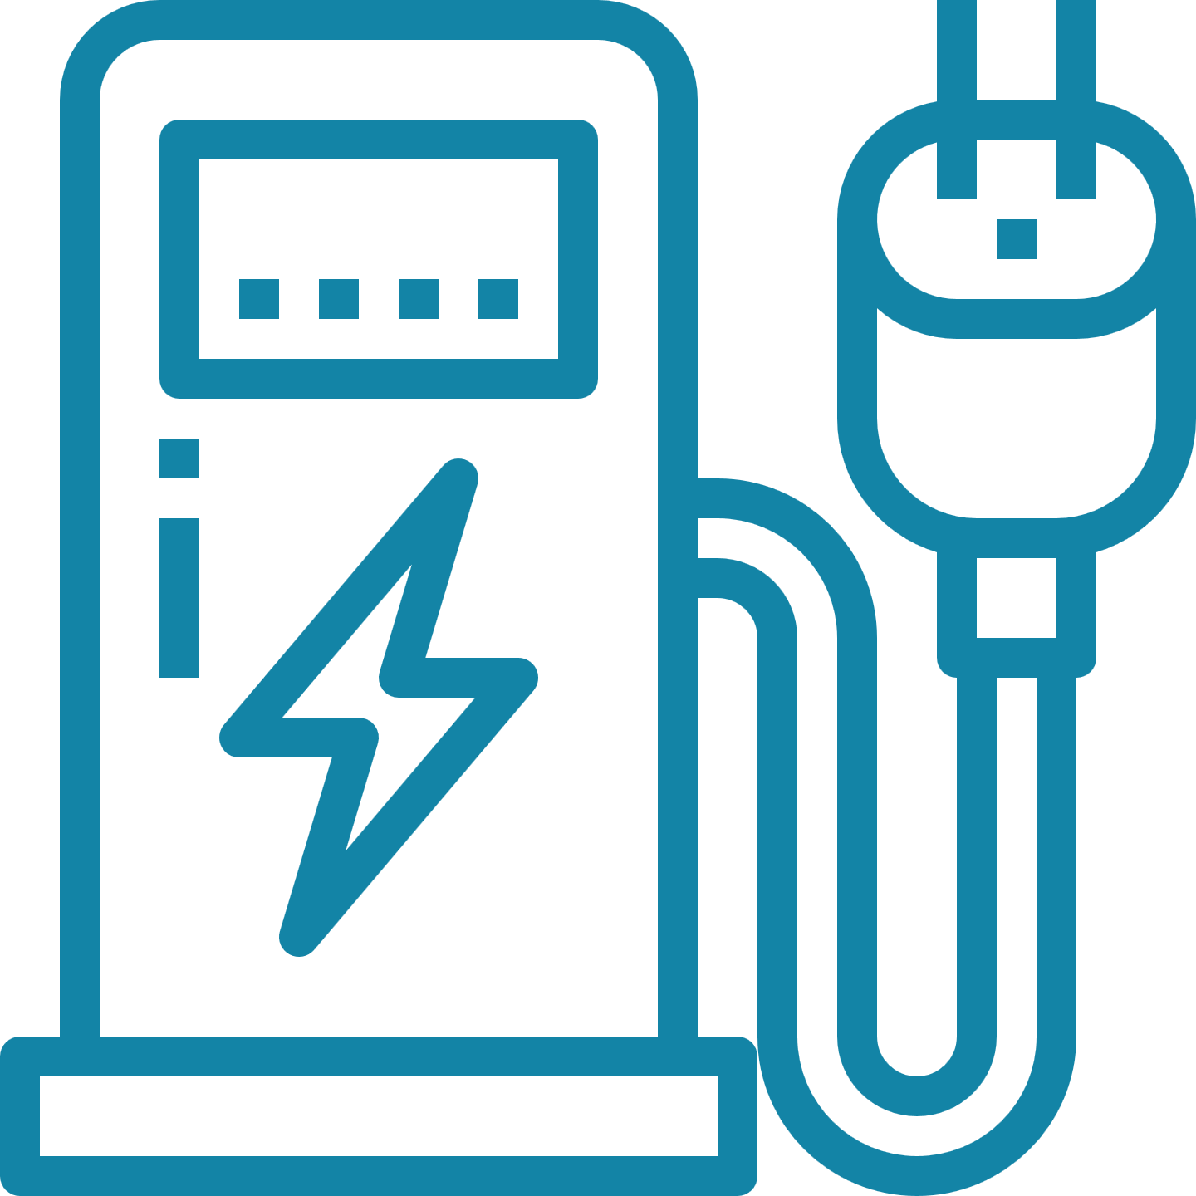
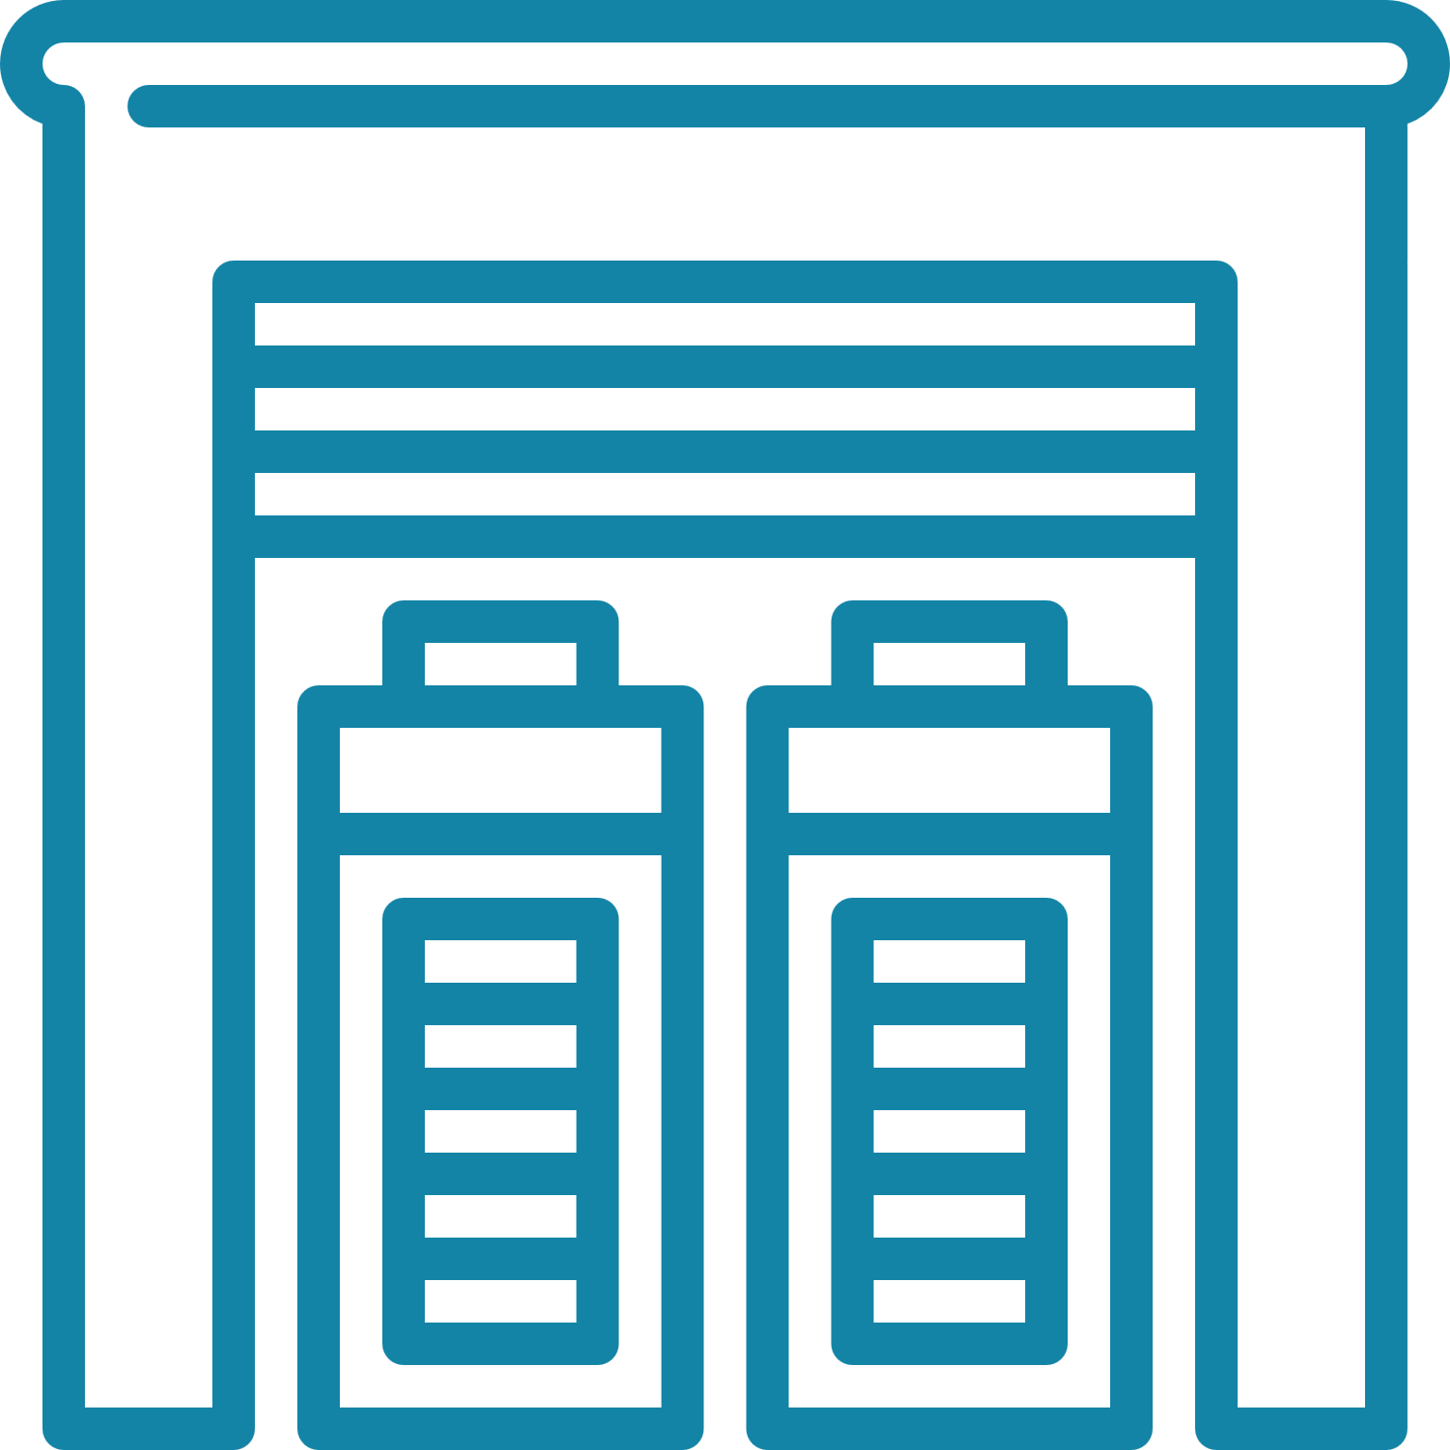
The Bluedot Station
Bluedot combines fast chargers, solar, and storage to create a high-use, sustainable, and resilient station:
Level 3 Fast Chargers
Solar
Storage
1. Fast Chargers: Vehicles charge in under 15 mins →more charging sessions per day
2. Solar: Greenest stations on the market, powered by solar panels installed on site
3. Storage: Inclement weather or grid failure, →the station still runs through battery back up
Add-on features:
ATM Touchpoint
Broadband
Carbon capture landscaping
5G Connectivity
Advertising

Slide 3
Bluedot Business Model: Public-private Charging Stations
Bluedot does the work
Load study
Site design
Utility planning
Government/stakeholder engagement
Project finance
Buildout/engineering
Maintenance
Bluedot determines kWh price
Lower than utility costs because of solar offset
Hedges against rising utility costs
Allows for a predictable fuel cost
Partner revenue share
Bluedot helps advance fleet conversion plan
Vehicle upgrades
Grant monitoring and application
Competitive advantage with manufacturers
Maintenance
Engineering
Landscape
architecture
Load study
and project
architecture
Bluedot project components
and services
Manufacturer
relations
Financial
Governmental/
stakeholder
engagement
Environmental
permitting

Slide 4
The Bluedot Advantage
Turnkey installation – Bluedot provides the capital for the project and shares revenues with the district
Minority and women-owned business enterprise with strong government relations and design team
Greener, faster, cheaper
Nimble – our company is nimble and can move quickly with permitting and builds and feels large because of our national and international partners – Siemens, Sargent & Lundy, Q CELLS and more.
Inclusive and accessible design – we tailor the site to fit your needs and vision for the future.
Solar allows us to hedge against rising utility costs
Storage means that your fleet will be able to charge even if there is a grid outage
Your organization does not have to handle ongoing station maintenance
Bluedot helps future proof; updated technology and equipment, and upgrades sites accordingly
Scalable – Bluedot works with OEMs to ensure availability and product delivery timelines match district goals.

Slide 5
Local Community Reinvestment and Key Activities
Bluedot looks to build inclusively by creating socially-conscious partnerships with public and private entities, community-based organizations (CBOs), and prioritizing disadvantaged/under-resourced areas.
We hire locally and provide opportunities for minority and women-owned businesses
Bluedot’s project design strives to incorporate inclusive workforce development and apprenticeship programs by working with local schools, young professional organizations, and business chambers
Bluedot partners with organized labor, nonprofits, elected offices, and CBOs to encourage neighborhood participation, sharing of resources, and safety improvements to the site
Carshare and first/last mile connectivity; Bluedot will provide an EV lease (at no-cost) for the nonprofit to encourage use and visibility.

Slide 6
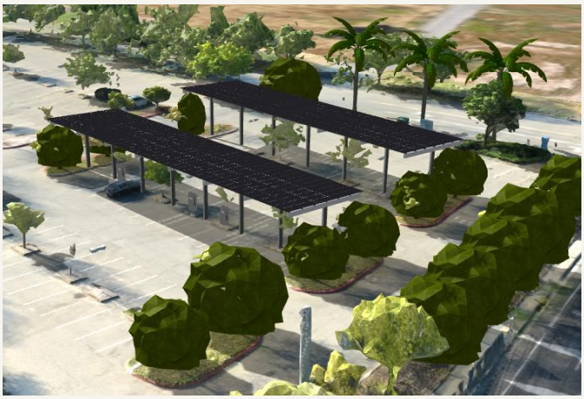
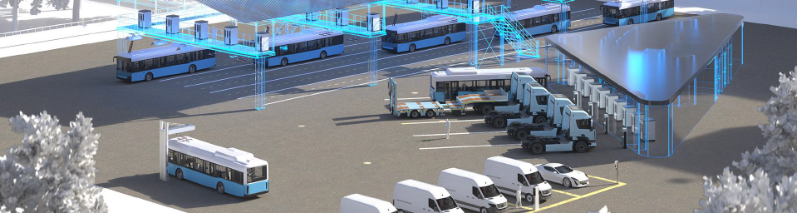
Sample Projects
House of Motorrad, Boulder Colorado
10 DCFC chargers, solar, and battery
Sacramento Regional Transit District (Power Inn light rail)
Helped design and managed project
St. Stevens, Chicago (various sites)
DCFC chargers, design, project management
For info on other projects: https://www.bluedotenergies.com

