Slide 1
Zero Emission Refuse Truck Funding
Sacramento BEV Refuse Truck Program
Kristian Damkier, P.E.
January 30, 2020

Slide 2
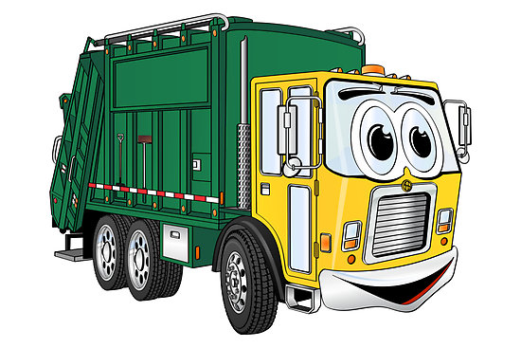
Presentation Overview
Zero Emission Transportation
HVIP Funding
District Funding
Other Funding
Timeline

Slide 3
Zero Emission Transportation
Promoting zero emission transportation is a priority of the Sac Metro Air District
Deployment is critical in community vehicles like refuse trucks that travel within neighborhoods especially in Disadvantaged Communities
Pilot phase in Sacramento; looking for partners
We would like to duplicate our success with school buses and transit vehicles into the refuse sector

Slide 4
HVIP Funding
Rough times for HVIP, but there is still hope
Major changes to program have greatly changed plans
New applications frozen with little fallout – so far
New 20/21 budget cuts 20% - similar to all programs
The major source of funding for refuse with $150,000 per vehicle potentially + $15,000 DAC
Hope to show the benefits of refuse to HVIP planners

Slide 5
District Funding
Cannot stack HVIP with Carl Moyer or Community Air Protection Incentives
Using DMV funds to pay $40,000 – 60,000 with scrap based on actual mileage of existing vehicle
Funding at $100,000/ton instead of $30,000/ton
Applicants need to destroy a pre-2007 diesel or pre-2010 alternative fuel to qualify for maximum funding
Up to 60% funding for charging infrastructure

Slide 6
Other Funding
Pilot phase leading to funding under CAP and SECAT
Flexibility to leverage federal DERA funding or other (unknown) state pilot programs
Sponsorships with sports teams, beverage companies, or other local businesses
Significant savings on maintenance and fueling, especially for replacing diesel units
Partners will likely have a large cost share

Slide 7
Timeline
Accepting online and paper applications immediately for zero emission vehicle replacement and infrastructure
Unknown timeline for HVIP
Flexibility on delivery timeline due to OEM
Hoping to build support for regional programs for planning efforts in Fall 2020
Starting the pilot process now to evolve over the next few years

Slide 8
Thank You
Question and Answer Session
http://www.airquality.org/
Kristian Damkier, P.E.
kdamkier@airquality.org
(916) 874-4892

