Slide 1
Commercial Electric Trucks
19681 Da Vinci Foothill Ranch, CA 92610
Peter Ford (248) 935-0789 pford@drivelabs.ai

Slide 2
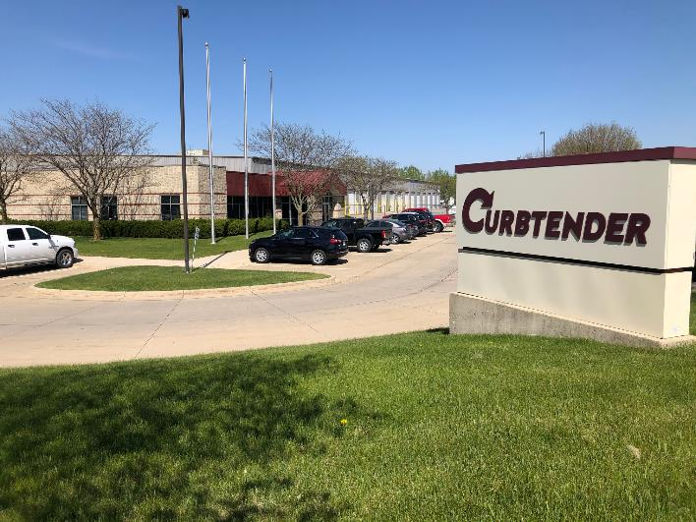
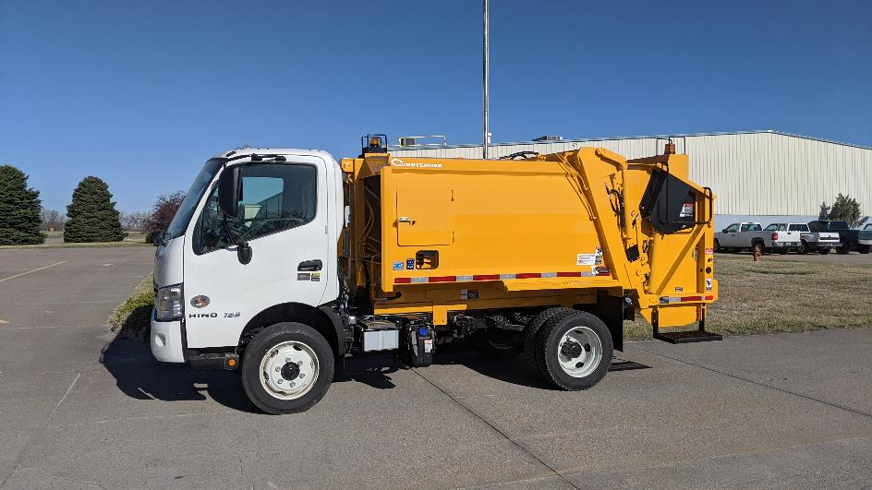
Curbtender is based in Cedar Falls, IA, and recently launched a second factory in Gothenburg, NE. Together, the company has over 210,000 square feet of production space, (2) High Definition CNC Plasma Tables, (1) CNC Laser Cutting Table, (3) Heavy Duty CNC Brake Presses, (3) Robotic welders, (4) Paint Booths, (4) CNC Vertical Machining Centers, and over 100 employees.

Slide 3
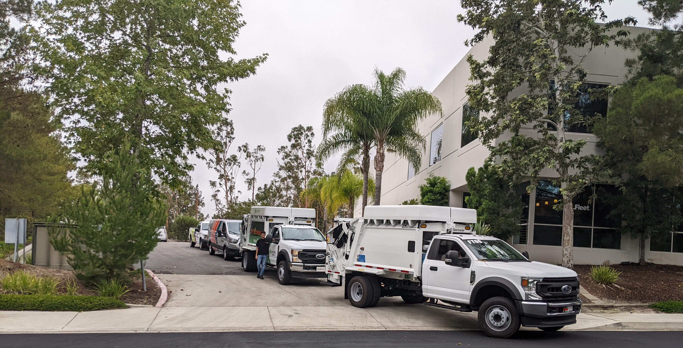
Drive Labs Facility Foothill Ranch, CA

Slide 4
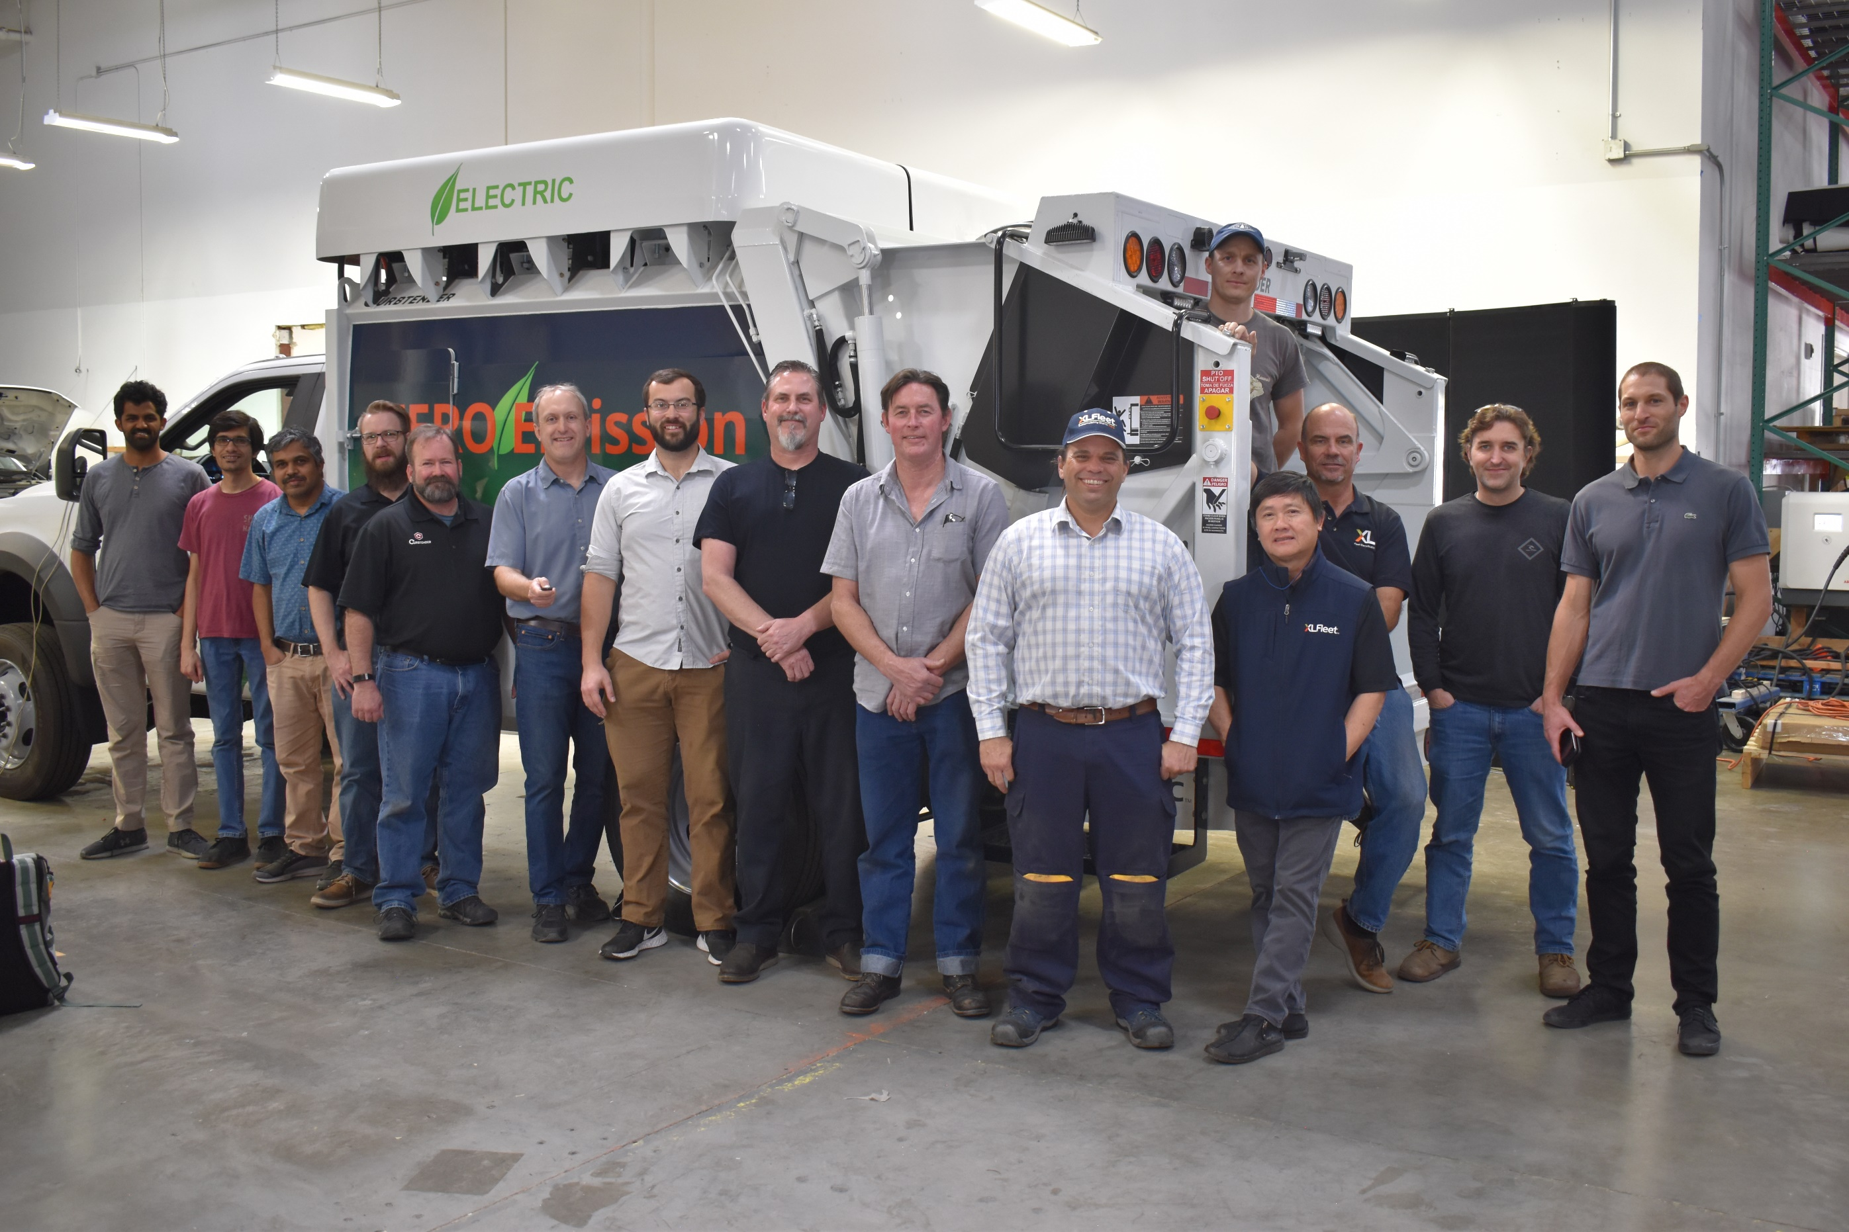
Curbtender and Drive Labs Team

Slide 5
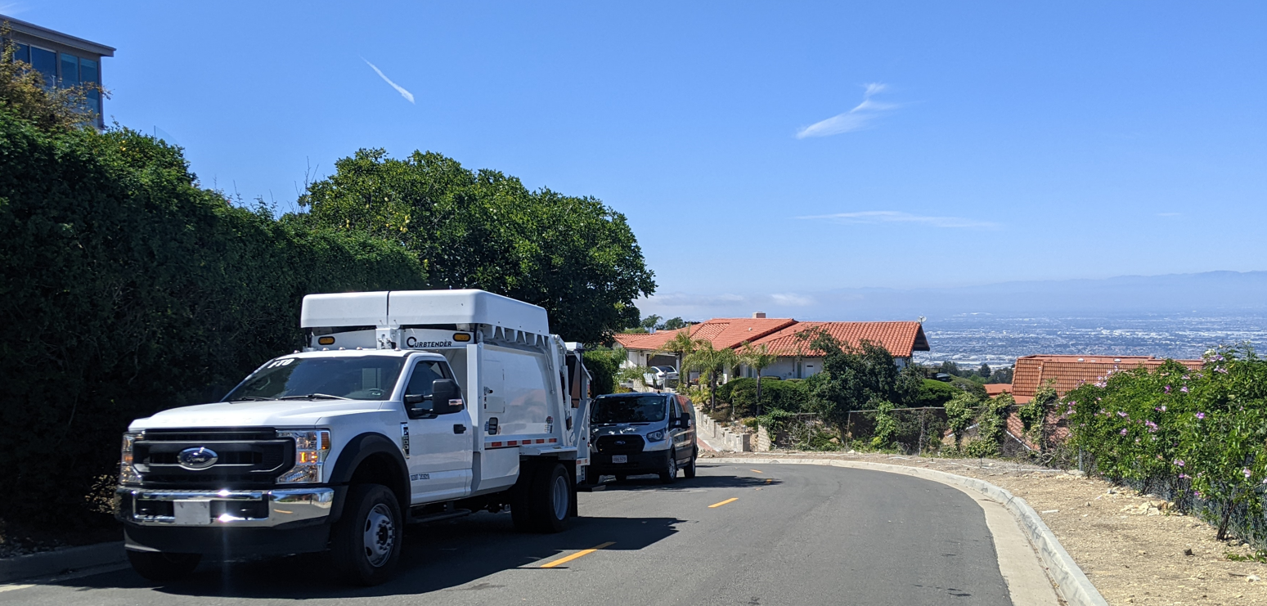
Testing In Palos Verdes

Slide 6
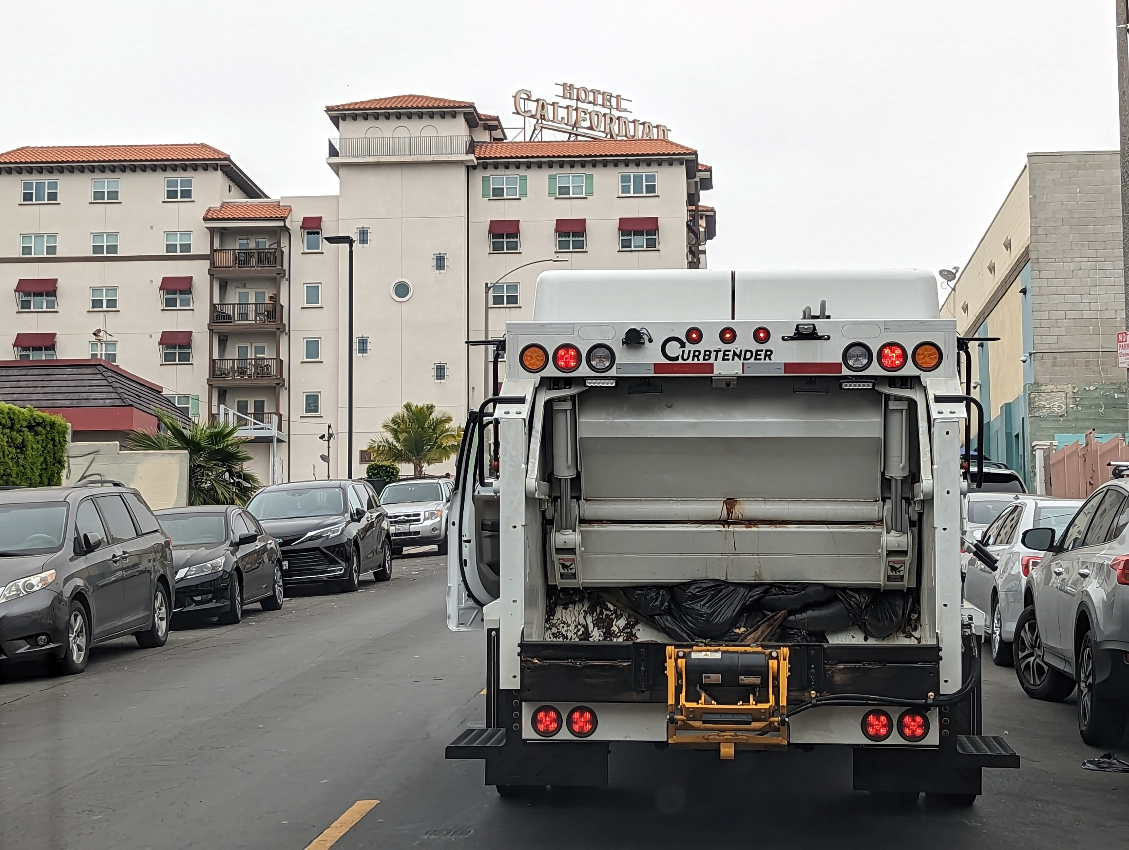
Real World Refuse Service in Los Angeles

Slide 7
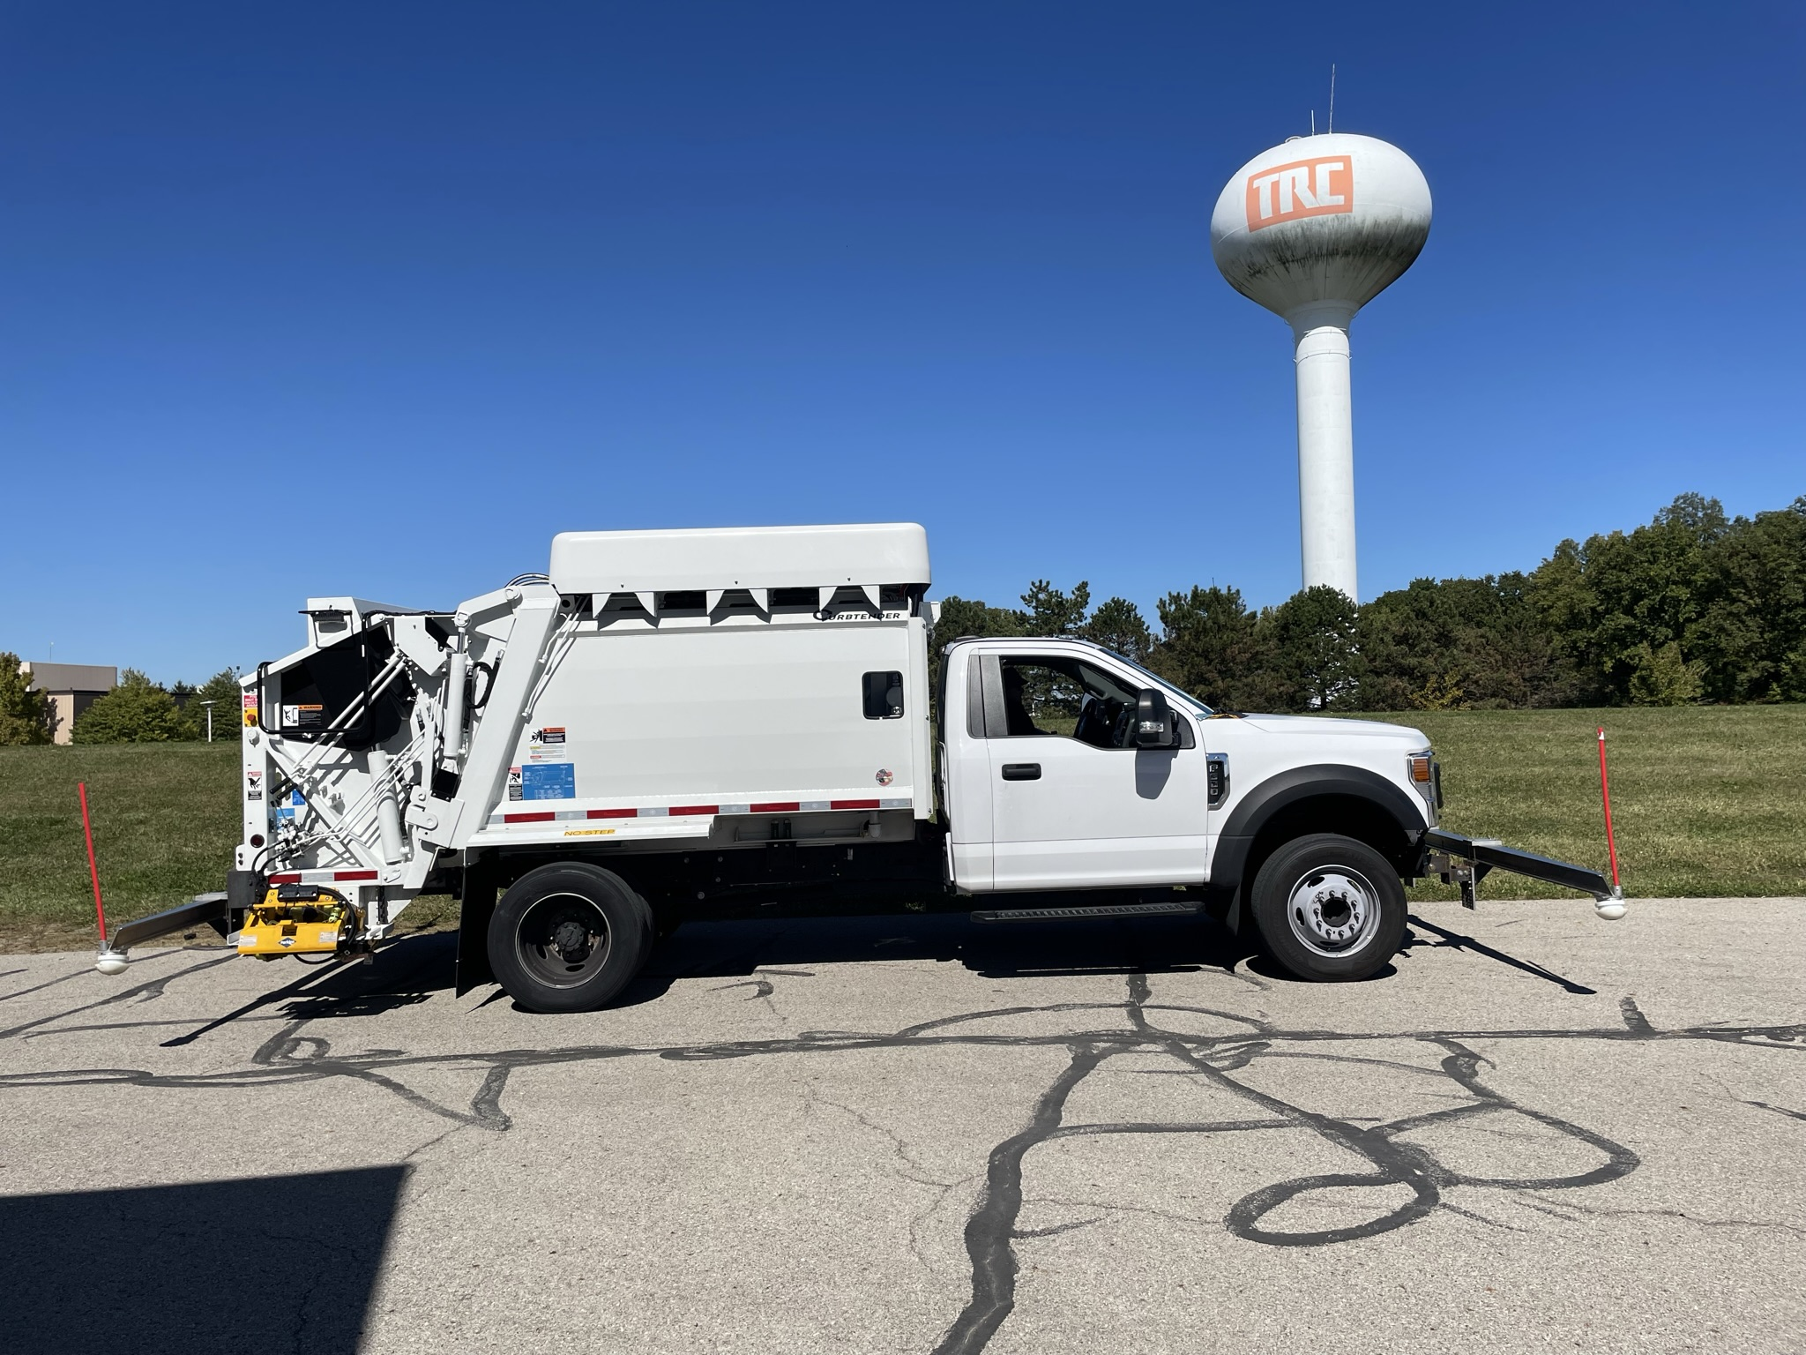
Testing at Transportation Research Center, Ohio

Slide 8
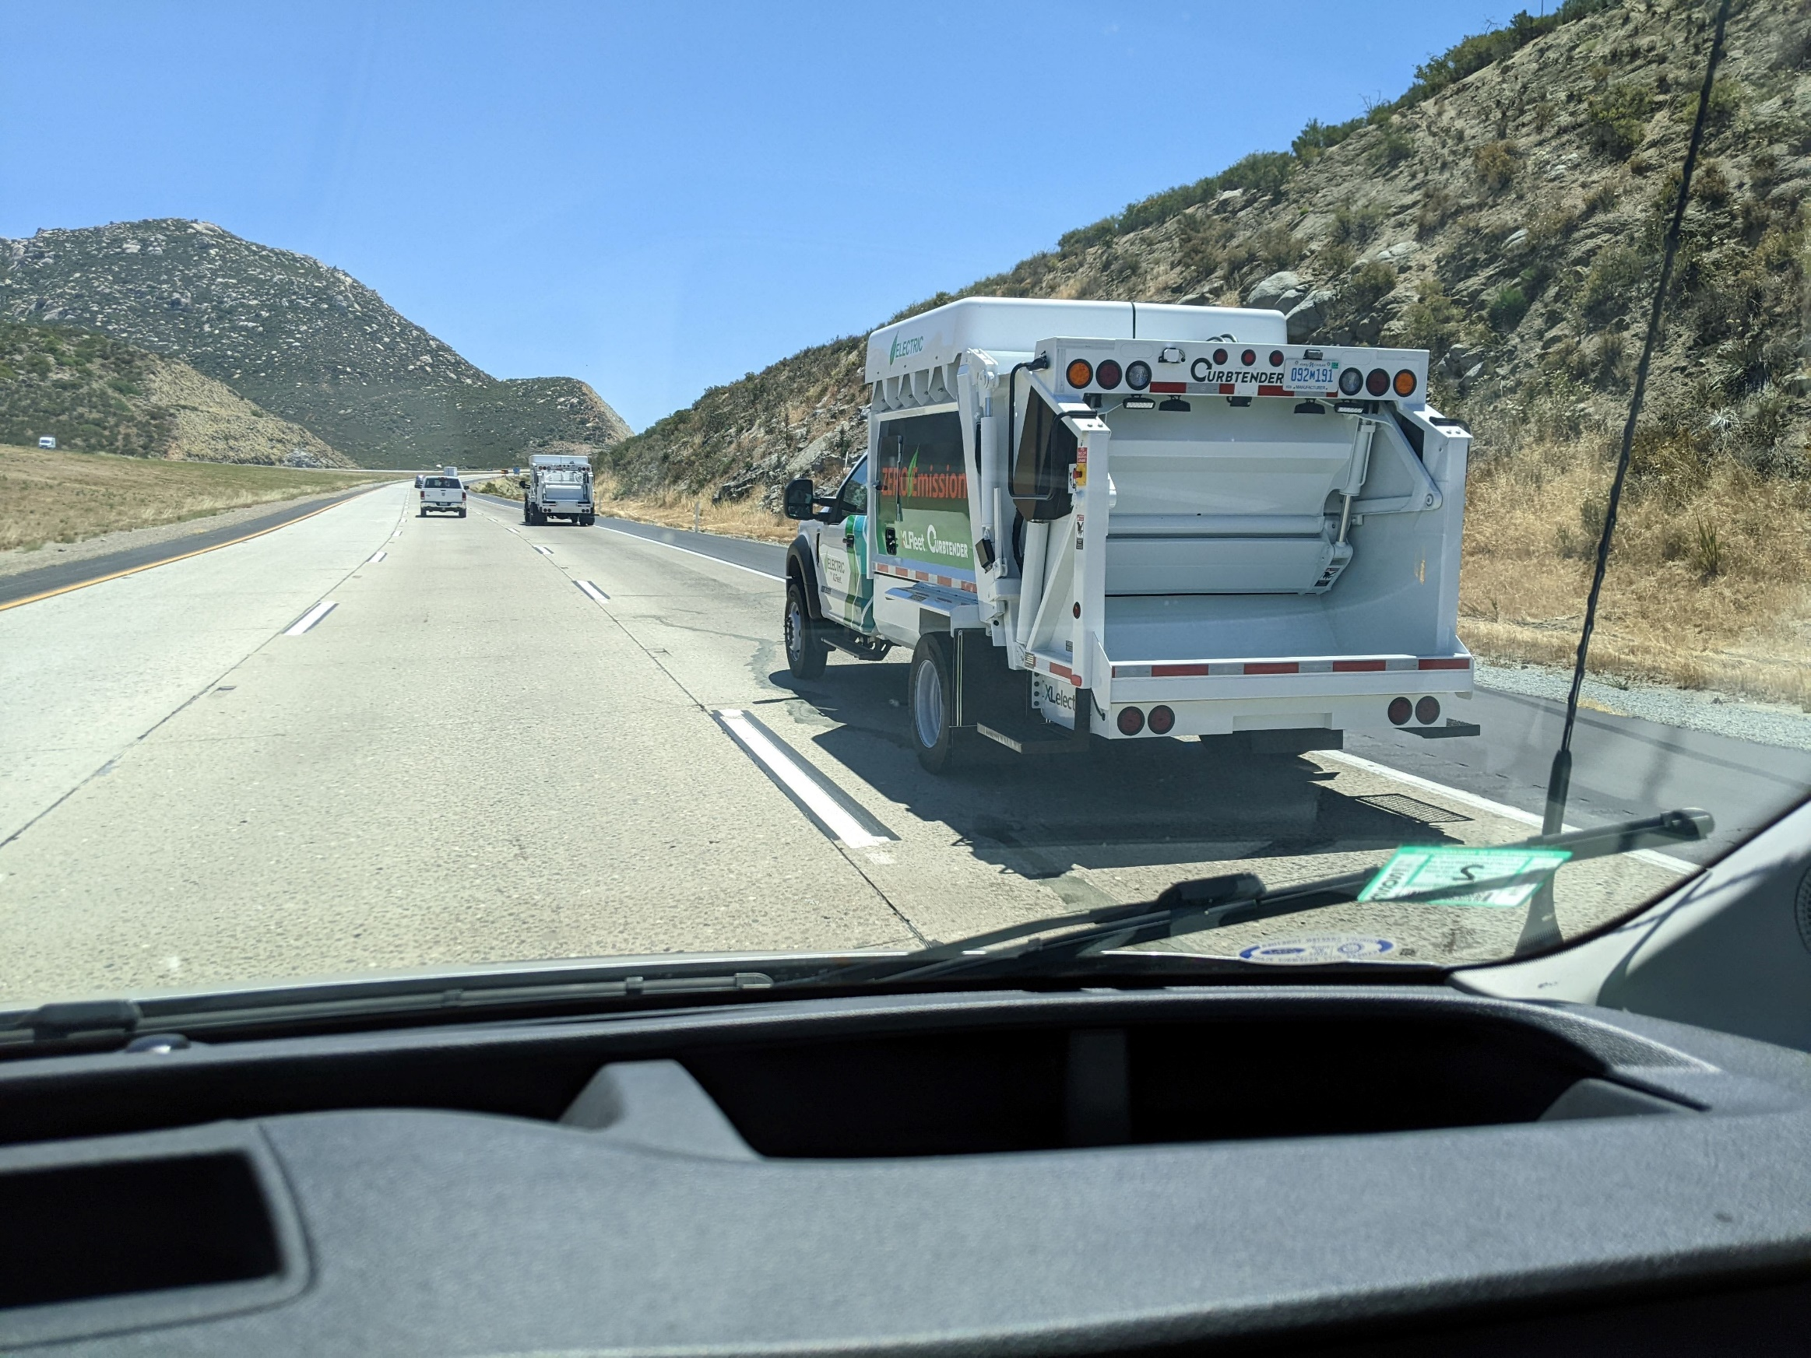
High Temperature 6% Desert Grades

Slide 9
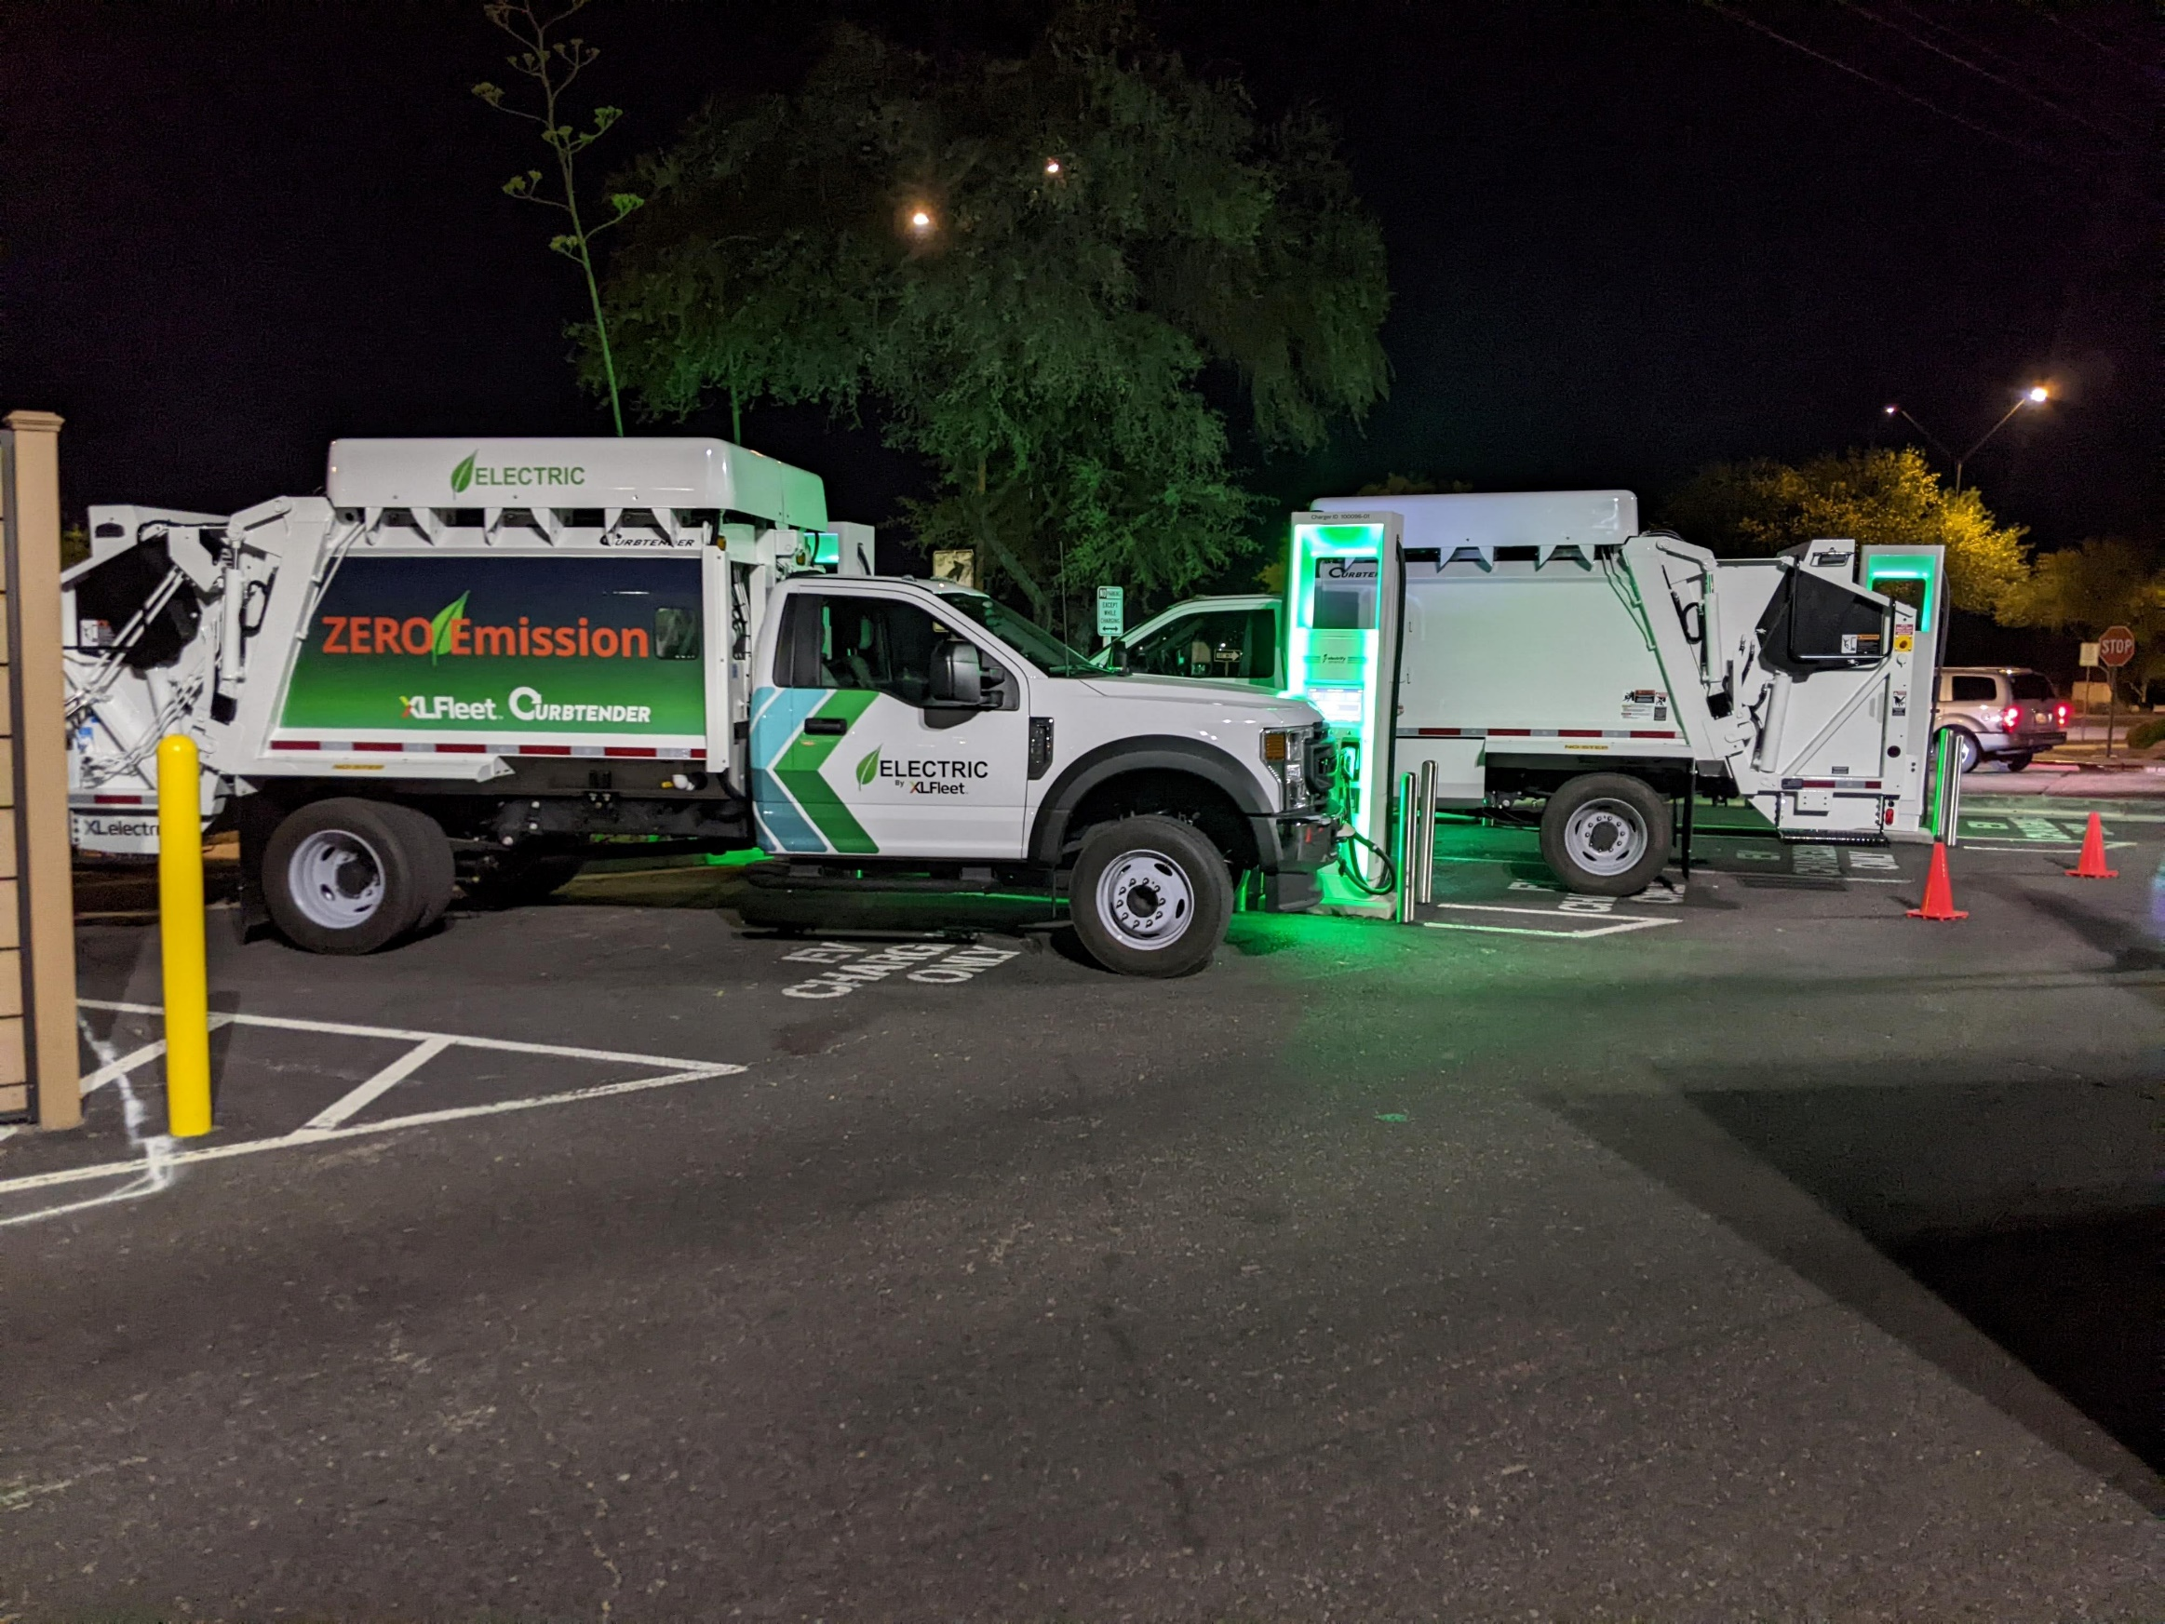
DC Fast Charging Interoperability Testing

Slide 10
“EV Ready” Truck Validation
Toyota Desert Proving Grounds (High-Temp Charging, Battery Cooling, Max Motor Derate)
Transportation Research Center Validation
FMVSS 105 (Braking Systems), FMVSS 103 (Windshield Defrost)
Stability Control, Traction Control, ABS
Remedial Fault Actions (Steering, Brakes, HMI)
DC Fast Charging Operability 157kW (ABB, Tellus, Chargepoint)
Gradeability (30%), Park Pawl on grades, On-Demand Camera
EV Range, Odometer, Powertrain System Limit De-Rates
ePTO – Electro-Hydraulic Body Operation
Cruise Control, Regen Braking Modes
Fault Handling (Over 200 Faults)
Cold Weather Proving Grounds, Vehicle Pre-Conditioning, Low-Temp Charging
Traction Control Refinement
American HV Battery Integration (XALT/FBS)
Cloud Fault Alerts and Snapshot Data
Water Fording

Slide 11
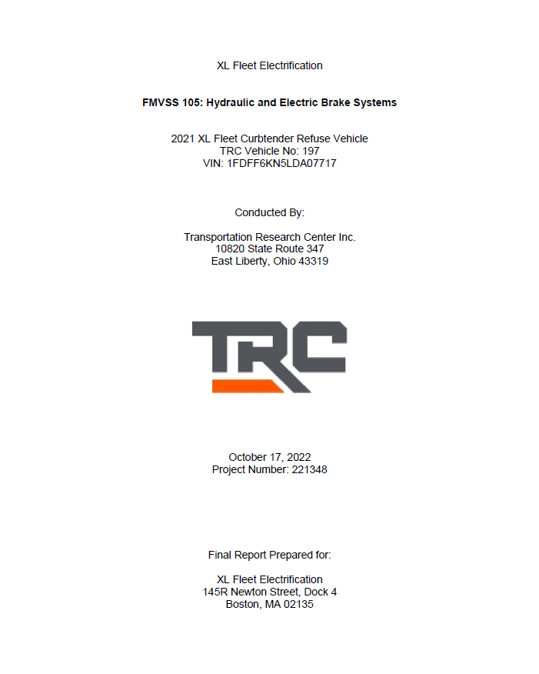
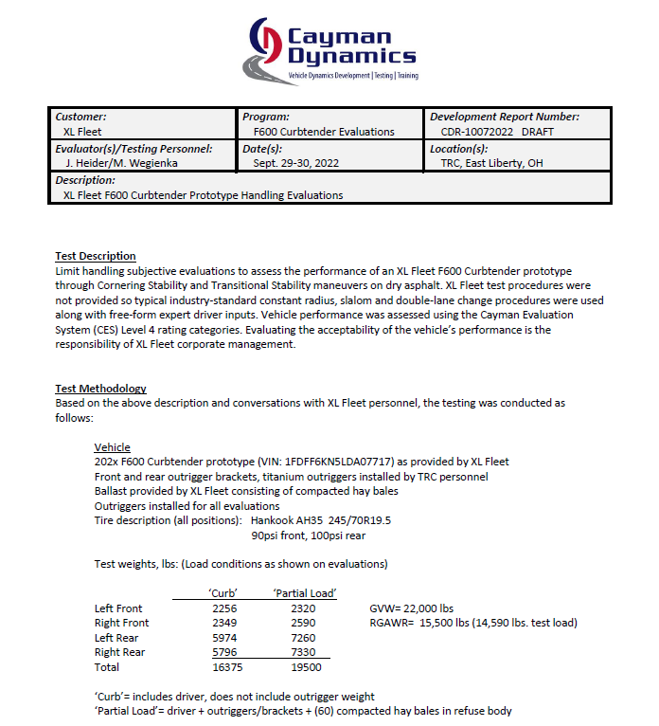
Third Party Validation

Slide 12
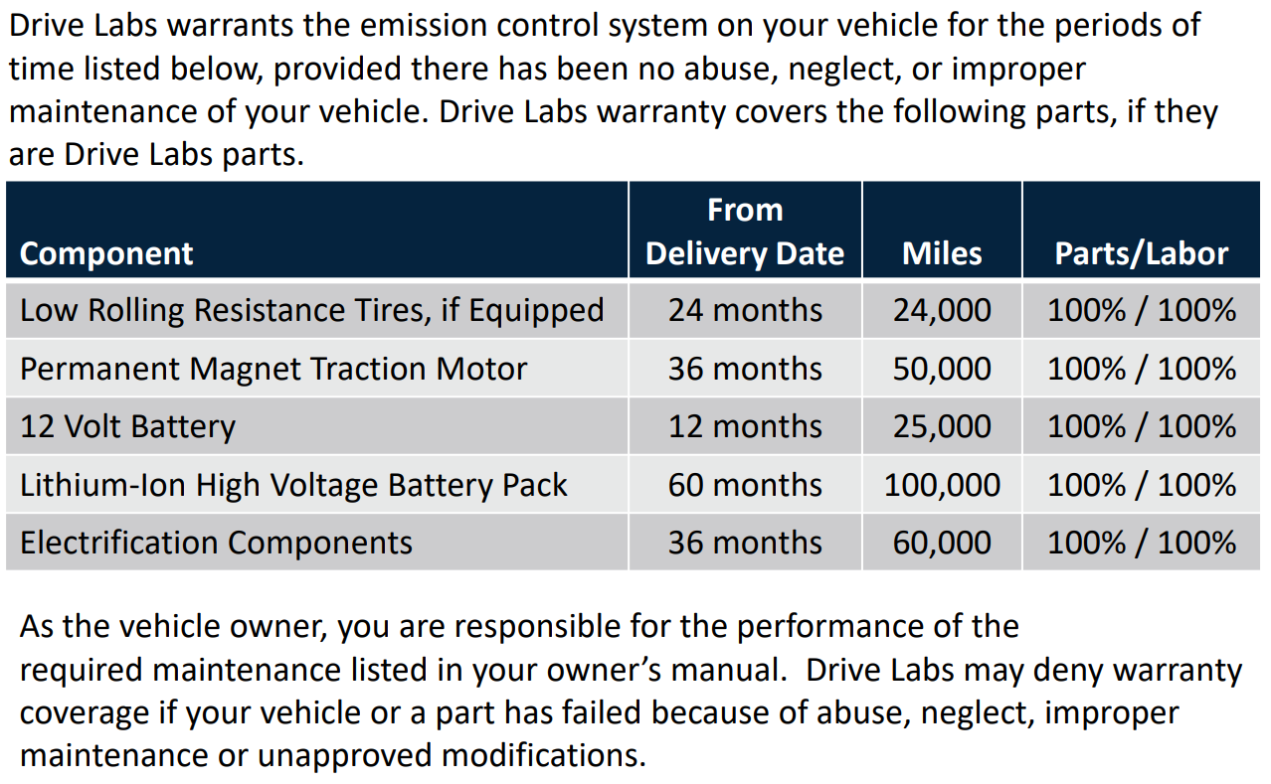
Warranty

Slide 13
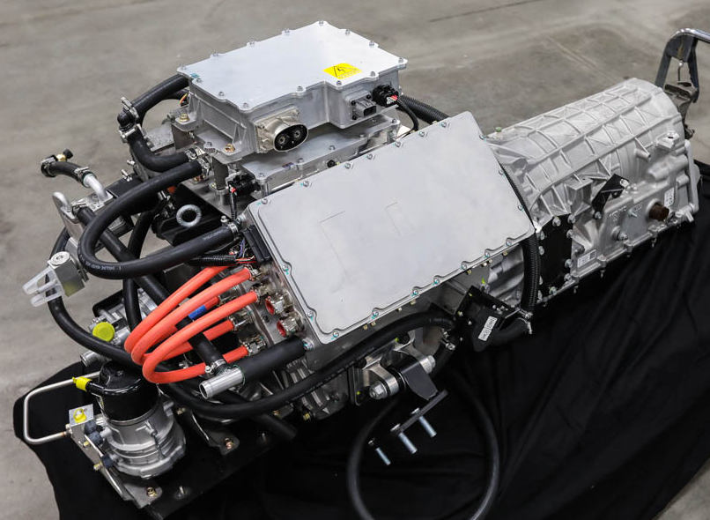
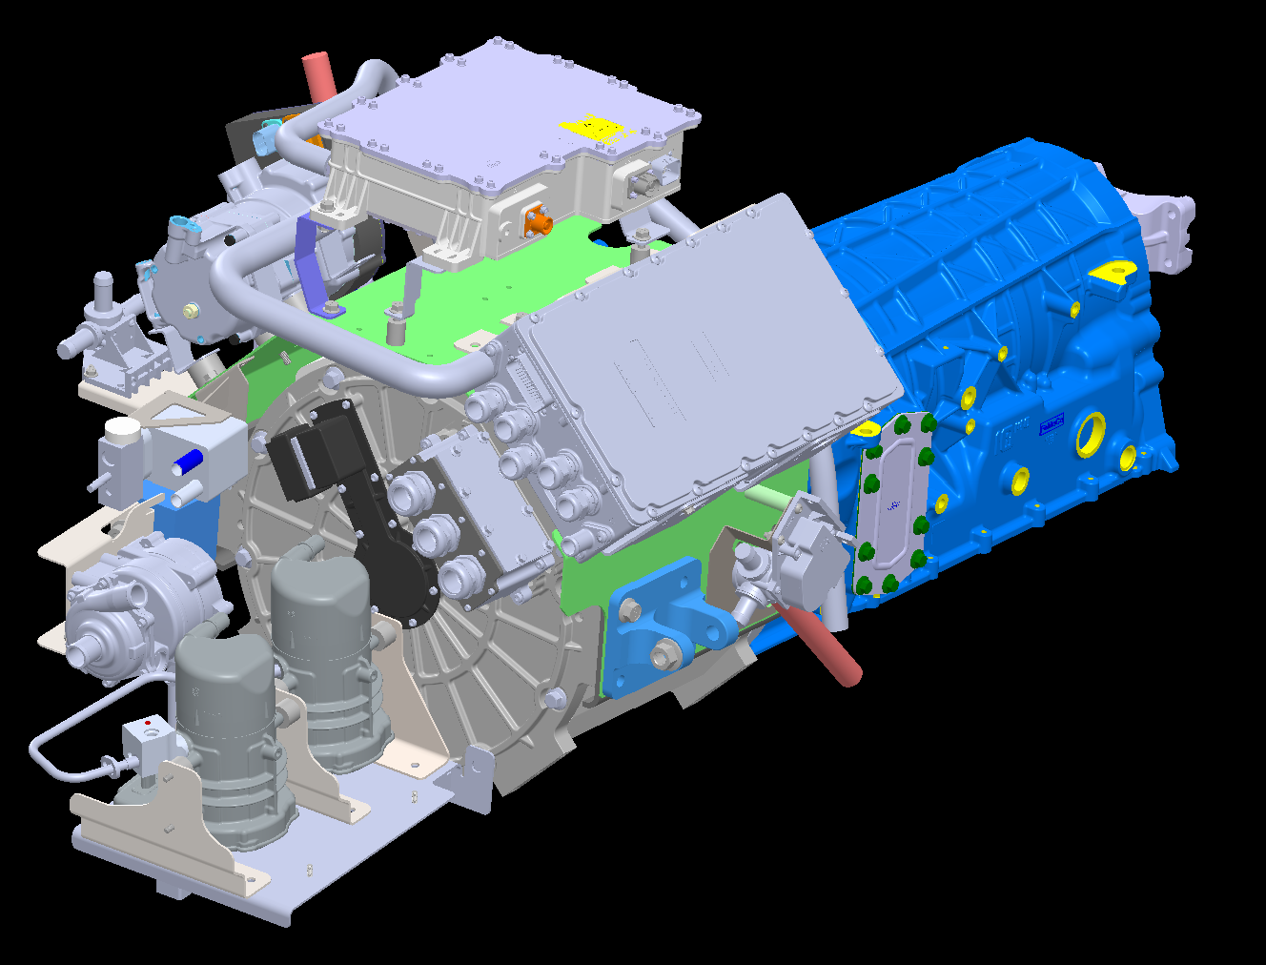
“EV Ready” Powertrain Module
214kW, 2800Nm – Integrates with Ford Super Duty F-350 through F-600
13

Slide 14
Ford Super Duty “EV Ready” Technical Advantages
Accommodates ANY wheelbase
Accommodates Production 4WD system
Retains Production Driveline
Retains Production Park Pawl and Parking Brake
Retains Production Shifter and redundant PRNDL electronics
Retains Production Steering Gear and Foundation Brake System
Retains Production Instrument Cluster
Reuses Ford 10R140 transmission housing with unique Single Speed Powershaft
Plug and Play Wire Harnesses – No Splices & Lowers Assembly Cost

Slide 15
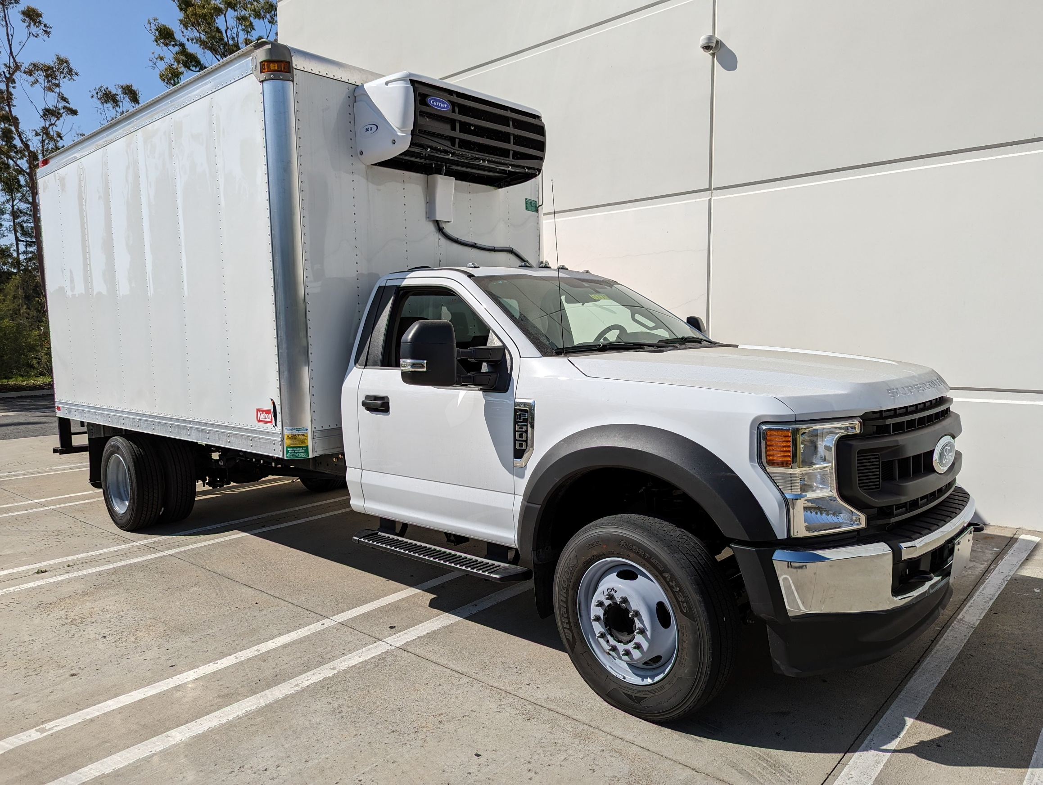
Refrigerated, Stake Bed, Dry Freight Options

Slide 16
19681 Da Vinci Foothill Ranch, CA 92610
Peter Ford (248) 935-0789 pford@drivelabs.ai
16

