Slide 1
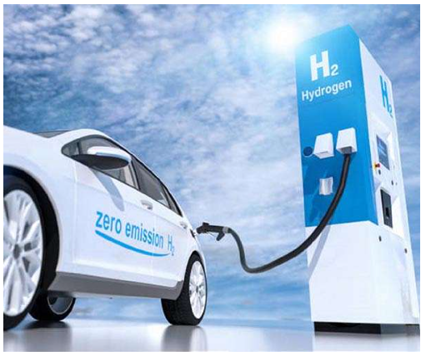
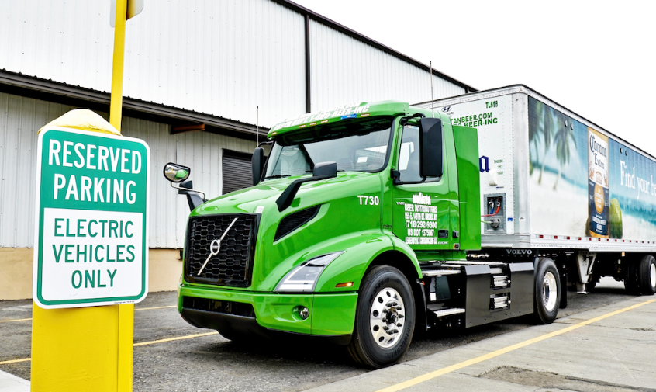


STRATEGIES FOR ZEV TRANSITION PLANNING & REGULATORY COMPLIANCE
10-19-2023
STRATEGIES FOR ZEV TRANSITION PLANNING & REGULATORY COMPLIANCE

Slide 2
Topics
Regulatory Compliance
  Overview of Advanced Clean Trucks (ACT) & Regulation
  Overview of Advanced Clean Fleets (ACF) Regulation
  Zero Emissions Vehicle (ZEV) Definition
  Exempted Vehicles
  Waste and Wastewater Utilities & Transit Fleet Provisions
  Vehicle Exemption Requests
  Fueling Infrastructure Extensions
10-19-2023
STRATEGIES FOR ZEV TRANSITION PLANNING & REGULATORY COMPLIANCE

Slide 3
Topics - Cont…
  Procurement Requirements
  Recordkeeping and Reporting Requirements
  Regulatory Language and Reference Documentation
  Compliance Option Pathways
  Compliance Strategies
ZEV Transition Planning
  Vehicle Challenges
  Operational Challenges
  Funding Resources
10-19-2023
STRATEGIES FOR ZEV TRANSITION PLANNING & REGULATORY COMPLIANCE

Slide 4
Topics – Cont…
Budgetary Cost Examples
  Cost Reduction Example
  Overall Transition Cost Example
Questions & Answers
10-19-2023
STRATEGIES FOR ZEV TRANSITION PLANNING & REGULATORY COMPLIANCE

Slide 5
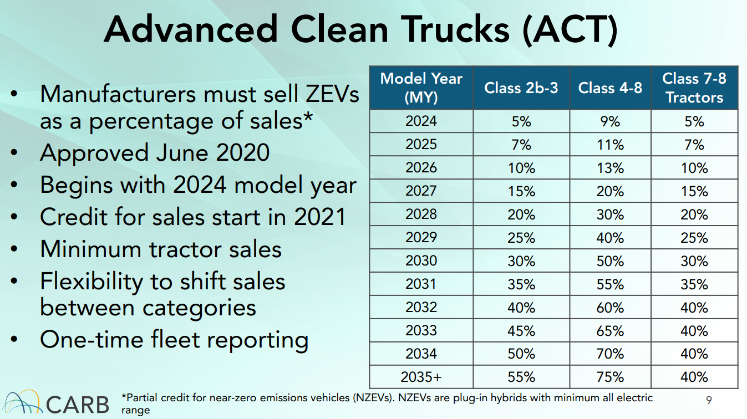
Advanced Clean Trucks Regulation – Companion to ACF
Enacted Prior to ACF Regulation
Requires vehicle manufacturers to sell an increasing percentage of their total sales volume as Zero Emissions Vehicles (ZEVs).
Required private and government fleets to submit a fleet report to CARB staff by 3/31/2022
  If you have not reported yet, do so as soon as possible.
  The ACF reports that must be submitted each year may be compared to your original ACT report submission.
https://ww2.arb.ca.gov/our-work/programs/advanced-clean-trucks
10-19-2023
STRATEGIES FOR ZEV TRANSITION PLANNING & REGULATORY COMPLIANCE

Slide 6
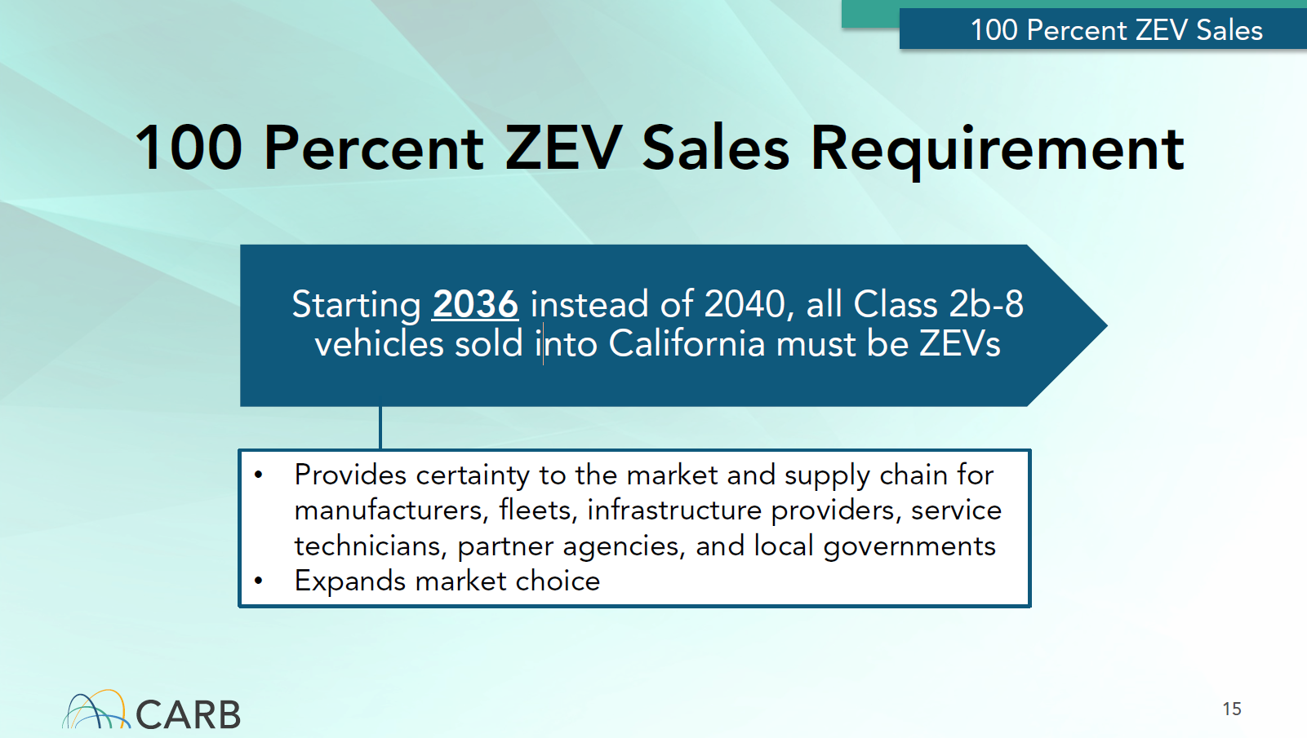
Advanced Clean Trucks Regulation – Companion to ACF
Regardless of the compliance strategy utilized, only ZEVs will be available in the marketplace to purchase as replacements for Class 2b-8 vehicles beginning with model year 2036 vehicles.
10-19-2023
STRATEGIES FOR ZEV TRANSITION PLANNING & REGULATORY COMPLIANCE

Slide 7
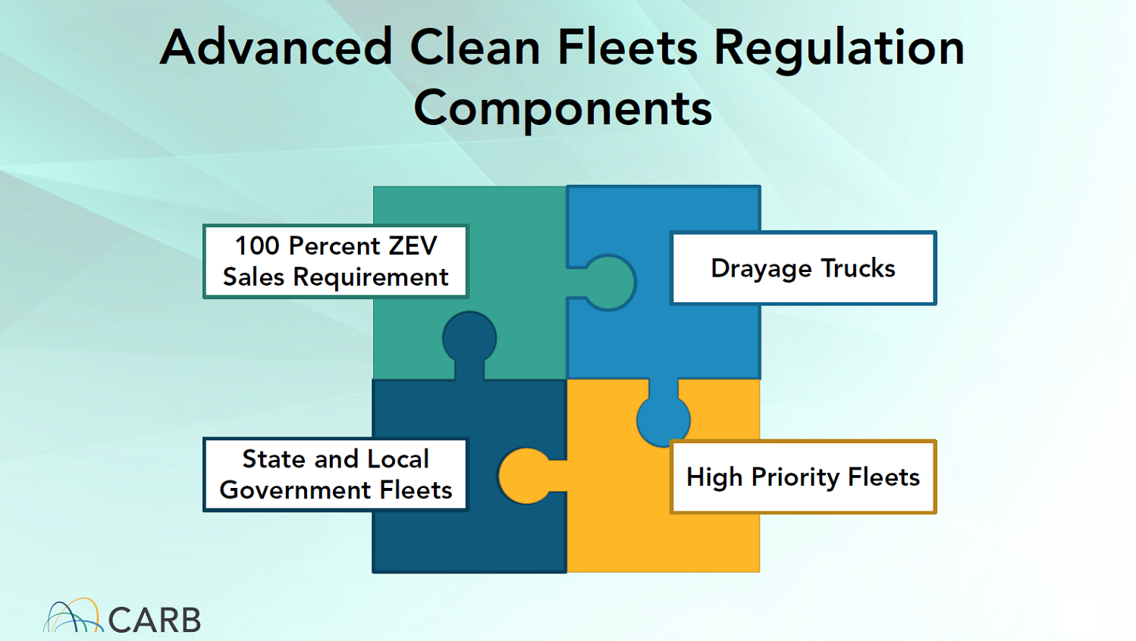
Advanced Clean Fleets (ACF) Regulation
The CARB Board of Directors voted and approved the ACF regulation on 4/28/2023
  There are three fleet components of the regulation
    Drayage Fleets
      Trucks traveling to and from Seaports, Airports, Intermodal Railyards and other Ports of Entry
    High Priority and Federal Fleets
      Private and Federal Fleets
    State and Local Governments Fleets
      Cities, Counties, State, and other Government Agencies and Districts
https://ww2.arb.ca.gov/our-work/programs/advanced-clean-fleets
Each component fleet type has common regulatory requirements as well as specific to only that component fleet type
IT IS VERY IMPORTANT THAT YOU READ THE REGULATIONS THAT APPLY TO YOUR FLEET TO AVOID CONFUSION
10-19-2023
STRATEGIES FOR ZEV TRANSITION PLANNING & REGULATORY COMPLIANCE

Slide 8
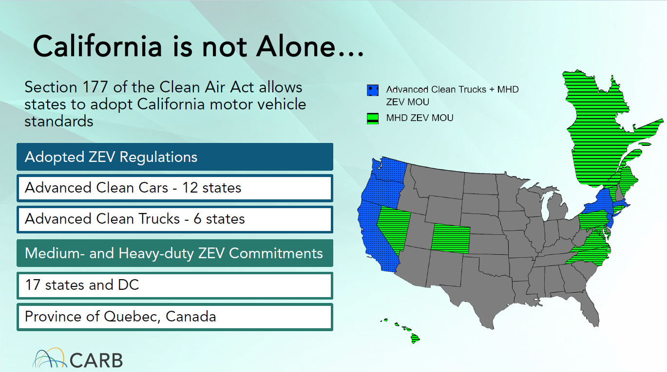
ACF Expansion Across the Nation
36% of Trucks in the US
https://ww2.arb.ca.gov/sites/default/files/barcu/board/books/2022/102722/22-14-1pres.pdf
10-19-2023
STRATEGIES FOR ZEV TRANSITION PLANNING & REGULATORY COMPLIANCE

Slide 9
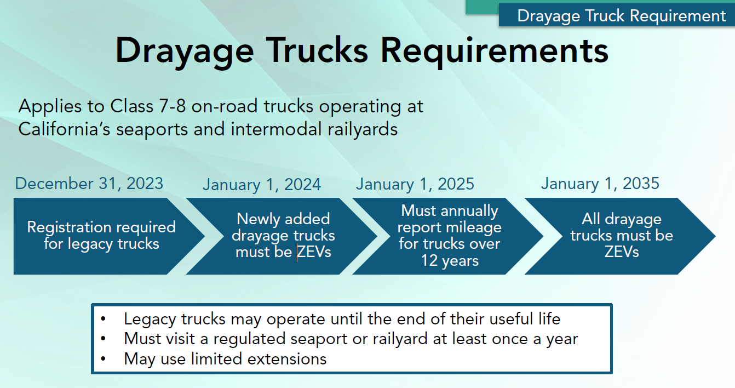
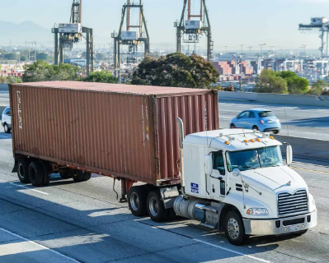
Drayage Trucks Requirements
Scope and Applicability
All legacy or combustion drayage trucks intending to begin or continue operations must be registered in TRUCRS by December 31, 2023
Only zero - emission drayage trucks can register to be added for drayage beginning January 1, 2024
10-19-2023
STRATEGIES FOR ZEV TRANSITION PLANNING & REGULATORY COMPLIANCE

Slide 10
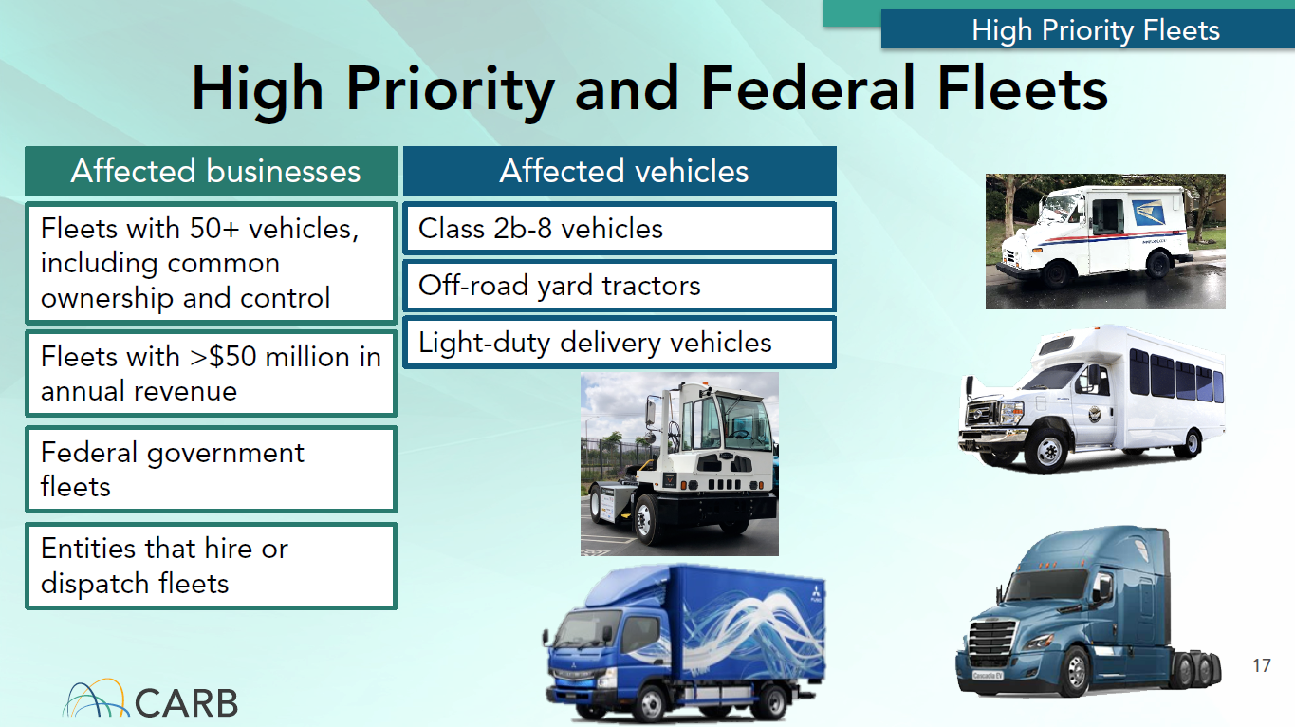
High Priority and Federal Fleets Requirements
Scope and Applicability
Private fleet size and gross annual revenue is based on United States business operations and not just California
Rental vehicle fleets have flexibility to use quarterly snapshots of fleet to address transient trucks and option to deploy NZEVs (plug-in hybrid electric vehicles) instead of ZEVs
Multistate fleets using the ZEV Milestone Phase-In compliance option are delayed until 2027 or 2030
  5-day pass flexibility to temporarily operate in California
10-19-2023
STRATEGIES FOR ZEV TRANSITION PLANNING & REGULATORY COMPLIANCE

Slide 11
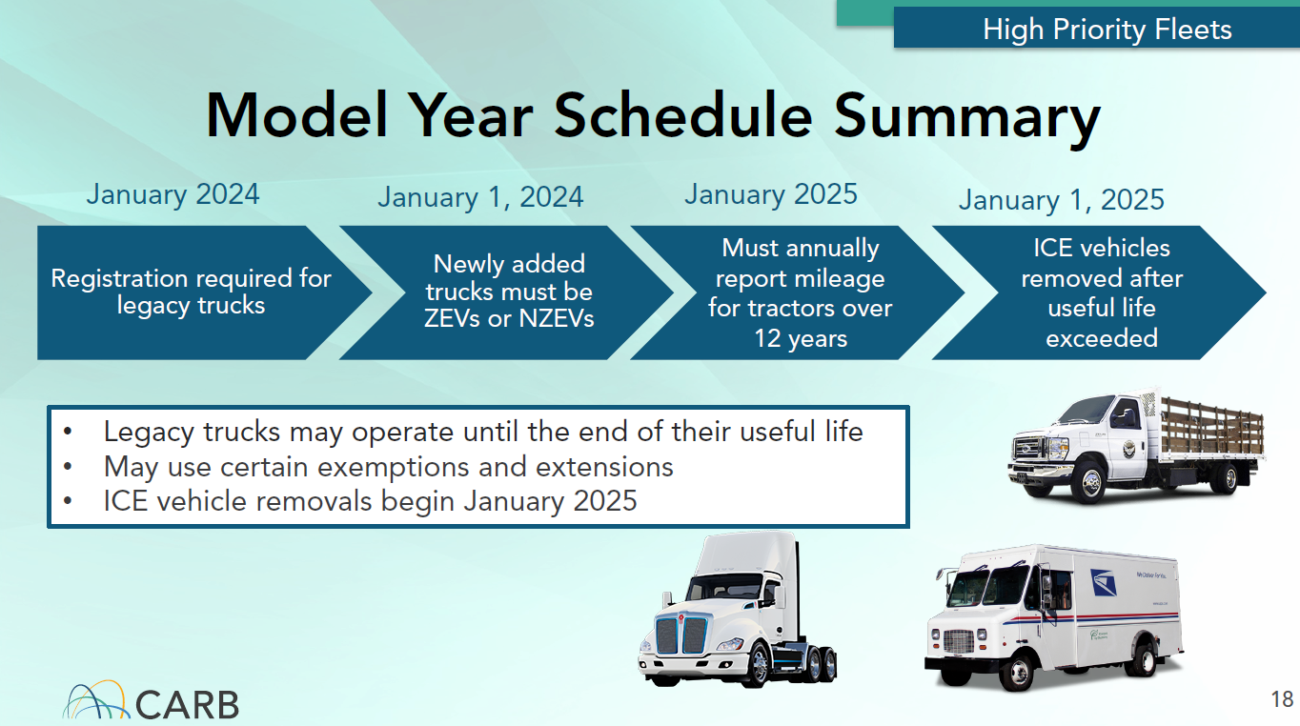
High Priority and Federal Fleets Requirements – Cont…
10-19-2023
STRATEGIES FOR ZEV TRANSITION PLANNING & REGULATORY COMPLIANCE

Slide 12
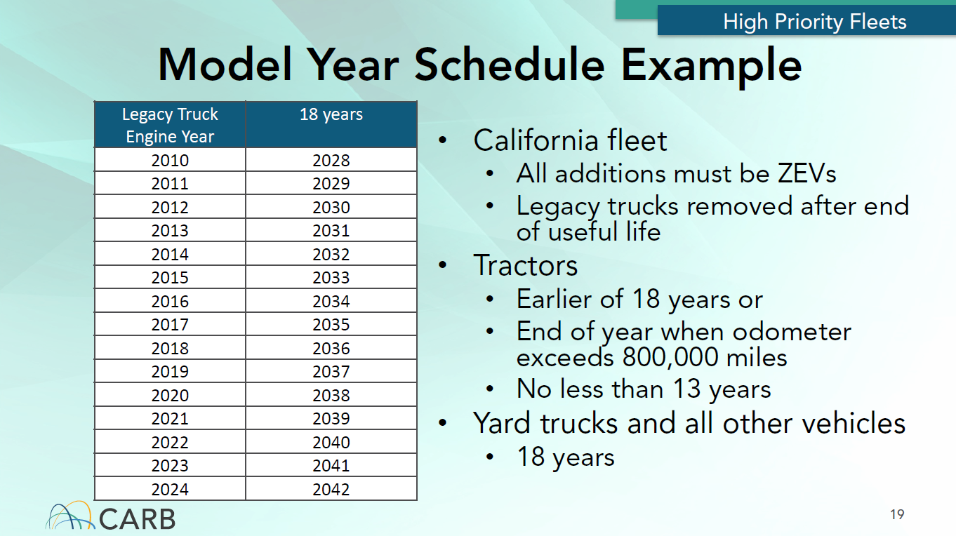
High Priority and Federal Fleets Requirements – Cont…
10-19-2023
STRATEGIES FOR ZEV TRANSITION PLANNING & REGULATORY COMPLIANCE

Slide 13
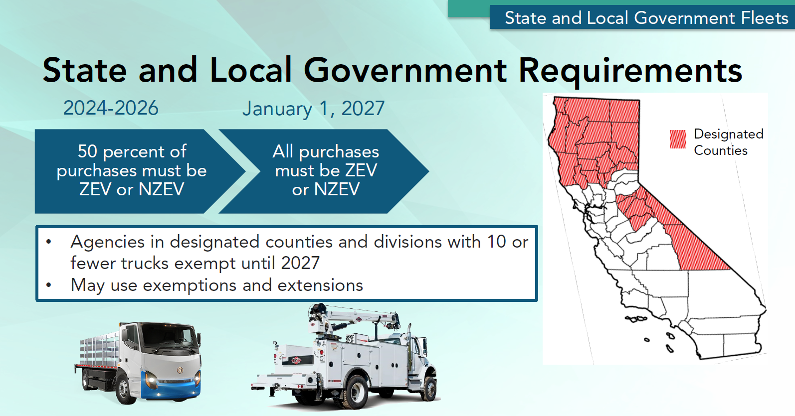
ACF State and Local Government Requirements
Scope and Applicability
Any state or local government agency with jurisdiction in California that owns, leases, or operates one or more vehicles that have a Gross Vehicle Weight Rating (GVWR) greater than 8,500 pounds, typically a 3/4 ton vehicles and larger.
Included are Hiring Entities such as motor carriers, brokers, governmental agencies, persons, or entities that hire and operate, or hires and directs the operation of vehicles in California.
10-19-2023
STRATEGIES FOR ZEV TRANSITION PLANNING & REGULATORY COMPLIANCE

Slide 14
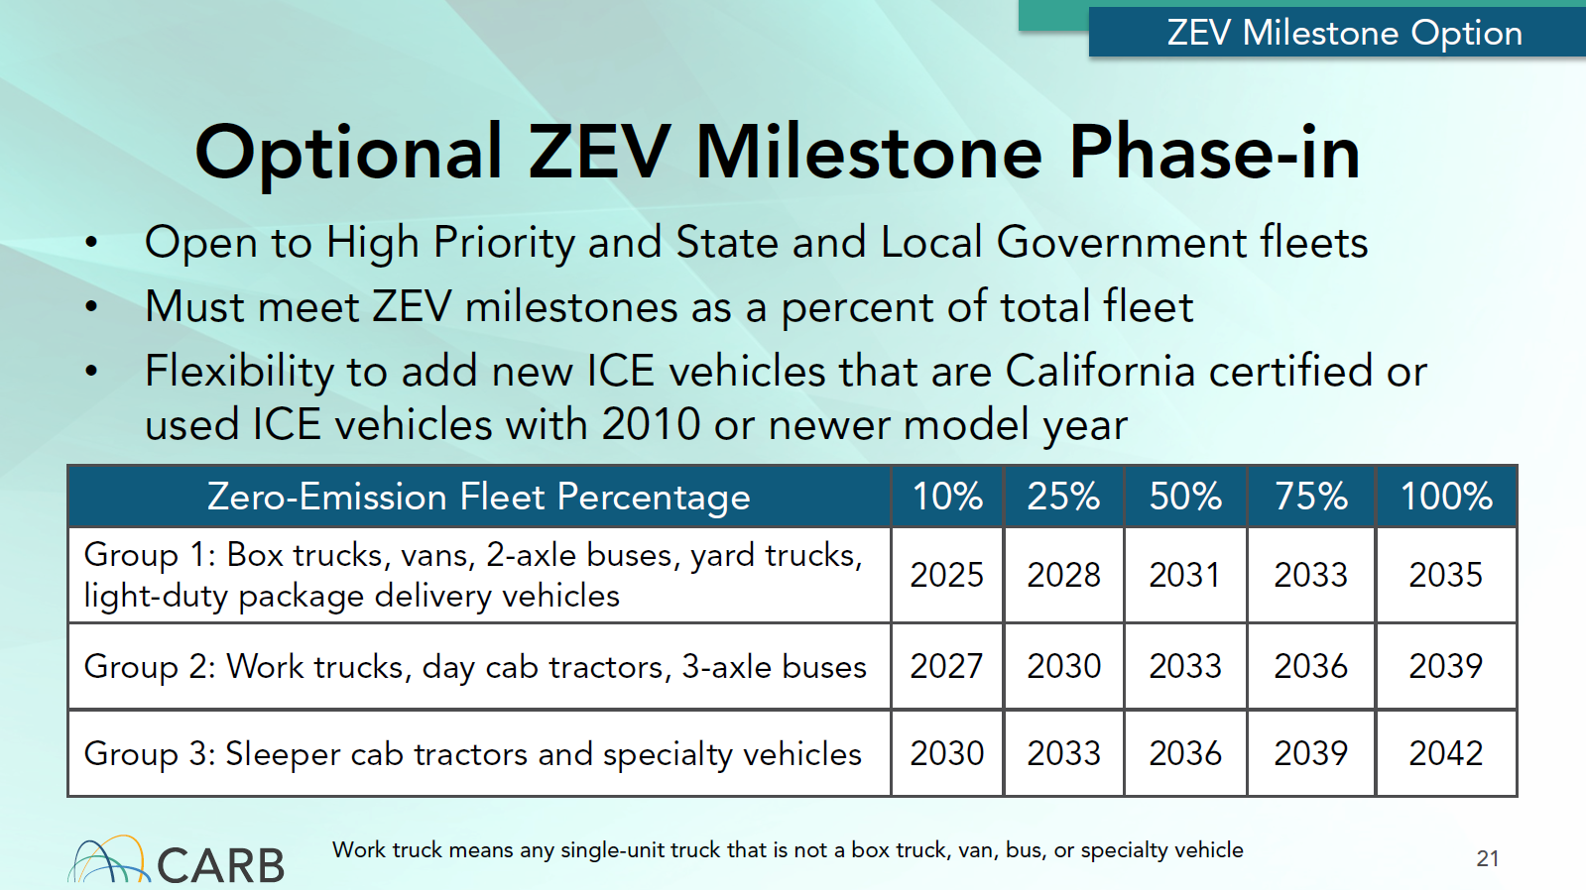
High Priority and State & Local Government Fleets Option
ZEV Milestone Phase In Option
May be beneficial if you already have charging or hydrogen fueling infrastructure in place, or it can be installed by 2025 for Group 1 vehicles.
May work for small fleets that have a lower overall cost of fueling infrastructure.
Adding applicable ICE vehicles to your fleet count will affect your ZEV compliance percentage immediately.
Delaying fueling infrastructure installation in later years will be at an increased cost.
Only ZEVs will be available to purchase beginning with Model Year 2036.
Must declare using the ZEV Milestone Phase-in Option by 4/1/2024. After electing to use this option, fleet owners are no longer subject to and may not switch back to the State or local government fleet requirements.
10-19-2023
STRATEGIES FOR ZEV TRANSITION PLANNING & REGULATORY COMPLIANCE

Slide 15
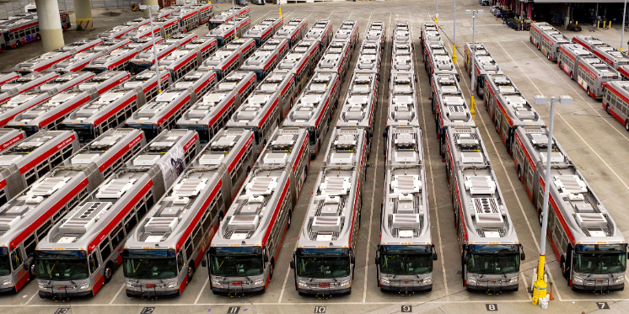
Waste and Wastewater Utilities & Transit Fleet Provisions
Provides more time for Waste and Wastewater fleets that are implementing organic waste diversions programs
Must be exclusively fueling vehicles with Compressed Natural Gas or Bio-Methane
10% ZEV targets start in 2027 or 2030 for most trucks
Defers ZEV requirement to 2030 for eligible fleets who elect to use the ZEV Milestone compliance path
Transit Fleet Exemption
This provision temporarily excludes Transit agencies until 2030 who are subject to the ICT regulation
This provides more time until ZEV purchases begin for their maintenance and support vehicles allowing them to focus their efforts on electrifying the transit buses first.
10-19-2023
STRATEGIES FOR ZEV TRANSITION PLANNING & REGULATORY COMPLIANCE

Slide 16
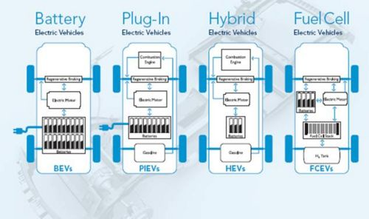
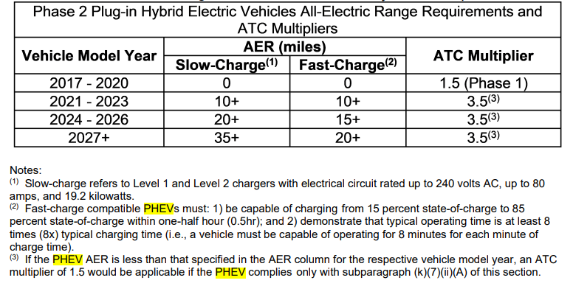
Zero Emission Vehicle ACF Definition
Zero Emission Vehicle (ZEV) Types
Battery Electric Vehicles (BEV)
Hydrogen Fuel Cell Electric Vehicles (FCEV)
Hybrid Electric Vehicles (HEV) Are Not ZEVs
Plug-In Hybrid Electric Vehicles (PHEV).
  Considered as Near Zero Emissions Vehicle (NZEV) in the regulation. Limited by All-Electric Range Requirement
Vehicle Manufacturers are currently focused on producing “Low Hanging Fruit” classes such as:
  Delivery Vans, Mini-Buses, Cargo Trucks, Transit Buses, and Trucks for Intrastate Commerce
  Vocational (work) Truck Designs are Forecast to be Available Beginning in 2026
10-19-2023
STRATEGIES FOR ZEV TRANSITION PLANNING & REGULATORY COMPLIANCE

Slide 17
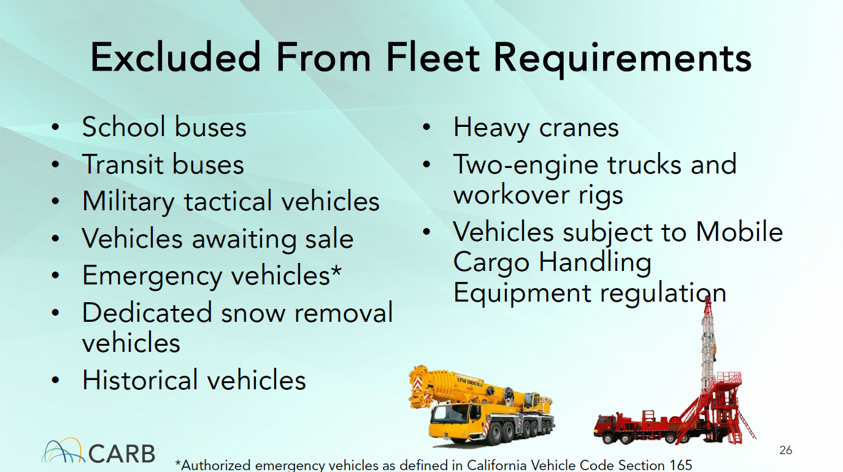
ACF State and Local Government - Exempted Vehicles
Non-Repairable Vehicles
Flexibility to purchase used replacement ICE vehicle in case of accident. Has to be the same configuration with an engine of the same or newer model year as the damaged vehicle. An exemption request process must be followed.
Intermittent Snow Removal Vehicles
May purchase ICE vehicles until 2030. An exemption request process must be followed.
Backup Vehicle Exemption
Excludes vehicles operated less than 1,000 miles per year. An exemption request process must be followed.
All exemptions have data collection and documentation requirements
10-19-2023
STRATEGIES FOR ZEV TRANSITION PLANNING & REGULATORY COMPLIANCE

Slide 18
Exempted - Emergency Vehicle Definition
California Vehicle Code
Sec. 165
An authorized emergency vehicle is:
(a) Any publicly owned and operated ambulance, lifeguard, or lifesaving equipment or any privately owned or operated ambulance licensed by the Commissioner of the California Highway Patrol to operate in response to emergency calls.
(b) Any publicly owned vehicle operated by the following persons, agencies, or organizations:
  (1) Any federal, state, or local agency, department, or district employing peace officers as that term is defined in Chapter 4.5 (commencing with Section 830) of Part 2 of Title 3 of the Penal Code, for use by those officers in the performance of their duties.
  (2) Any forestry or fire department of any public agency or fire department organized as provided in the Health and Safety Code.
(c) Any vehicle owned by the state, or any bridge and highway district, and equipped and used either for fighting fires, or towing or servicing other vehicles, caring for injured persons, or repairing damaged lighting or electrical equipment.
(d) Any state-owned vehicle used in responding to emergency fire, rescue, or communications calls and operated either by the Office of Emergency Services or by any public agency or industrial fire department to which the Office of Emergency Services has assigned the vehicle.
(e) Any vehicle owned or operated by any department or agency of the United States government when the vehicle is used in responding to emergency fire, ambulance, or lifesaving calls or is actively engaged in law enforcement work.
(f) Any vehicle for which an authorized emergency vehicle permit has been issued by the Commissioner of the California Highway Patrol.
10-19-2023
STRATEGIES FOR ZEV TRANSITION PLANNING & REGULATORY COMPLIANCE

Slide 19
ACF State and Local Government – Vehicle Exemption Process Example
A List of Truck Types that are Exempt from the ZEV Purchase Requirement if Not Available as a ZEV or
NZEV (Near Zero Emission Vehicle) will be published on the CARB ACF website.
CARB staff have until 1/1/2025 for the list to be made available on the ACF website.
Vehicles on the list can be purchased as an ICE vehicle without an exemption request application.
The list will not include pickups, buses, box trucks, vans, or any tractors.
Initially vehicle exemption requests will be used by CARB staff to develop the list of exempt truck types.
Individual Fleet Exemption Process
Fleets can submit an exemption request application if a ZEV is not available for a specific body configuration, or a ZEV cannot meet operational range and duty cycles.
  Data and documentation is required to be included in the exemption request.
  CARB will have 45 days to confirm approval by email.
    There is currently no appeal process to dispute an exemption being declined.
10-19-2023
STRATEGIES FOR ZEV TRANSITION PLANNING & REGULATORY COMPLIANCE

Slide 20
ACF State and Local Government – Infrastructure Extensions Example
Construction Infrastructure Extension Requests – Continued
A ZEV purchase agreement must be entered into prior to submitting an Extension Request
  A ZEV could be delivered and need to be stored for up to 2 years until the infrastructure installation is completed.
Extension Requests must be submitted at least 45 calendar days prior to the next applicable compliance date for the CARB Executive Officer to consider the request.
  Documentation is required with Extension Requests.
  Extension Requests must be submitted by email to the TRUCRS@arb.ca.gov email address.
CARB will have 45 days to confirm approval by email.
  There is currently no appeal process to dispute an exemption being declined.
10-19-2023
STRATEGIES FOR ZEV TRANSITION PLANNING & REGULATORY COMPLIANCE

Slide 21
ACF State and Local Government – Infrastructure Extensions Example Cont…
New Site Electrification Delay Extension Requests – Until 1/1/2030
Site Electrification Extension Requests are to algin the estimated ZEV delivery date with the amount of time the electric utility determines it needs to supply the required power to a site.
Extension Requests for delays up to 5 years.
  The initial Extension Request for delays is for up to 3 years.
    A subsequent Extension Request may be approved for up to 2 years.
      The subsequent Extension Request is when an electric utility cannot supply the needed power by the end of the initial Extension Request time period.
      The Extension Request must be submitted at least 45 calendar days prior to the expiration of the initial extension period.
  A ZEV could be delivered and need to be stored for up to 5 years until the infrastructure installation is completed.
  The Fleet owner may request an extension for the number of ZEVs for which the electric utility cannot supply sufficient power to support.
    The Fleet owner is required to deploy the maximum number of ZEVs that the site can support.
    To maintain the Extension, the Fleet owner must deploy an additional ZEVs that can be supported by electric utility upgrades to the site’s electrical capacity each calendar year during the delay until the project is complete.
10-19-2023
STRATEGIES FOR ZEV TRANSITION PLANNING & REGULATORY COMPLIANCE

Slide 22
ACF State and Local Government – Infrastructure Extensions Example Cont…
New Site Electrification Delay Extension Requests – Continued
  The Fleet owner may request an extension for the number of ZEVs for which the electric utility cannot supply sufficient power to support.
      The Fleet is required to deploy the maximum number of ZEVs that the site can support.
  Extension requests must be submitted by email to the TRUCRS@arb.ca.gov email address.
  Documentation is required with Extension Requests.
  CARB will have 45 days to confirm approval by email.
    There is currently no appeal process to dispute an Extension Request being declined.
Both Extension Requests types require a Fleet to begin planning 1 year ahead for infrastructure installation.
10-19-2023
STRATEGIES FOR ZEV TRANSITION PLANNING & REGULATORY COMPLIANCE

Slide 23
Procurement – Requirement to Hire Compliant Fleets
Beginning on 1/1/2024 Fleets will be required to hire or dispatch ACF “Compliant Fleets”.
  The first reporting of ZEV compliance requirement for hire fleets deadline is 4/1/2025.
  Provided hired fleets are purchasing ZEVs to meet their 2024 regulatory requirements, they will be in compliance up until 3/30/2025.
Compliant Fleets are private or government agency fleets in compliance with the ACF regulation at the time they are hired and throughout the term of any contract or agreement or exempt from the ACF regulation.
  Any High Priority or Federal Fleet that meets any of the following four criteria are required to comply with the ACF regulation:
  Is an entity that has $50 million or more in total gross annual revenues, including revenues from all subsidiaries, subdivisions, and branches, reported to the United States Internal Revenue Service, or its equivalent in another country in the calendar year immediately preceding the prior to the current calendar year;
  Is a fleet owner that owns, operates, or directs the operation of 50 or more vehicles in the total fleet, excluding light-duty package delivery vehicles;
10-19-2023
STRATEGIES FOR ZEV TRANSITION PLANNING & REGULATORY COMPLIANCE

Slide 24
Procurement – Requirement to Hire Compliant Fleets
Is a fleet owner or a controlling party whose fleet in combination with other fleets operated under common ownership and control totals 50 or more vehicles in the total fleet, excluding light-duty package delivery vehicles; or
Is any federal government agency, or is a State or local government agency as defined in title 13, California Code of Regulations (CCR) section 2013(b) that has elected to comply with the ZEV Milestones Option specified in section 2015.2 pursuant to title 13, CCR section 2013(e).
Examples:
  Rental Car or Truck Companies – Rental agreement is for less than one year.
  Vehicle Leasing Companies - Lease agreement is for less than one year.
  Trucking Companies- Hired to pickup or deliver large goods.
  Contracted Non-Government Organizations (NGOs) delivering services or goods.
  General Contractors.
    Subcontractors are excluded. Waiting for CARB to release a FAQ confirming this exception
10-19-2023
STRATEGIES FOR ZEV TRANSITION PLANNING & REGULATORY COMPLIANCE

Slide 25
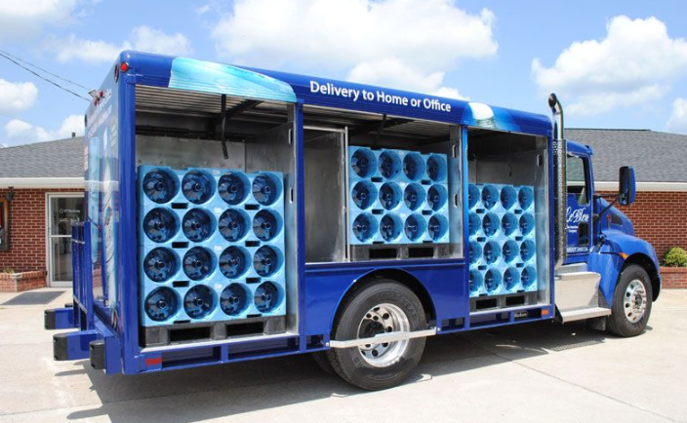
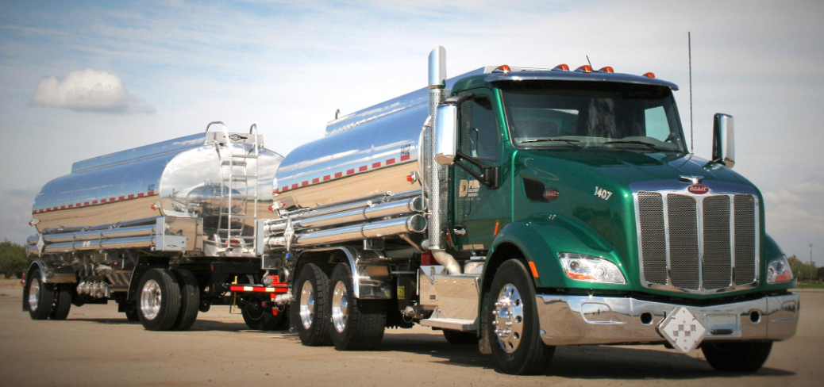
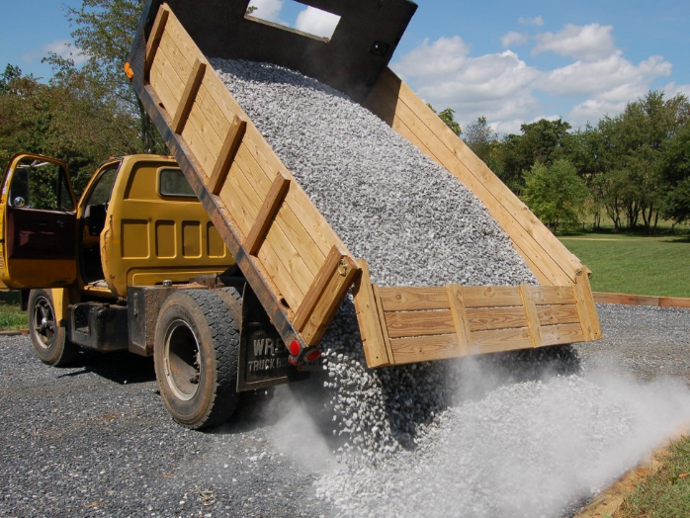
Procurement – Requirement to Hire Compliant Fleets
Continued Examples:
  Facility Repair Businesses
  Equipment Rental Businesses
  Bottled Water Delivery Businesses
  Uniform Cleaning Service and Delivery Businesses
  Food Delivery Businesses
Exception: Private or Government Agency Fleets that are exempt from the ACF regulation
10-19-2023
STRATEGIES FOR ZEV TRANSITION PLANNING & REGULATORY COMPLIANCE

Slide 26
Procurement - Compliant Fleets Reporting Requirements
Verification of ACF Compliance
  Check for verification that each fleet that will be hired or dispatched is listed on the CARB ACF webpage as a Compliant Fleet.
  Acquire a statement from fleets that are not listed on the ACF webpage that their fleet is not subject to the High Priority and Federal Fleets and the State and Local Government Fleets regulation.
  Collect and retained verification documents and attestation statements on a Calendar year basis.
  Cannot hire or dispatch a fleet that does not meet steps 1 and 2 above.
10-19-2023
STRATEGIES FOR ZEV TRANSITION PLANNING & REGULATORY COMPLIANCE

Slide 27
Procurement – Disclosure of Regulation Applicability
to Hired or Dispatched Fleets
Provide disclosure of ACF compliance requirement in writing
  Include in regulatory language in new hiring or dispatch contracts or agreements
  Incorporate regulatory language as an addendum to existing hiring or dispatch contracts or agreements
    Required Regulatory Language
    “Vehicles with a GVWR greater than 8,500 lbs. and light-duty package delivery vehicles operated in California may be subject to the California Air Resources Board Advanced Clean Fleets regulations. Such vehicles may therefore be subject to requirements to reduce emissions of air pollutants. For more information, please visit the CARB Advanced Clean Fleets webpage at https://ww2.arb.ca.gov/our-work/programs/advanced-clean-fleets.”
10-19-2023
STRATEGIES FOR ZEV TRANSITION PLANNING & REGULATORY COMPLIANCE

Slide 28
Procurement – Sales Disclosure of Regulation Applicability
Provide disclosure of ACF compliance requirement in writing to purchaser of a vehicle
  The required regulatory language must be disclosed on or with the Bill of Sale, sales contract addendum, or invoice.
    Required Regulatory Language
    “A vehicle operated in California may be subject to the California Air Resources Board Advanced Clean Fleets regulations. It therefore could be subject to requirements to reduce emissions of air pollutants. For more information, please visit the CARB Advanced Clean Fleets webpage at https://ww2.arb.ca.gov/our-work/programs/advanced-clean-fleets.”
    Contracts with auction companies should be amended to require the ACF regulatory language.
10-19-2023
STRATEGIES FOR ZEV TRANSITION PLANNING & REGULATORY COMPLIANCE

Slide 29
Procurement – Recordkeeping Requirements
Must keep records of reported information required and documentation for a period of 5 Years
Records must be available in electronic or paper format to CARB Staff within 72 hours of a written or verbal request for audit
  Examples:
    Vehicle purchase, rental, and leasing documents, such as purchase agreements, purchase orders, notices to proceed, leasing agreements, or rental agreements for vehicles.
    If a vehicle is sold or consigned to an auction house, a copy of the contract and the Transfer of Liability form filed with DMV, if applicable.
10-19-2023
STRATEGIES FOR ZEV TRANSITION PLANNING & REGULATORY COMPLIANCE

Slide 30
Procurement – Recordkeeping Requirements
  Continued Examples:
    Documentation for Mutual Aid Assistance
      Fleet owners that utilize the Mutual Aid Assistance Exemption must keep copies of all documents, mutual aid agreements, and letters submitted to CARB to support their request and qualifications for the exemption.
    Hiring Entity Documentation
      Hiring Entities must keep certificates of reported compliance or signed statements received from Hired Fleets used to verify that Hired Fleets are compliant with the applicable regulations. Additionally, hiring entities must keep copies of contracts with Hired Entities that Include the disclosure of regulation applicability.
10-19-2023
STRATEGIES FOR ZEV TRANSITION PLANNING & REGULATORY COMPLIANCE

Slide 31
Procurement – Recordkeeping Requirements
  Continued Examples:
    Sales Disclosure Documentation
      Fleets must keep a copy of the written sales disclosure.
State and Local Government Fleet Regulatory Enforcement
    The government agency and individual employees who fail to comply with the requirements of the regulation, who fails to submit any information, report, or statement required by the regulation, or who knowingly submits any false statement or representation in any application, report, statement, or other document filed, maintained, or used for the purposes of compliance with the regulation may be subject to penalties.
Penalties
  Financial penalties vary with a minimum amount of $500.
  Individuals may be charged with a misdemeanor and not more than one year in county jail.
10-19-2023
STRATEGIES FOR ZEV TRANSITION PLANNING & REGULATORY COMPLIANCE

Slide 32
ACF State and Local Government – Annual Fleet Reporting Requirements Example
Reporting Deadline and End Date
Fleet owners must submit an annual compliance report no later than 4/1 of each year through to year 2045 as the fleet is composed as of January 1 of the corresponding calendar year.
The annual reporting period is during the month of March.
The initial report must be submitted by 4/1/2024.
Beginning 1/1/2025, fleet owners that submit initial reporting information after the initial reporting deadline specified are subject to penalties.
Fleet vehicle data will be submitted to CARB through the TRUCRS Reporting System.
  https://ssl.arb.ca.gov/trucrs_reporting/login.php
10-19-2023
STRATEGIES FOR ZEV TRANSITION PLANNING & REGULATORY COMPLIANCE

Slide 33
ACF State and Local Government – Annual Fleet Reporting Requirements Cont…
Required Information and Data for Each Fleet Vehicle
  VIN;
  Vehicle make and model;
  Vehicle model year;
  Vehicle license plate number and state or jurisdiction of issuance;
  Vehicle GVWR (Greater than 8,500 lbs. and equal to or less than 14,000 lbs., greater than 14,000 lbs. and equal to or less than 26,000 lbs., or greater than 26,000 lbs.);
  Vehicle body type;
  Fuel and powertrain type;
  Date vehicle purchase was made;
  Date vehicle was added to or removed from the California fleet;
  Whether the vehicle will be designated under or was purchased pursuant to any exemption or extension
  Odometer, or if applicable, hubodometer readings:
  Engine family and engine model year for any vehicles added to the California fleet after 1/1/2024
10-19-2023
STRATEGIES FOR ZEV TRANSITION PLANNING & REGULATORY COMPLIANCE

Slide 34
ACF State and Local Government – Annual Fleet Reporting Requirements Cont…
Required Information and Data for Each Fleet Vehicle - Continued
  Funding contract start and end date for vehicles purchased with California State-funding if the vehicle is to be excluded during the funding contract period as specified by the funding program.
  ZEV Purchase Reporting
    Fleet owners that are replacing a vehicle pursuant to the ZEV Purchase Exemption specified in section 2013.1(d) must identify which vehicle is being replaced.
  Joint Compliance Reporting
    If an agency chooses to comply jointly as specified in section 2013(k), each individual department, division, district, subsidiary, or agency must report separately, and include the CARB-issued ID number of the primary controlling agency or designated primary entity.
  Emergency Mileage
    The fleet owner must report the number of miles travelled in support of the emergency for backup vehicles used in emergency operations that would exceed the backup vehicle mileage limit.
10-19-2023
STRATEGIES FOR ZEV TRANSITION PLANNING & REGULATORY COMPLIANCE

Slide 35
ACF State and Local Government – Annual Fleet Reporting Requirements Cont…
Required Information and Data for Each Fleet Vehicle - Continued
  Changes to an Existing Fleet -Adding or removing vehicles from the California fleet:
    Vehicles added to the California fleet must be reported within 30 calendar days of being added to the fleet;
    Vehicles that are permanently removed from the fleet must be reported within 30 calendar days of removal. The report must include the date of removal;
    If a backup vehicle exceeds the allowable mileage limit the change must be reported within 30 calendar days of the date the mileage limit was exceeded; and
    ZEV Conversions. Fleets that convert a vehicle to a ZEV must report the vehicle’s new fuel type within 30 calendar days of being converted.
10-19-2023
STRATEGIES FOR ZEV TRANSITION PLANNING & REGULATORY COMPLIANCE

Slide 36
ACF State and Local Government – Annual Fleet Reporting Requirements Cont…
Required Information and Data for Each Fleet Vehicle – Continued
Backup Vehicle Odometer or Hubodometer Reading Reporting.
  Odometer Readings. Report annually the odometer reading from January 1 of the current calendar year and the date the reading was recorded from a properly functioning odometer or hubodometer.
  Odometer Failure and Replacement. If the vehicle’s originally equipped odometer has failed and is replaced, report the following information within 30 calendar days of the date the original odometer failed or was replaced, whichever comes first: the original odometer’s final reading, the new odometer’s initial reading, and the date of replacement.
    Hubodometers. If the vehicle’s originally equipped odometer has failed and is not being replaced, the fleet owner must equip the vehicle with a hubodometer. Fleet owners must report the serial number of the hubodometer within 30 calendar days of the date the hubodometer was installed.
10-19-2023
STRATEGIES FOR ZEV TRANSITION PLANNING & REGULATORY COMPLIANCE

Slide 37
Regulatory Language and Reference Documentation
  CARB ACF Regulatory Language Website
  Main website
    https://ww2.arb.ca.gov/our-work/programs/advanced-clean-fleets
  Final Regulation Order: State and Local Government Agency Fleet Requirements Document
    https://ww2.arb.ca.gov/sites/default/files/barcu/regact/2022/acf22/acffroa1.pdf
  Final Regulation Order: High Priority and Federal Fleet Requirements
    https://ww2.arb.ca.gov/sites/default/files/barcu/regact/2022/acf22/acffroa2.pdf
10-19-2023
STRATEGIES FOR ZEV TRANSITION PLANNING & REGULATORY COMPLIANCE

Slide 38
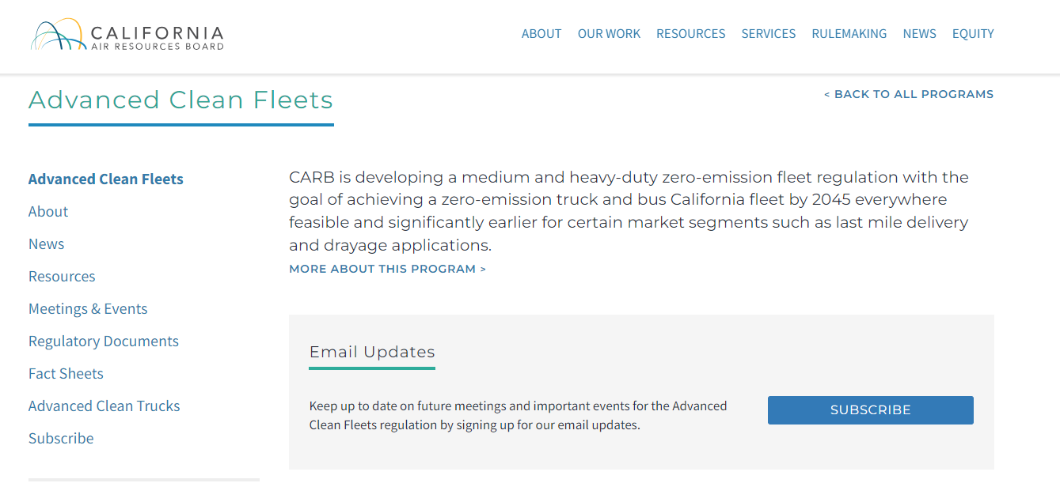
More Information
Sign up for emails for the latest news about the CARB ACF regulation
  https://ww2.arb.ca.gov/our-work/programs/advanced-clean-fleets
10-19-2023
STRATEGIES FOR ZEV TRANSITION PLANNING & REGULATORY COMPLIANCE

Slide 39
Compliance Option Pathways
ZEV Milestone Phase-In Option vs ZEV Purchase Percentage Requirements as Part of Normal Vehicle Replacement Planning
ZEV Milestone Phase-In Option
  Allows fleets to purchase ICE vehicle replacements provided the overall ZEV fleet percentage requirement is met each year.
  Advantages
    More time to purchase and have refueling infrastructure in place for certain Groups of vehicles designs
  Challenges
    The management of different Groups of vehicle designs that have different compliance percentage requirements on different dates.
    Less flexibility due overall fleet percentage requirements.
    Increasing fleet size in the early compliance years will require the purchase of ZEVs to maintain compliance percentage ratios.
    Cannot extend the life of ICE vehicles due to compliance percentage ratios.
    “Useful Life” uses SB-1 definition. 18 years or 800,000 miles whichever comes first.
10-19-2023
STRATEGIES FOR ZEV TRANSITION PLANNING & REGULATORY COMPLIANCE

Slide 40
ACF State and Local Government Compliance Option Pathways Example
ZEV Purchase Percentage Requirements as Part of Normal Vehicle Replacement Planning Option
  Allows fleets to purchase ZEVs during normal vehicle replacement cycle planning.
  Advantages
    More flexibility on which ICE vehicles are replaced with ZEVs from 1/1/2024 to 12/31/2026.
      50% of vehicle purchases need to be ZEVs during these years.
    Can extend the life of an ICE vehicle while waiting for applicable ZEVs to be available or refueling infrastructure to already be in place.
    The management of individual groups of vehicle designs is not necessary
    Fleet size can be increased in the early years using a combination of ZEV and ICE vehicles provided the 50% purchase ratio is maintained.
  Challenges
    Cannot easily prepurchase current EPA certified engine vehicles in bulk prior to the 100% ZEV purchase requirement beginning on 1/1/2027.
    Some vehicles will be replaced earlier with ZEVs because they have reached the end of service sooner and the 100% purchase requirement is in place from 1/1/2027 and on.
10-19-2023
STRATEGIES FOR ZEV TRANSITION PLANNING & REGULATORY COMPLIANCE

Slide 41
ACF State and Local Government Compliance Strategies Example Cont…
ZEV models are currently available to replace fleet vehicles
  Order vehicles to coincide with charging station infrastructure in place to support them
  Allows an equal number of vehicles to be ordered with an Internal Combustion Engine (ICE)
    50% ZEV purchase requirement from 1/1/2024 to 12/31/2026
ZEV models are currently available to replace a fleet vehicle, but the infrastructure will not be available for more than three years
  Delay replacement and extend the life of the vehicle
  Order ZEV
    Submit an infrastructure delay request for 2 years
ZEV models are currently available, but the replacement of a current vehicle cannot be delayed by two years waiting for the fueling infrastructure to be installed
  Match it up with a vehicle that can be replaced by a ZEV to meet the 50% purchase requirement up to 12/31/2026
10-19-2023
STRATEGIES FOR ZEV TRANSITION PLANNING & REGULATORY COMPLIANCE

Slide 42
ACF State and Local Government Compliance Strategies Example Cont…
ZEV models are not currently available, but will be available within 5 years
  Submit an exemption request to CARB for approval to purchase an ICE vehicle
ZEV Manufacturer Support Challenges
  Focus on ZEV manufacturers that have local dealerships or contracted warranty/repair stations
  Dealerships for warranty or repair work may be located anywhere in California
    The regulation does not allow for an exemption if there are no local dealership or warranty repair stations.
    If there is one ZEV manufacturer selling vehicles in California and it meets vehicle body design and duty cycles requirements, then a vehicle exemption will not be approved by CARB staff.
    A lack of ZEV dealerships will reduce competition and increase purchase costs
      The regulation does not allow for an exemption based on the cost differential between a conventional ICE vehicle or a ZEV
10-19-2023
STRATEGIES FOR ZEV TRANSITION PLANNING & REGULATORY COMPLIANCE

Slide 43
ZEV Transition Planning
  What ZEVs are available for purchase in the near term?
  What ZEVs are available to order versus be manufactured and delivered within 12 months?
  What charging or hydrogen refueling infrastructure is in place? Public or Private stations?
    Can the infrastructure be in place at the time the ZEVs are delivered?
    Is there sufficient local electric grid capacity to support charging station installations?
    Will the regional electric grid capacity be exceeded due to multiple fleets installing charging infrastructure?
  Where is the nearest ZEV dealership located? 10 miles or 500 miles away?
  Can you perform ZEV warranty work in house?
  Will your maintenance and repair facility need to be remodeled, extended, or replaced to meet OSHA and safety requirements to work on high voltage amperage batteries and control systems?
10-19-2023
STRATEGIES FOR ZEV TRANSITION PLANNING & REGULATORY COMPLIANCE

Slide 44
ZEV Transition Planning Cont…
  Will your local fire marshal approve modifications to your maintenance and repair facility to work on hydrogen fuel cell electric vehicles (FCEV)?
    Will FCEVs need to be parked outside the facility overnight?
  What volume of work can the nearest ZEV dealership perform?
    Will they need to modified their dealership to work on ZEVs?
      Will this limit their parking capacity and volume of work that can be perform?
  Are local collision repair facilities certified to work on the ZEV manufacturer and models you plan on purchasing?
  Will leased facility owners allow charging stations to be installed either at their expense or yours?
  Will the ZEV manufacturers delay battery warranty start dates if vehicles cannot be placed into service due to refueling infrastructure installation delays?
  Do you have or can acquire the necessary funding for vehicle acquisitions and refueling infrastructure?
10-19-2023
STRATEGIES FOR ZEV TRANSITION PLANNING & REGULATORY COMPLIANCE

Slide 45
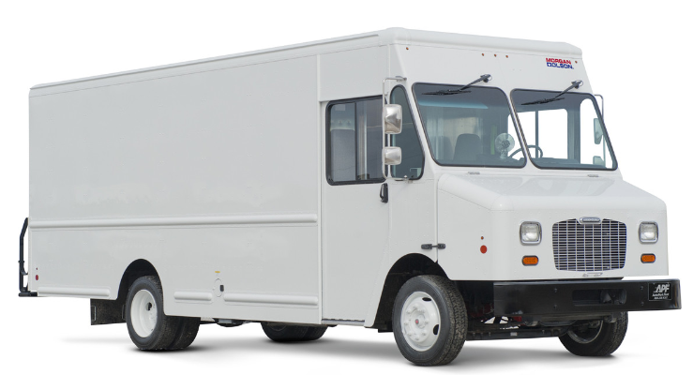
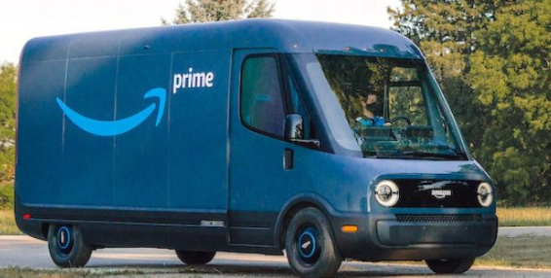
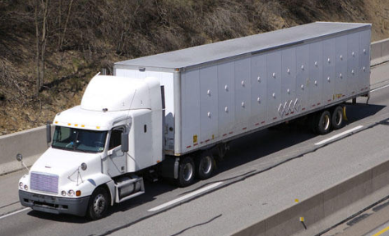
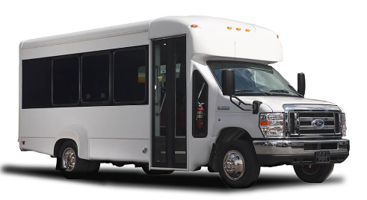
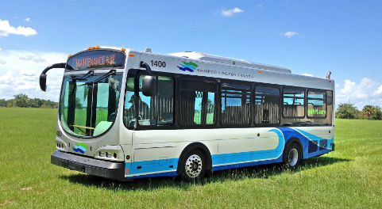
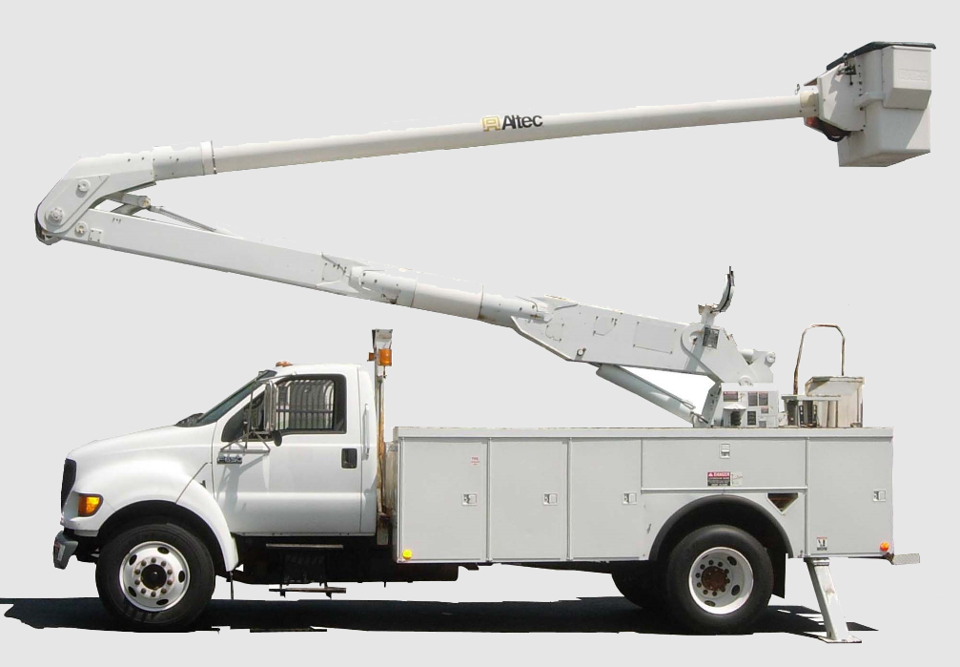
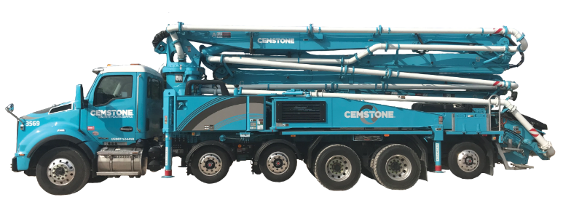
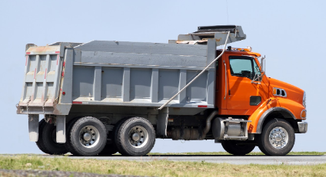
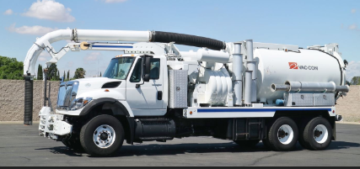
Vehicle Challenges
Vehicle Manufacturers are Currently Focused on Producing “Low Hanging Fruit” Classes
  Delivery Vans
  Mini Buses
  Cargo Trucks
  Transit Buses
  Trucks for Intrastate Commerce
Vocational (work) Truck Designs are Forecast to be Available Beginning in 2026
10-19-2023
STRATEGIES FOR ZEV TRANSITION PLANNING & REGULATORY COMPLIANCE

Slide 46

Vehicle Design Challenges - Upfitting
Upfitting limitations depending on vehicle trim level package?
Can additional pieces of equipment be grounded to the frame?
Are there amperage restrictions on what additional electrical load can be added to truck?
Are there restrictions on where electrical equipment can be connected to the truck’s 12-volt system?
Can auxiliary 12-volt batteries be added to the truck?
    Where and how can they be added?
Where can equipment be mounted?
    What panels can be drilled through?
What happens when the 12-volt battery is discharged?
    Does the powertrain system lock up like a smart phone in a “brick” mode?
    Does the truck need to be towed on dollies only?
10-19-2023
STRATEGIES FOR ZEV TRANSITION PLANNING & REGULATORY COMPLIANCE

Slide 47
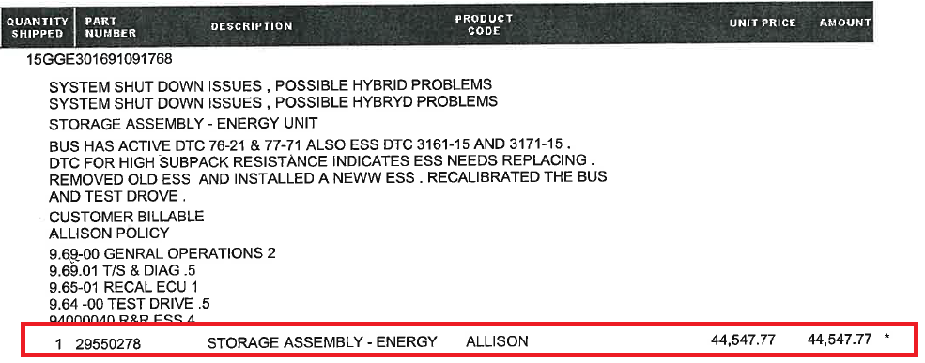
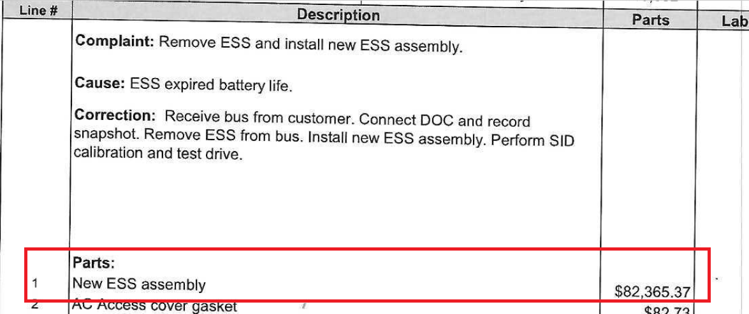
Vehicle Battery Module Replacement
Will future replacement battery modules be backwards compatible?
Will vehicles need to be replaced because battery modules and control systems are not backwards compatible or cannot be retrofitted?
Battery cost per kWh reduction advancements may not decrease older battery module replacement costs
8/2012 – Battery Module Replacement Cost
11/2022 – Battery Module Replacement Cost
10-19-2023
STRATEGIES FOR ZEV TRANSITION PLANNING & REGULATORY COMPLIANCE

Slide 48
EV Accident Damage
California Vehicle Registrations – 2022 Data
    36,229,205 Vehicle Registered
    425,300 EVs Registered
      1.01% of Vehicles Registered are EVs
Vehicle Fire Data
    1 in 1,500 chance of a vehicle catching fire in the United States
    1 in 20,000 chance of a Tesla EV catching fire in Europe
Current EV fire data is insufficient to determine proper safety protocols for every scenario
A single EV on fire can need as much as 40,000 gallons of water to extinguish it
EV fires can require a Haz Mat response – You may be billed for the costs - $5K to $20K+
Dedicated containment systems may be necessary to store damaged EVs as a safety precaution
Simple accident damage may require battery module/box replacement, effectively “totaling” the vehicle
10-19-2023
STRATEGIES FOR ZEV TRANSITION PLANNING & REGULATORY COMPLIANCE

Slide 49
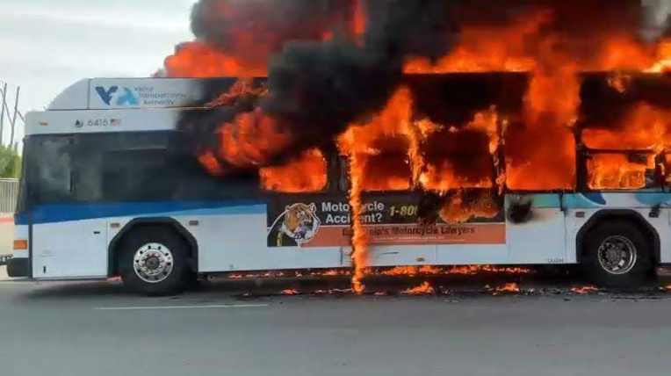
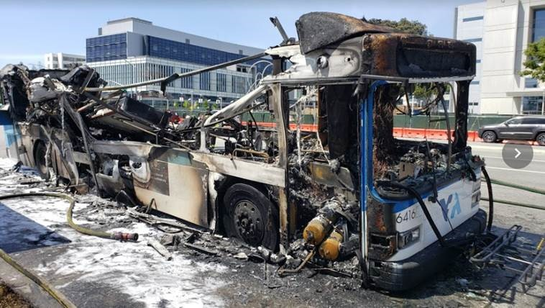
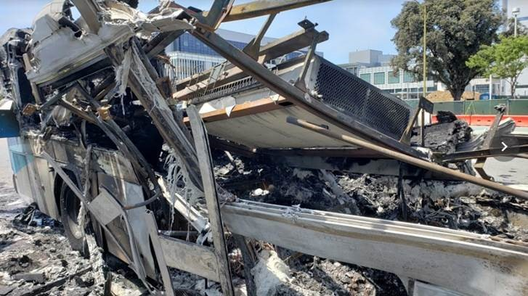
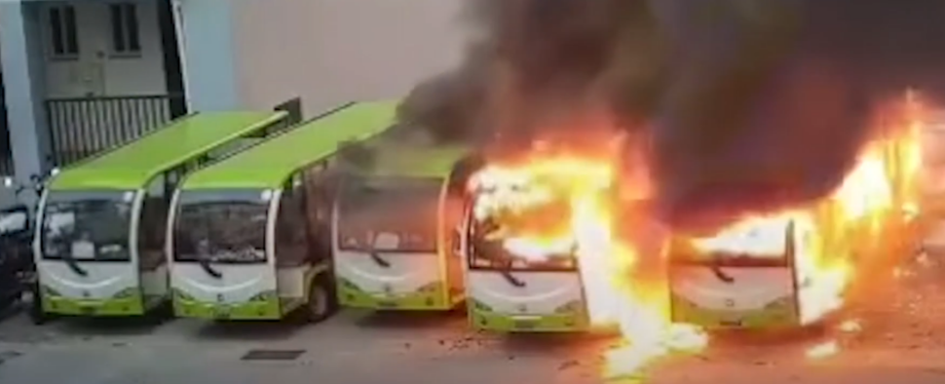
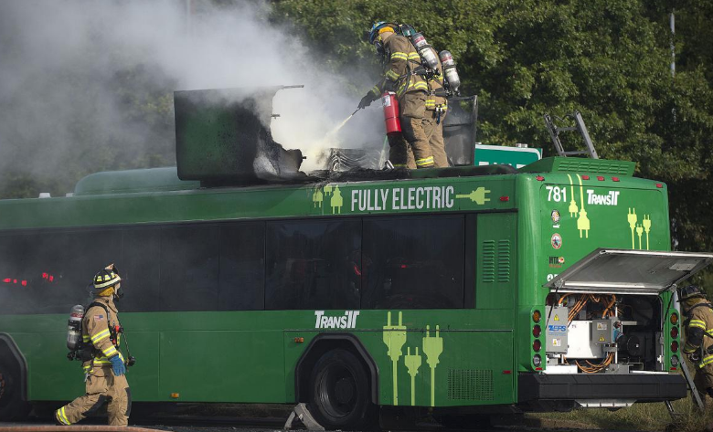
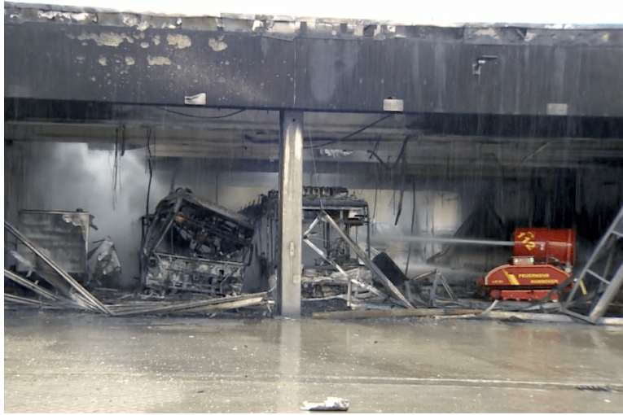
EV Battery Fires
An Electric Scooter Taken On Board the Bus Caught Fire and Spread to the Rest of the Bus. The Bus Hybrid Electric Battery was Intact After the Fire
An EV Bus Caught Fire and It Spread to Adjacent Buses
Firefighters Utilized Dry Chemical
Extinguisher and Foam to Put Out this Fire
EV Bus Fire Damages Depot
10-19-2023
STRATEGIES FOR ZEV TRANSITION PLANNING & REGULATORY COMPLIANCE

Slide 50
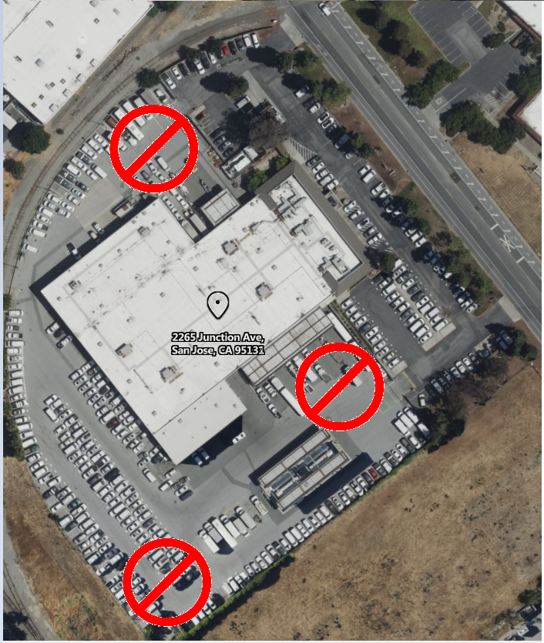
Accident Damage – EV Quarantine
Light Duty EV Trucks require a 50’ radius between the vehicle and the next closest object in case of a fire
Medium/Heavy Duty Truck radius requirements may be greater
An EV Truck will need to remain in quarantine for between 48 hours and 2 weeks depending on the manufacturer’s recommended safety protocols
A majority of towing vendors do not have space to meet manufacturer recommended safety protocols for just one EV sedan
10-19-2023
STRATEGIES FOR ZEV TRANSITION PLANNING & REGULATORY COMPLIANCE

Slide 51
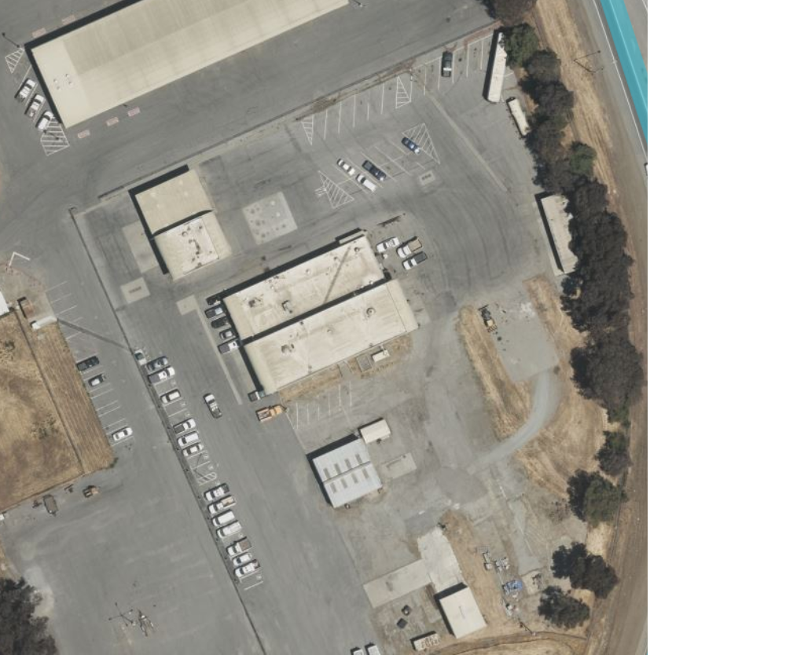
Accident Damage – EV Fire Containment
The EV needs to be parked on concrete, asphalt, or gravel away from combustible material such as grass and weeds
EV battery fires can reach temperatures of up to 1,400 degrees Fahrenheit
Surface modifications at this facility will provide a quarantine location for two EVs at a time
Contracted towing providers will be directed to take all damaged EVs to this location
EV accident repair damage costs are 27% to 43% higher than conventional vehicles
10-19-2023
STRATEGIES FOR ZEV TRANSITION PLANNING & REGULATORY COMPLIANCE

Slide 52
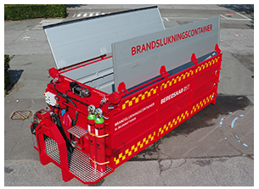
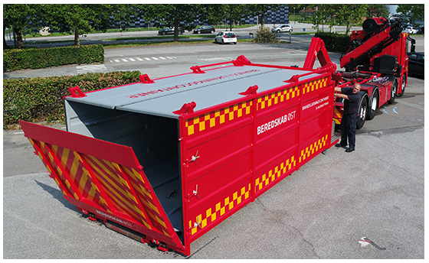
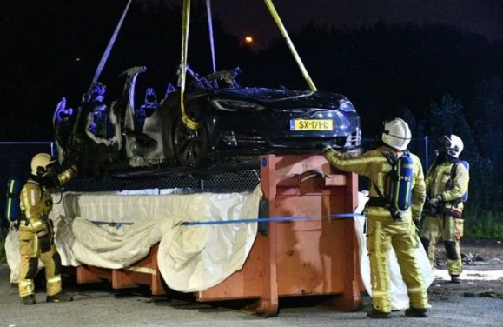
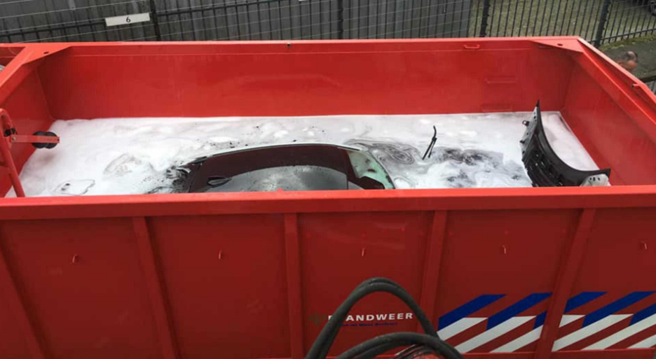
Accident Damage – EV Fire Containment
Runoff water may contain hazardous chemicals that can trigger a HAZMAT response if the contaminated water threatens to enter a storm drain or Creek
First Responders may decide that letting the EV burn out is the best strategy
10-19-2023
STRATEGIES FOR ZEV TRANSITION PLANNING & REGULATORY COMPLIANCE

Slide 53

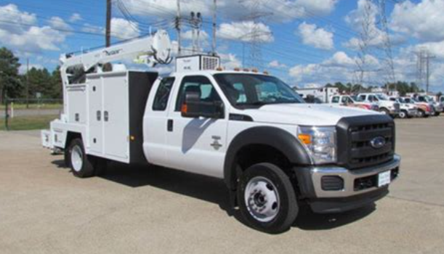
Operational Challenges
Take-Home Trucks
  Commute mileage uses up battery range
  Charging at an employee’s residence is not realistic
  Will your agency/company assume the risk of an EV fire damaging an employee’s home?
      Can you acquire insurance to cover damage to an employee’s home in the event of an EV fire?
  Emergency operations can be ongoing for days limiting recharging opportunities
Charging Session Electricity Interruptions – Restart?
  Is someone notified via an email of interruptions in power?
Are staff on hand to restart charging stations?
    Does the charging station or vehicle restart a charge sessions automatically when electrical power is restored?
Do you have a back-up plan for 3 days of power outages?
    Do you have alternative locations with unaffected localize electrical grids to charge vehicles?
10-19-2023
STRATEGIES FOR ZEV TRANSITION PLANNING & REGULATORY COMPLIANCE

Slide 54
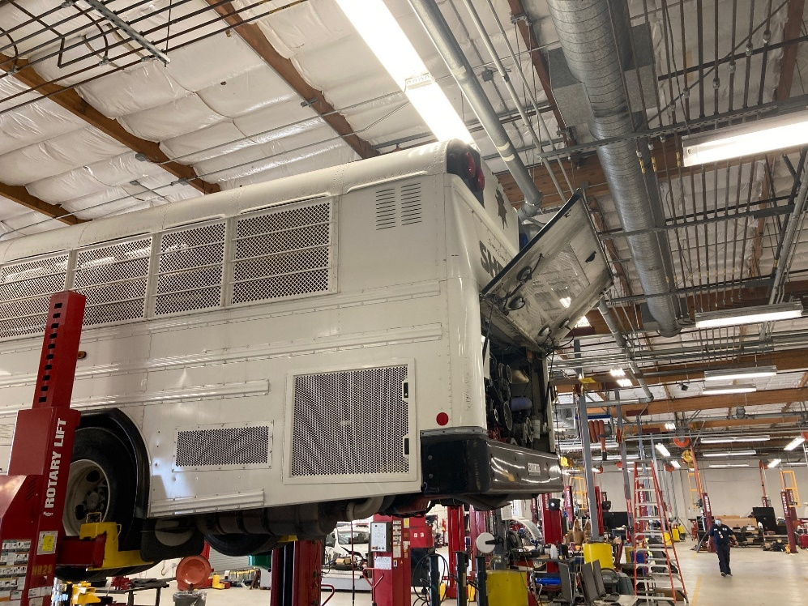
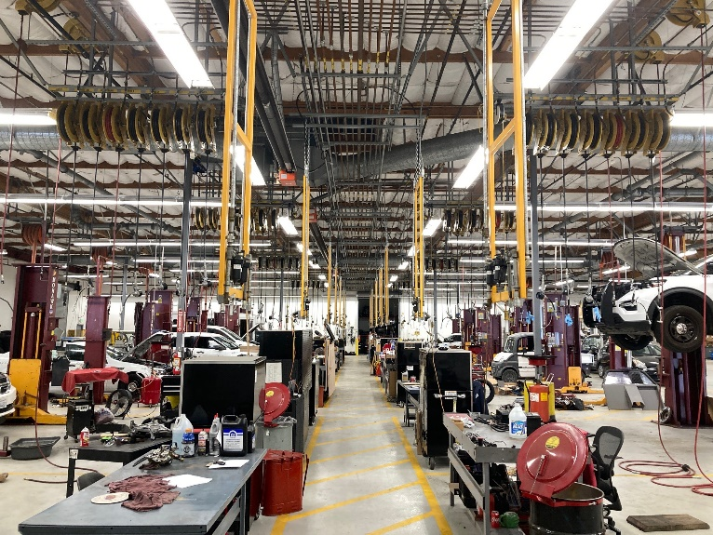
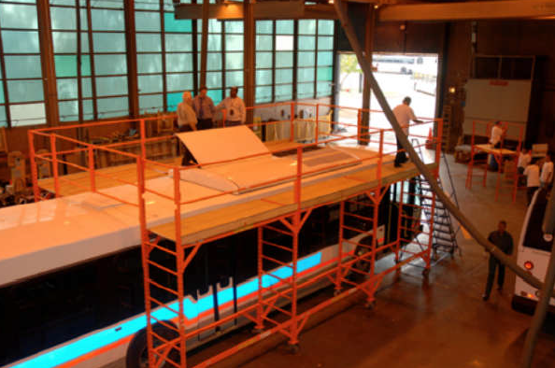
Operational Challenges - Facilities
Employee Safety - 10’ Clearance Between EV and Closest Metal Object Possible?
Employee Safety – Additional 10’ of Clearance Between Insulated Fall Protection Work Platforms and Closest Metal Object
Maintenance Facility - Vehicle to Roof Clearance Sufficient?
10-19-2023
STRATEGIES FOR ZEV TRANSITION PLANNING & REGULATORY COMPLIANCE

Slide 55
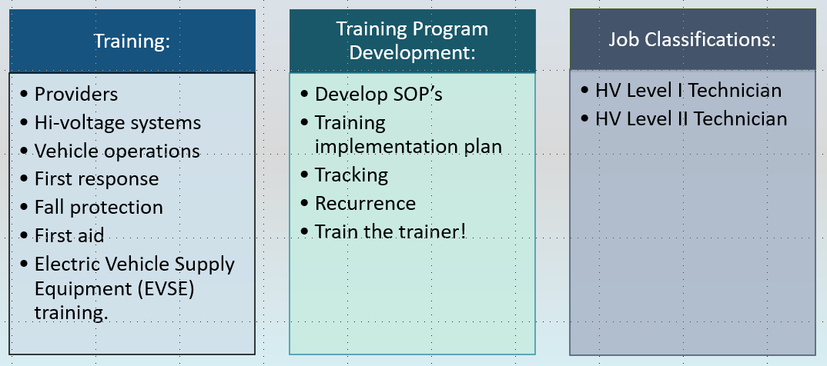
Operational Challenges - Training
Trainings Costs – Onsite, Out of State, Minimum # of Hours, Etc. After Training - Mechanics/Technicians Will Still Need High Voltage Arc Flashing Training
10-19-2023
STRATEGIES FOR ZEV TRANSITION PLANNING & REGULATORY COMPLIANCE

Slide 56



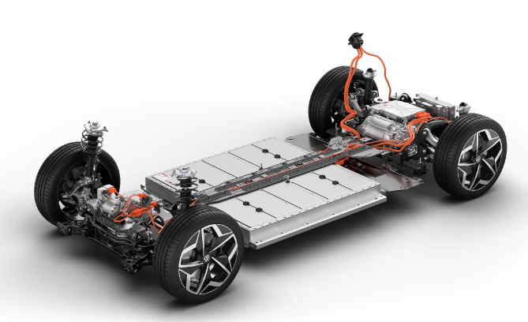
EV Accident Damage Safety Training – First Responders
First Responders
  Police
  Fire
  Tow Truck Drivers
  Fleet Staff
    In many cities unless there are injuries, gasoline or fluids from the vehicles, or they are blocking a major throughfare, Police dispatchers will direct the vehicle operators/owners to exchange contact, insurance, and driver license information and then call a tow company to remove the vehicles from the accident scene
    Vehicle undercarriage damage is not seen, and this is where many vehicle battery modules are located
      Skateboard design
    Damage to an EV battery module may not develop into a fire for days or weeks
10-19-2023
STRATEGIES FOR ZEV TRANSITION PLANNING & REGULATORY COMPLIANCE

Slide 57



Operational Challenges – Safety Training
Tow Truck Operator Safety Training
Job Description Changes
High Voltage - Mechanic, Technician, and
Facilities Employee Training and Certifications
High Voltage Safety Training
10-19-2023
STRATEGIES FOR ZEV TRANSITION PLANNING & REGULATORY COMPLIANCE

Slide 58
Operational Challenges – ZEV Warranties
Charging Infrastructure Installation Delays
ZEV Warranties
  The start of a warranty may be when the ZEV is delivered and not when it is put into service
  Infrastructure installation delays can cause a ZEV to need to be stored after delivery for up to five years
    It is unlikely that a ZEV manufacturer will delay the beginning of a battery warranty for up to five years after delivery
Infrastructure Exemptions can exist for up to 5 years
  Does a ZEV in storage need the tires replaced due to age?
  Software upgrades while in storage
  Storage facility costs
  Maintaining battery module voltage
  Changes in charging technology or connectors
10-19-2023
STRATEGIES FOR ZEV TRANSITION PLANNING & REGULATORY COMPLIANCE

Slide 59
Capital and Budgetary Costs
ZEV Trucks Cost 1.5X – 5X More than conventional powered trucks.
  Costs highly dependent upon class of vehicle and duty cycles.
  $90K to $1M each.
  Limited amount of cost data is available.
    Example: 3 Axle Day Cab Diesel Engine. Frame modified for a Low Boy trailer. Quote from June
    2014 cost was $114,000
    2023 cost is $175,000 with same specifications
    2023 ZEV Battery Electric is $569,000. 3.25X more than diesel powered alternative
      Dealership is not positive if the frame can be modified for a Low Boy Trailer
Purchase of additional vehicles because available designs can’t meet current fleet vehicle duty cycles or towing requirements.
Charging Infrastructure - $35K to $200K per charging station depending on voltage and amperage needs.
Additional charging infrastructure needed to recharge electric auxiliary equipment on truck bodies.
  Cranes, generators, compressors, aerial units, welders, hydraulic pumps, etc.
10-19-2023
STRATEGIES FOR ZEV TRANSITION PLANNING & REGULATORY COMPLIANCE

Slide 60

Capital and Budgetary Costs
Facilities
  Higher lease rate costs
Human Resources
  New Facilities Positions
    To manage charging station infrastructure maintenance, repairs, warranties and regulatory compliance.
    To research, apply for, and manage the administration of grants, rebates, and vouchers funding source requirements.
  New Fleet Positions
    New Job Classification to ZEV Research, Specification Development, and Regulatory Compliance
      To research available ZEV technology, vehicle designs, specialty body designs, develop specifications, and manage ACF regulatory compliance.
      Submit and manage ACF regulatory extensions and exemptions for vehicles that there is no currently available ZEV equivalent in the marketplace or where supporting EV charging station infrastructure installations are delayed.
10-19-2023
STRATEGIES FOR ZEV TRANSITION PLANNING & REGULATORY COMPLIANCE

Slide 61

Capital and Budgetary Costs
Human Resources - Continued
  New Fleet Job Classifications for the Repair and Maintenance of ZEVs
    High Voltage Safety Disconnect and ARC Flash training and certifications
    Contact Release Safety Training and Certification
    Repair work related to vehicle High Voltage Battery System and components
  Update Fleet Job Classifications for the Repair and Maintenance of ZEVs
    Normal maintenance and repair work not related to High Voltage
    Battery System and components
    Contact Release Safety Training and Certification
  Other Challenges
    Pay scale increases
    Bargaining unit negotiations
    Talent pool availability
    Industry wide mechanic / technician shortage
    Phase-In of positions
10-19-2023
STRATEGIES FOR ZEV TRANSITION PLANNING & REGULATORY COMPLIANCE

Slide 62

Capital and Budgetary Costs
Human Resources - Continued
Expanded Procurement Department Staff Workload
  Collection, tracking, and management of vendor certificates and contracts that require the use of an ACF applicable vehicle for providing services the government agency.
  Higher public works project costs as private fleets pass on their compliance costs and operational impacts.
10-19-2023
STRATEGIES FOR ZEV TRANSITION PLANNING & REGULATORY COMPLIANCE

Slide 63
Funding Resources
NOTE: Beginning on 1/1/2024, vehicles acquired with California State incentive program funding for ZEVs or NZEVs will not be counted as a compliant vehicle during the contract period if the general program requirements state that funding cannot be used for compliance requirements.
  All funding program requirements need to be reviewed in depth to prevent unintended use restrictions.
CARB Website Incentives & Funding
  https://ww2.arb.ca.gov/our-work/programs/truckstop-web-resources/zev-truckstop/incentives-funding
Advanced Vehicle Technology and Infrastructure Funding Finder Tool
  https://fundingfindertool.org/?
Hybrid & Zero-Emission Truck & Bus Voucher Incentive Program (HVIP)
  https://californiahvip.org/
Low Carbon Fuel Standard
  https://ww2.arb.ca.gov/our-work/programs/low-carbon-fuel-standard
EnergIIZE Commercial Vehicles
  https://www.energiize.org/
Truck Loan Assistance Program
  Truck Loan Assistance Program | California Air Resources Board
10-19-2023
STRATEGIES FOR ZEV TRANSITION PLANNING & REGULATORY COMPLIANCE

Slide 64
Funding Resources - Continued
Carl Moyer Program
  https://ww2.arb.ca.gov/our-work/programs/carl-moyer-memorial-air-quality-standards-attainment-program
Low Carbon Transportation Investments Program
  https://ww2.arb.ca.gov/our-work/programs/low-carbon-transportation-investments-and-air-quality-improvement-program
Volkswagen Environmental Mitigation Trust
  https://ww2.arb.ca.gov/our-work/programs/volkswagen-environmental-mitigation-trust-california
Voucher Incentive Program (VIP)
  https://ww2.arb.ca.gov/our-work/programs/road-heavy-duty-voucher-incentive-program
Community Air Protection Incentives for On-Road Heavy-Duty Vehicles
  https://ww2.arb.ca.gov/our-work/programs/community-air-protection-incentives
10-19-2023
STRATEGIES FOR ZEV TRANSITION PLANNING & REGULATORY COMPLIANCE

Slide 65

Funding Resources – Cost Savings Example
Applies to Battery Electric Vehicles (BEV) and Plug-In Hybrid Vehicles (PHEV) over 6K lbs. Gross Vehicle Weight Rating (GVWR)
Funding Summary
  PG&E covers all costs up to the electrical meter.
  Rebates for approved charging stations.
  Rebates for approved electric vehicles.
  Fleet pays for all infrastructure costs after the electrical meter.
11 Sites considered for program that meet PG&E’s requirements.
  1 Site removed from consideration due to no additional infrastructure is needed to the meter.
  46 Charging Ports
    22 DC Charging Station Ports
    24 Level 2 AC Charging Station Ports
10-19-2023
STRATEGIES FOR ZEV TRANSITION PLANNING & REGULATORY COMPLIANCE

Slide 66
Funding Resources – Cost Savings Example
Funding is tied to commitment to purchase BEVs, PHEVs, and charging stations and have operational by 2026
PG&E’s commitment to each site is based on contract signatures being received ASAP.
  Requirement to enter into contract within 30 days.
  Potential for another program applicant to take up all existing grid capacity at individual locations until contracts are signed.
  Total Project Estimated Costs
    $ 2,198,398 - PG&E Costs – 40% of total project costs covered by PG&E
    $ 3,222,591 - County Estimated Costs
    $ 5,420,989 – Total Cost 10 Sites with 46 charging ports. Level 2 and DC Charging
10-19-2023
STRATEGIES FOR ZEV TRANSITION PLANNING & REGULATORY COMPLIANCE

Slide 67

ZEV Refueling Infrastructure Planning
  Example:
Decentralized Fleet covering an operational area of 1,300 square miles
454 – Trucks, Vans, SUVs, and Specialty Truck Designs
  47 – Overnight Parking Locations
    39 – Owned Facility Locations
    8 – Leased Facility Locations
    12 – Facilities lack sufficient local grid capacity to meet charging needs
    1 – Facility has no excess local grid capacity
Most vehicles will need to be charged between 6 and 10 hours per day
  Charge time dependent upon
    Charging station kWh rating
    Maximum kWh each vehicle can accept
    kW size of vehicle battery module
10-19-2023
STRATEGIES FOR ZEV TRANSITION PLANNING & REGULATORY COMPLIANCE

Slide 68


Charging Infrastructure Cost Example
5-Year Forecast Cost of $28,704,000 for infrastructure only. Does not include the acquisition cost delta for ZEVs
10-19-2023
STRATEGIES FOR ZEV TRANSITION PLANNING & REGULATORY COMPLIANCE

Slide 69

Charging Infrastructure Example – 454 Trucks Daily Electricity Consumption
7
28,350 to 47,250
City of Chino – 28,654 Homes
Varies Between 350 – 750 Homes per MW Depending on Location in U.S. and Size of Home
City of Concord – 47,816 Homes
10-19-2023
STRATEGIES FOR ZEV TRANSITION PLANNING & REGULATORY COMPLIANCE

Slide 70
Internal and External Group Collaboration Required
Budget
Facilities
Purchasing
Real Estate
Office of Sustainability
Technical Training Providers
Grant Application & Administration
Executive Leadership
Engineering
Departments (customers)
Fleet Management
Architects
Vehicle End Users
Public Utility Providers
Human Resources
Vehicle Manufacturers
Technical Services Support (IT)
Vehicle Upfitters
FMIS Integration
Occupational Health and Safety
Infrastructure Management
Emergency Management
Regulatory Compliance
10-19-2023
STRATEGIES FOR ZEV TRANSITION PLANNING & REGULATORY COMPLIANCE

Slide 71

Thank You
Questions?
Contact Information
David Worthington
Fleet Manager
County of Santa Clara, California
David.Worthington@faf.sccgov.org
10-19-2023
STRATEGIES FOR ZEV TRANSITION PLANNING & REGULATORY COMPLIANCE

