Slide 1
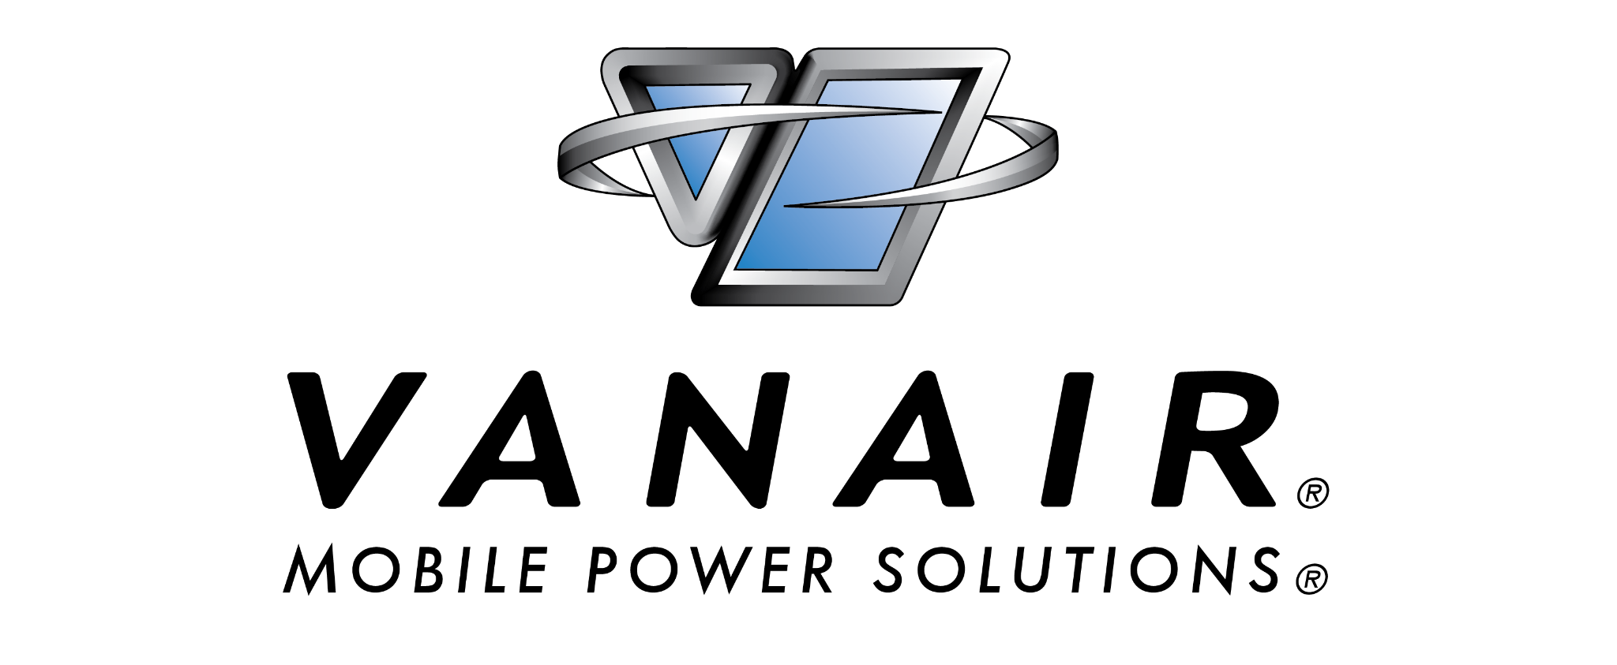
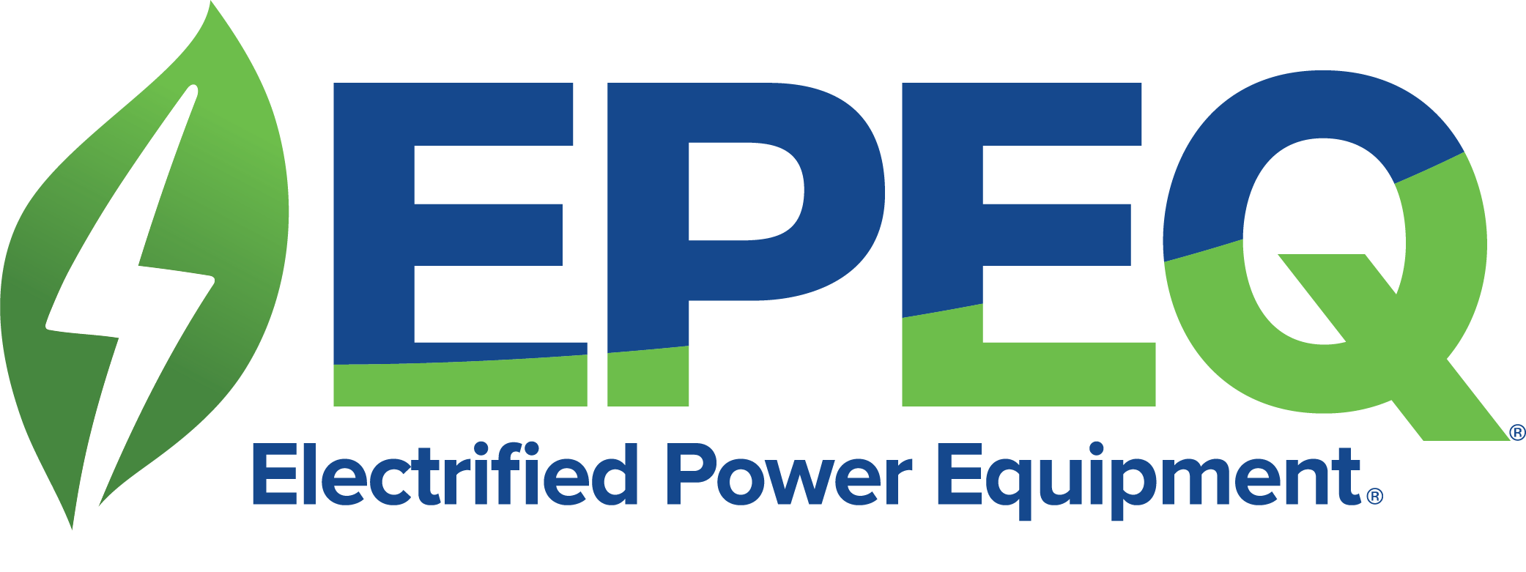

Slide 2
ABOUT US
01

Slide 3
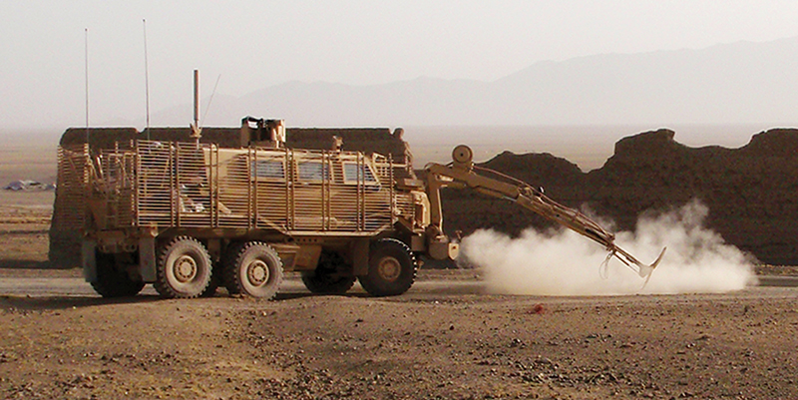
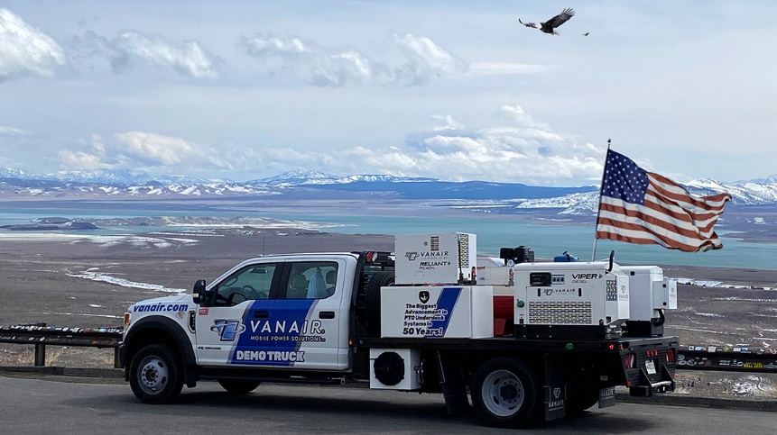
Over Five Decades as the MOBILE POWER SOLUTIONS® LEADER
For over 50 years, Vanair® has worked toward one goal – being the industry leader in Mobile Power Solutions®. During that time, it has been an honor to collaborate with a multitude of companies to engineer products that deliver a true performance edge. Today, from our facilities in
Michigan City, Indiana, Vanair® offers the world’s most comprehensive product line of mobile power solutions:
Air Compressors
Generators
Welders
Hydraulics
Electrified Power Equipment®
Chargers / Boosters
Engine Starters
Custom Mobile Power Equipment

Slide 4
EPEQ – Electrified Power Equipment
02

Slide 5
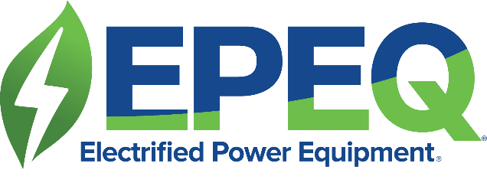
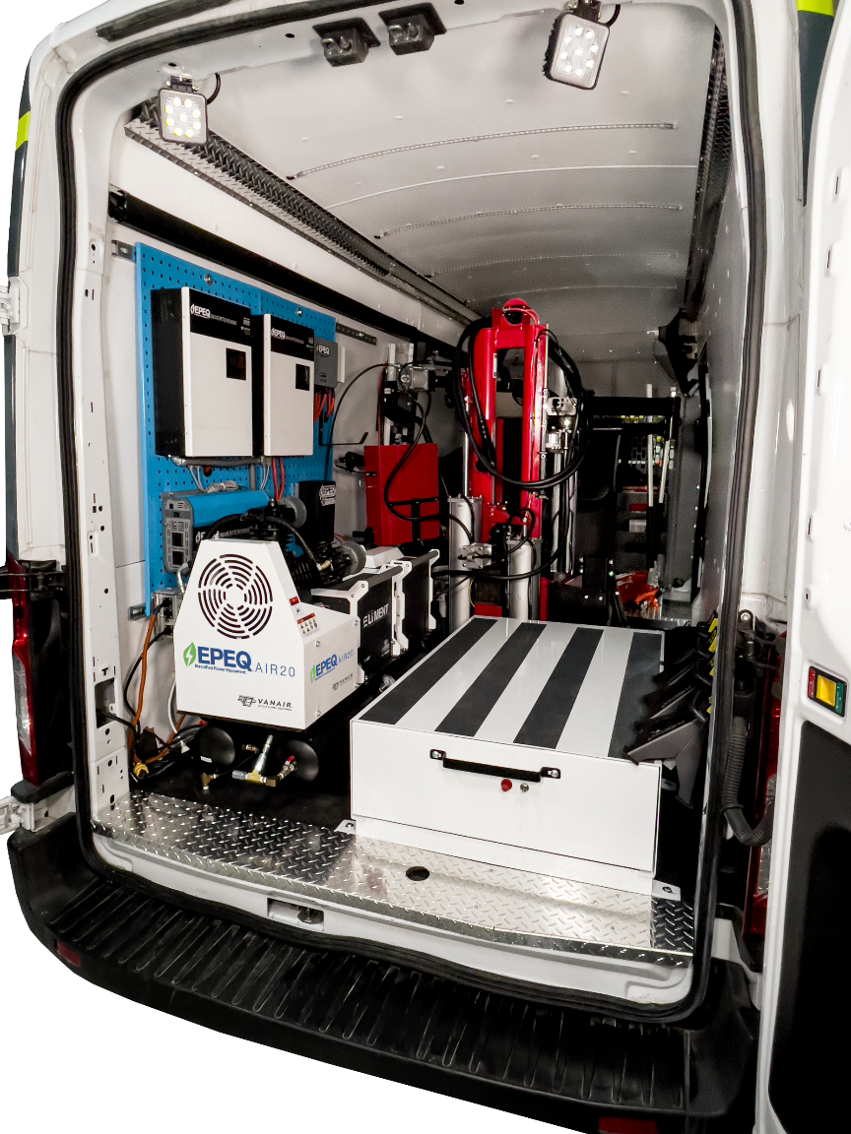
Vanair® Product Offerings
EPEQ® Electrified Power Equipment^{® -} Powering Fleet Electrification™
EPEQ® is a patent pending comprehensive, end-to-end system, of zero emission and clean, quiet Electrified Power Equipment® products developed by Vanair®. Powered by Vanair’s specially developed line of Lithium Iron Phosphate (LiFePO4) ELiMENT™ batteries, EPEQ® allows you to turn off the vehicle’s engine and run the equipment you need on the job site in a fully electric fashion.
The EPEQ® Solution provides: Clean, Quiet, Power™, Idle Management and Reduced Emissions, Lower Cost of Ownership - Reduced Maintenance & Fuel Costs, Data Driven Benefits, Operational Efficiency
Clean, Quiet, Power™

Slide 6
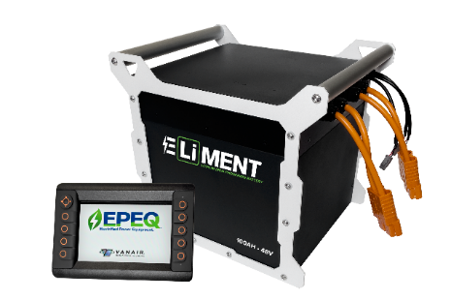
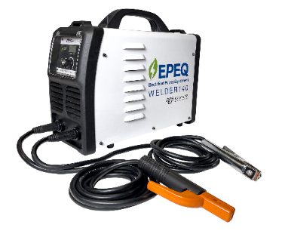
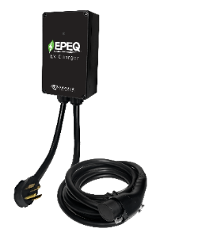
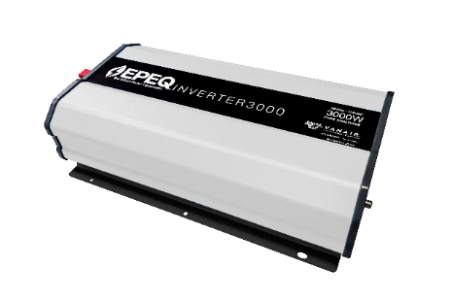
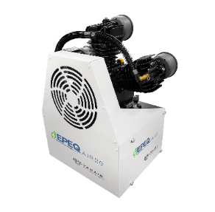
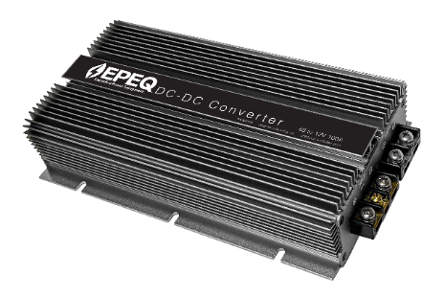
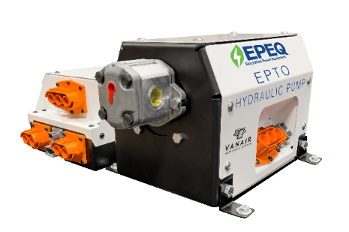
LiFePO4 BATTERIES &
SMART CONTROLLER
WELDERS
EV CHARGING
INVERTERS
The
EPEQ®
Ecosystem
AIR COMPRESSORS
CONVERTERS
EPTO HYDRAULIC POWER
IDLE MANAGEMENT &
VANAIR® TELEMATIC SYSTEM
Notes:
Discuss the battery – 48vdc/5.12kWh – Lithium Iron Phosphate safeties. 7” Smart Controller – Discuss charge methods – Converter/Charger, Shore Charger, and Alternator
Welder – Self-contained, battery is internal, weighs less than 50’ of weld leads at 34lbs. 140amp max, 80a @ 100% duty cycle.
EV Charging – Level 2 charging with 24’ cable and J1772 plug.
Inverters – 48v input, up to 15kW output
Air Compressors – 20cfm recip utilizing same air end as ANA150, and 45cfm rotary screw.
Converter – Operate 12vdc accessories via ELiMENT Battery
EPTO – Up to 15gpm!
Idle Mitigation – Everything from a simple start/stop to full HVAC in-cab controls.

Slide 7
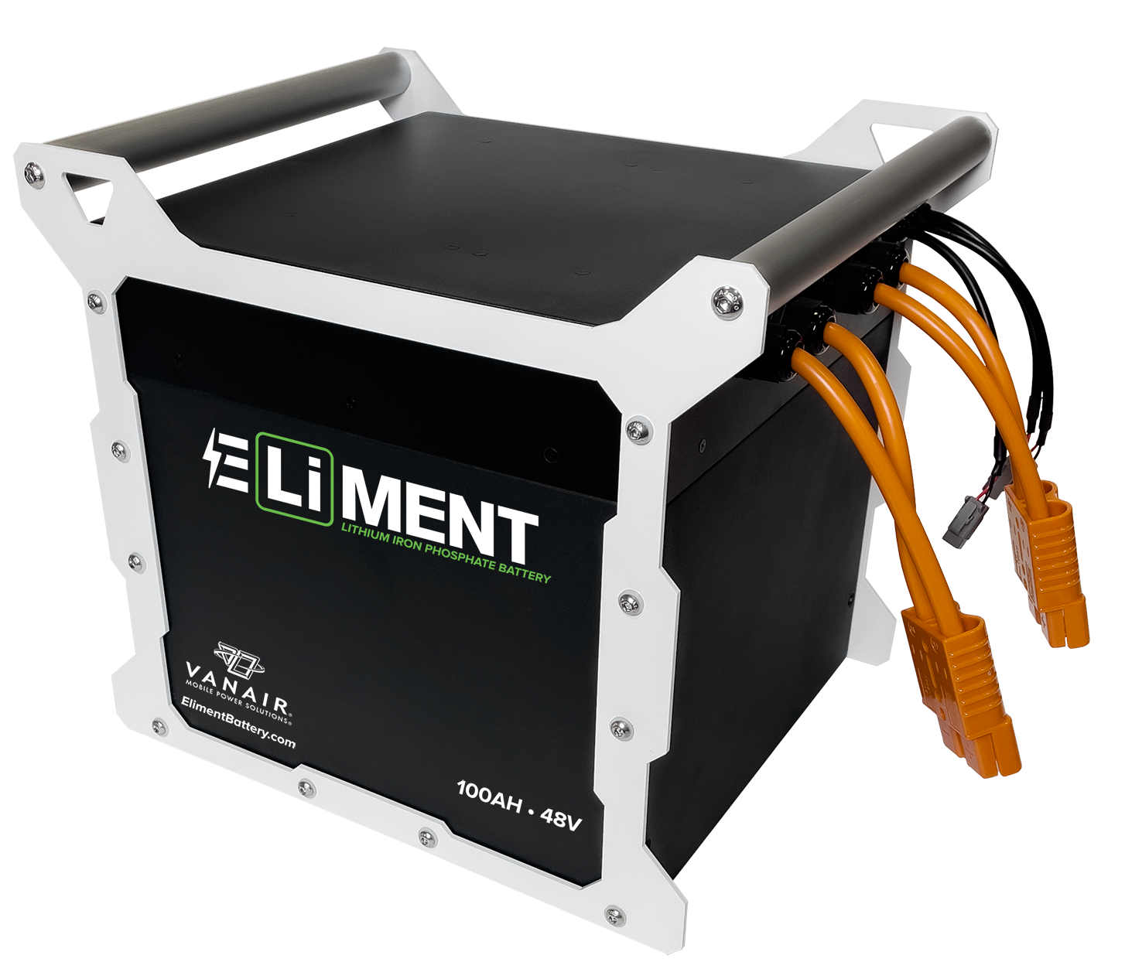
ELiMENT™ Battery
ELiMENT™ 100
48V, 100 Ah battery
LiFePO4 Chemistry
5.12 kWh capacity
13.2”L x 12.2“W x 12.5“H
95 lbs.
Protections:
Over-current and short-circuit
Over-charge and over-discharge
Over-temperature and under-temperature
Automatic pre-charge function
Built-in thermal blanket for cell warming in cold weather
SOLID STATE Battery Management System (BMS)

Slide 8
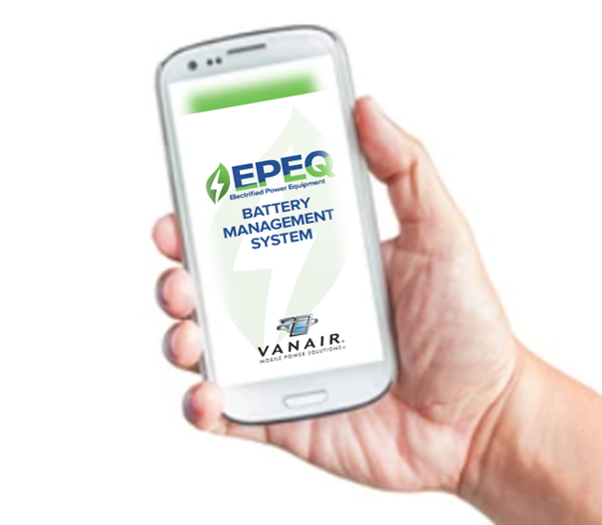
ELiMENT™ Battery Management System (BMS)
BIG Power Requires a BIG Brain:
Monitor battery charge, temperature, and discharge
Solid State Design
Automatically adjusts charge power based on battery needs
Individual cell monitoring and balancing
Connect up to SIX bateries in parrallel and BMS will automatically detect and balance across all batteries!
APP COMING SOON!
Notes:
The BMS is a key portion of the EPEQ lineup and sets us apart from others. This systems ensures longevity of the battery system, but also offers safeties and allows CAN communications for easy tie in to smart systems. The EPEQ™ system is controlled by a smart display which has proprietary software designed to intelligently monitor and control all EPEQ™ system components. Each component can communicate to the display allowing the user to make priority decisions to manage the load applied to the battery. The loads allowed to draw on the battery can be adjusted based on various factors such as: temperature, heat build-up, duty cycle, assigned function priorities, and power remaining.

Slide 9
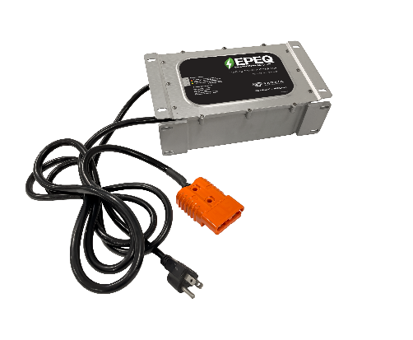
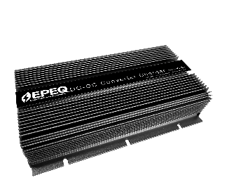
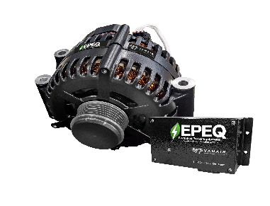
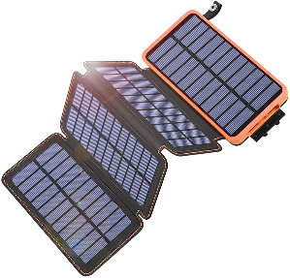
ELiMENT™ Battery Charging
EPEQ® DC-DC Converter (Charger)
Only “smart” converter on the market
12VDC input to 48V output (20ª)
CAN Communications
Featuring industry leading safeties, as well as internal cooling capabilities
Shore Power
ELiMENT™ Battery must be plugged into an AC power source
Slowest battery charging – 4 hours
Solar Power
Options being reviewed; further development under way
EPEQ® Alternator and Regulator
In Development
Notes:
Note that because our EPEQ system operates at 48vdc rather than the standard 12vdc vehicle charge system, we must provide a 48v power source or a converter to transform from 12v to 48v power. Also a good note is that most electric vehicle operate on a 48v system.
Shore power is a good option to charge systems at the shop when the truck is not operating. However shore power does not give them the option to operate the equipment with the vehicle running if the battery is depleted.
The EPEQ™ Alternator and Regulator is the perfect addition to charge your ELiMENT™ battery under hood within 1-2 hours. By adding the EPEQ™ alternator, your EPEQ™ system stays charged with no user interaction. The EPEQ™ Alternator and Regulator communicates with the EPEQ™ System Smart Controller and automatically adjusts power output based on needs. This ensures long battery life, safe operation, and optimal performance.
The EPEQ™ DC-DC Converter, easily converts 12V input to 48V output to charge the ELiMENT™ Battery, available in 30A charge rates. Recharges the battery back while driving.

Slide 10
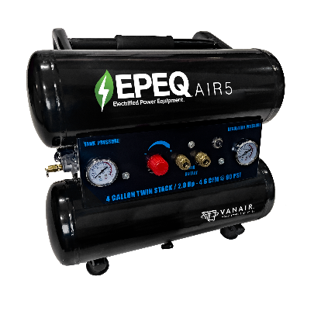
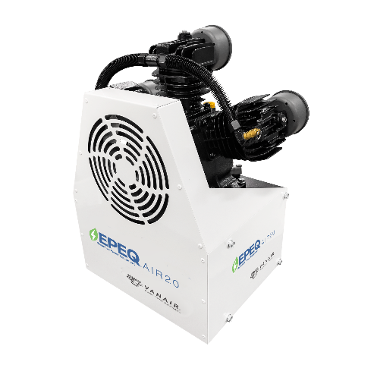
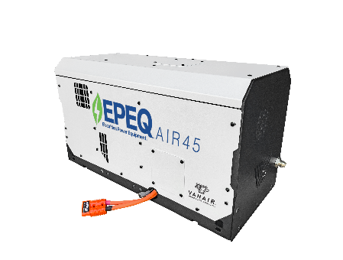
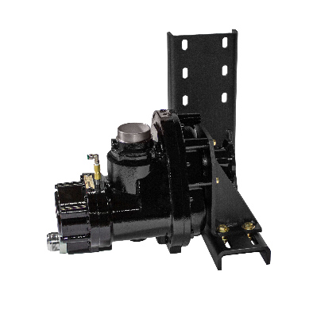
EPEQ® AIR5
EPEQ® AIR20
EPEQ® AIR45
EPEQ® Underdecks
Air Compressor Options
4-5 CFM Cast Iron,
Oil Lubricated
Air Compressor
20 CFM Reciprocating
Air Compressor
20-45 CFM Rotary Screw
Air Compressor
Up to 185 CFM
Air Compressor
* In Development
Notes:
This is a good representation of Vanair’s versatility. Like our Reliant offering, we can offer reciprocating compressors as well as rotary screw. The reciprocating unit does require an air tank, but the rotary screw options do not.
EPEQ™ Air Compressors are driven by highly tuned specialized PMAC electric motors for increased efficiency to prolong battery range. The EPEQ™ AIR20 and AIR45 compressors communicate with the EPEQ™ System Smart Controller and are designed to provide optimal performance.

Slide 11
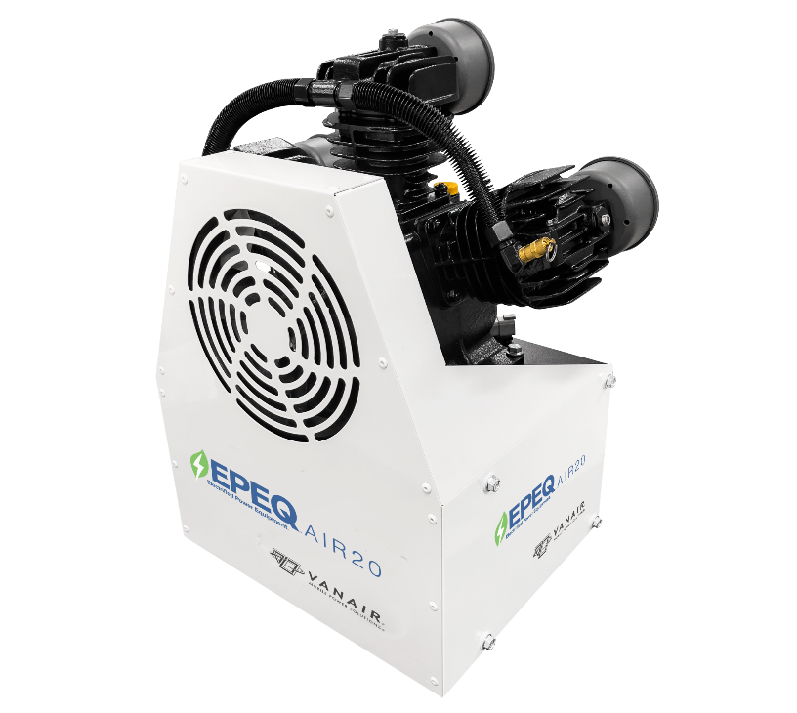
Example: EPEQ® AIR20 Run Time
Compressors Developed for REAL WORLD USAGE!
Battery
Type
Low Speed
Run Time
High Speed
Run Time
Capacity
Run Time*
ELiMENT™ Battery
100 Ah
120 Minutes
60 Minutes
Cycling ON/OFF to Maintain 150 PSI (100 PSI ON/150 PSI OFF):
700+ on a single charge!
*Run Time @ 70% Duty Cycle with 15-Gallon Air Tank
Notes:
The EPEQ AIR20 is a proven compressor option when you need dependable air! Providing 20cfm/150psi, this is a great solution for those who are doing tire service, or operating air tools. The 48v PMAC motor mounts below the compressor for a clean, compact installation.

Slide 12
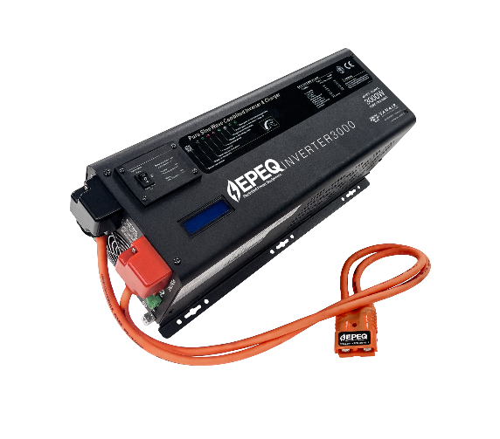
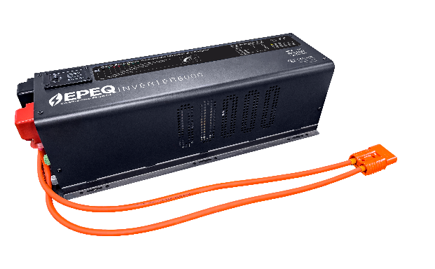
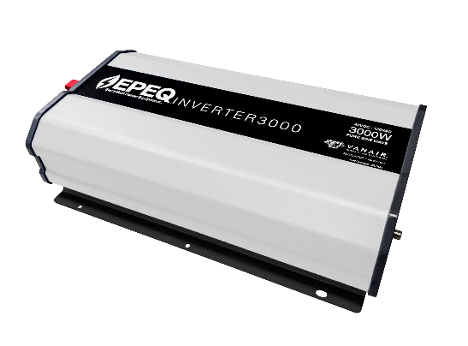
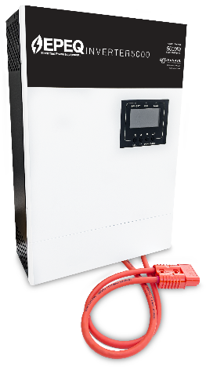
EPEQ® AC Power Inverters
Low Frequency
High Frequency
EPEQ® INVERTER3000
3000W, 120/240VAC, 48VDC
Pure Sine Wave inverter
EPEQ® INVERTER6000
6000W, 120/240VAC, 48VDC
Pure Sine Wave inverter
EPEQ® INVERTER3000
3000W, 120VAC, 48VDC
Pure Sine Wave inverter
EPEQ® INVERTER5000
5000W, 240VAC, 48VDC
Pure Sine Wave inverter
Notes:
The EPEQ™ 48V AC Power Inverter lineup includes multiple Pure Sine Wave high frequency inverters to fit any need. All EPEQ™ high frequency inverters communicate with the EPEQ™ System Smart Controller for simple, efficient use, and installation. The uniqueness of the EPEQ™ 5kW inverter offers 240VAC output and is stackable to offer additional power output. All inverters offer remote on/off and a port for simple installation of a remote outlet box. Low frequency options are also available.

Slide 13
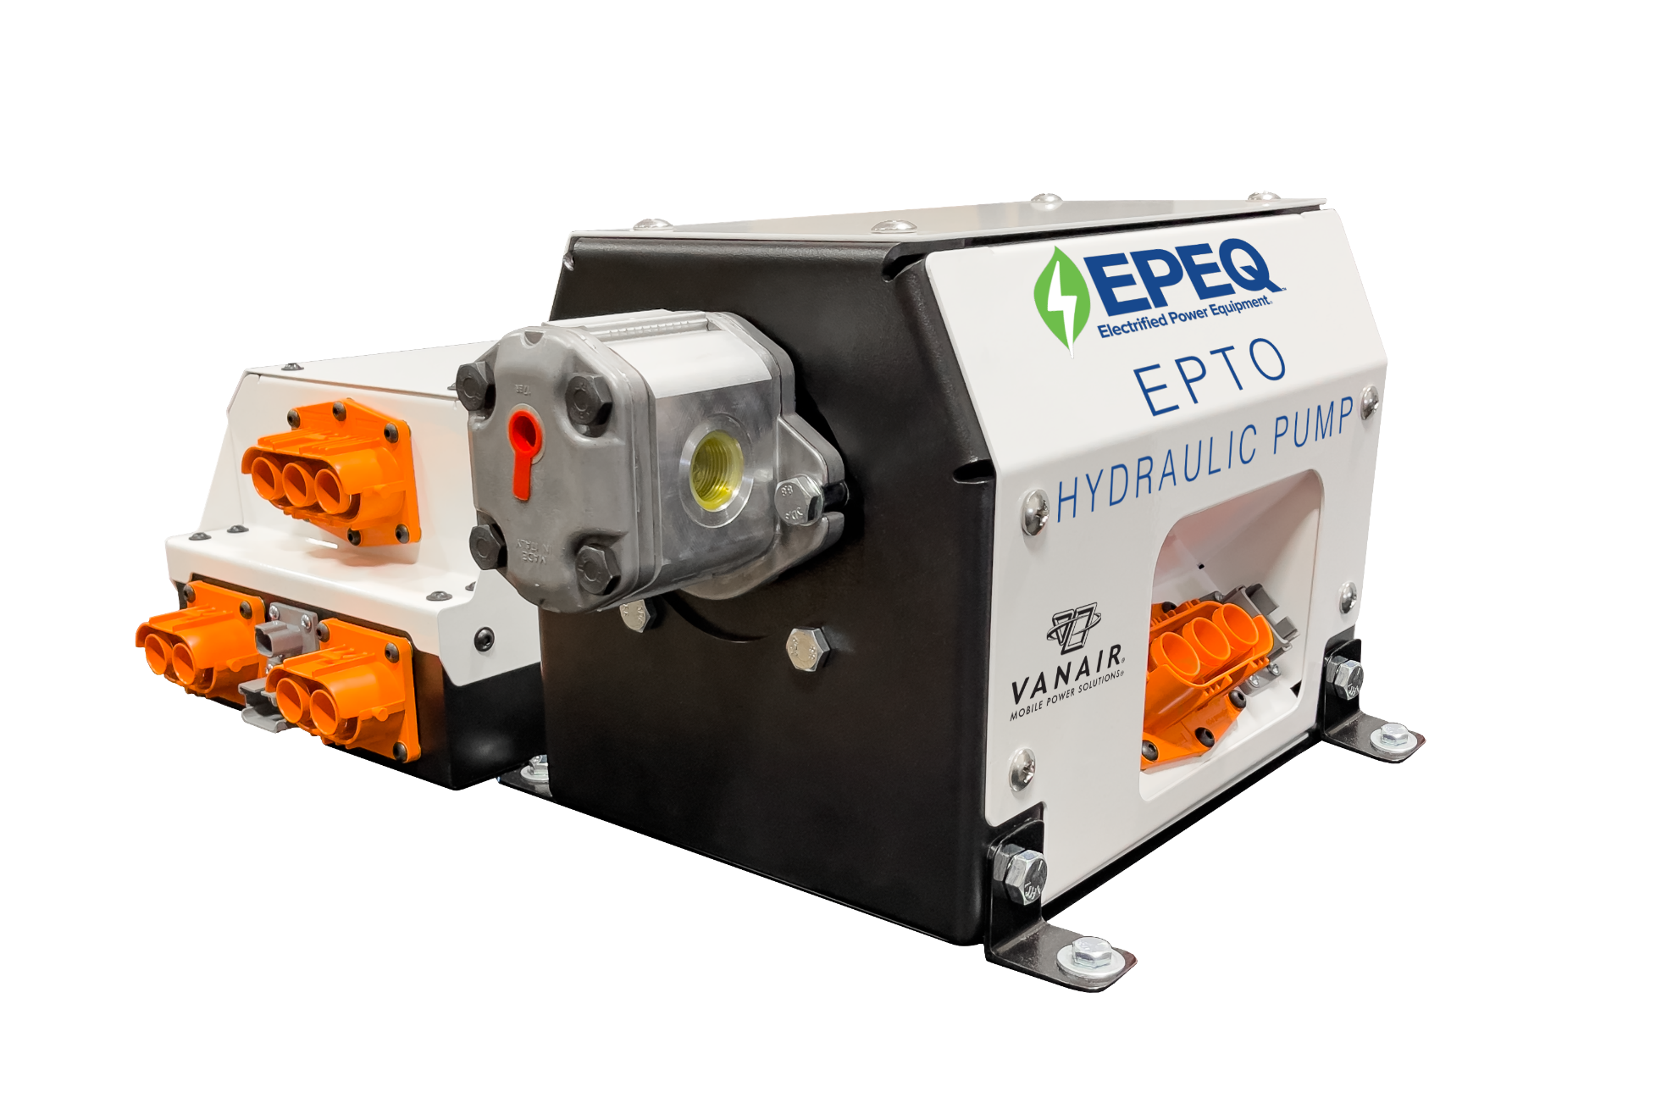
EPEQ® EPTO
EPEQ® EPTO System
Power your hydraulic crane, boom truck, and other hydraulic operated components using our EPEQ® power system and ELiMENT™ Battery
Best for electric vehicles and vehicles that do not have a traditional PTO setup, or when you want to power hydraulics with the vehicle off
Operates like a traditional PTO/pump setup, no need for a full re-engineering of your hydraulic equipment
Custom solutions available in multiple flow rates & pressures
Notes:
Now, you can power your hydraulic crane, boom truck, and other hydraulic operated components using our EPEQ™ power system and ELiMENT™ Battery. This new way to operate hydraulic components is the best fit for electric vehicles and vehicles that do not have a traditional power take off (PTO) setup, or in instances when you want to power hydraulics with the vehicle off. The EPEQ™ Hydraulic Power system operates like a traditional PTO/pump setup, meaning there’s no need for a full re-engineering of your hydraulic equipment.

Slide 14
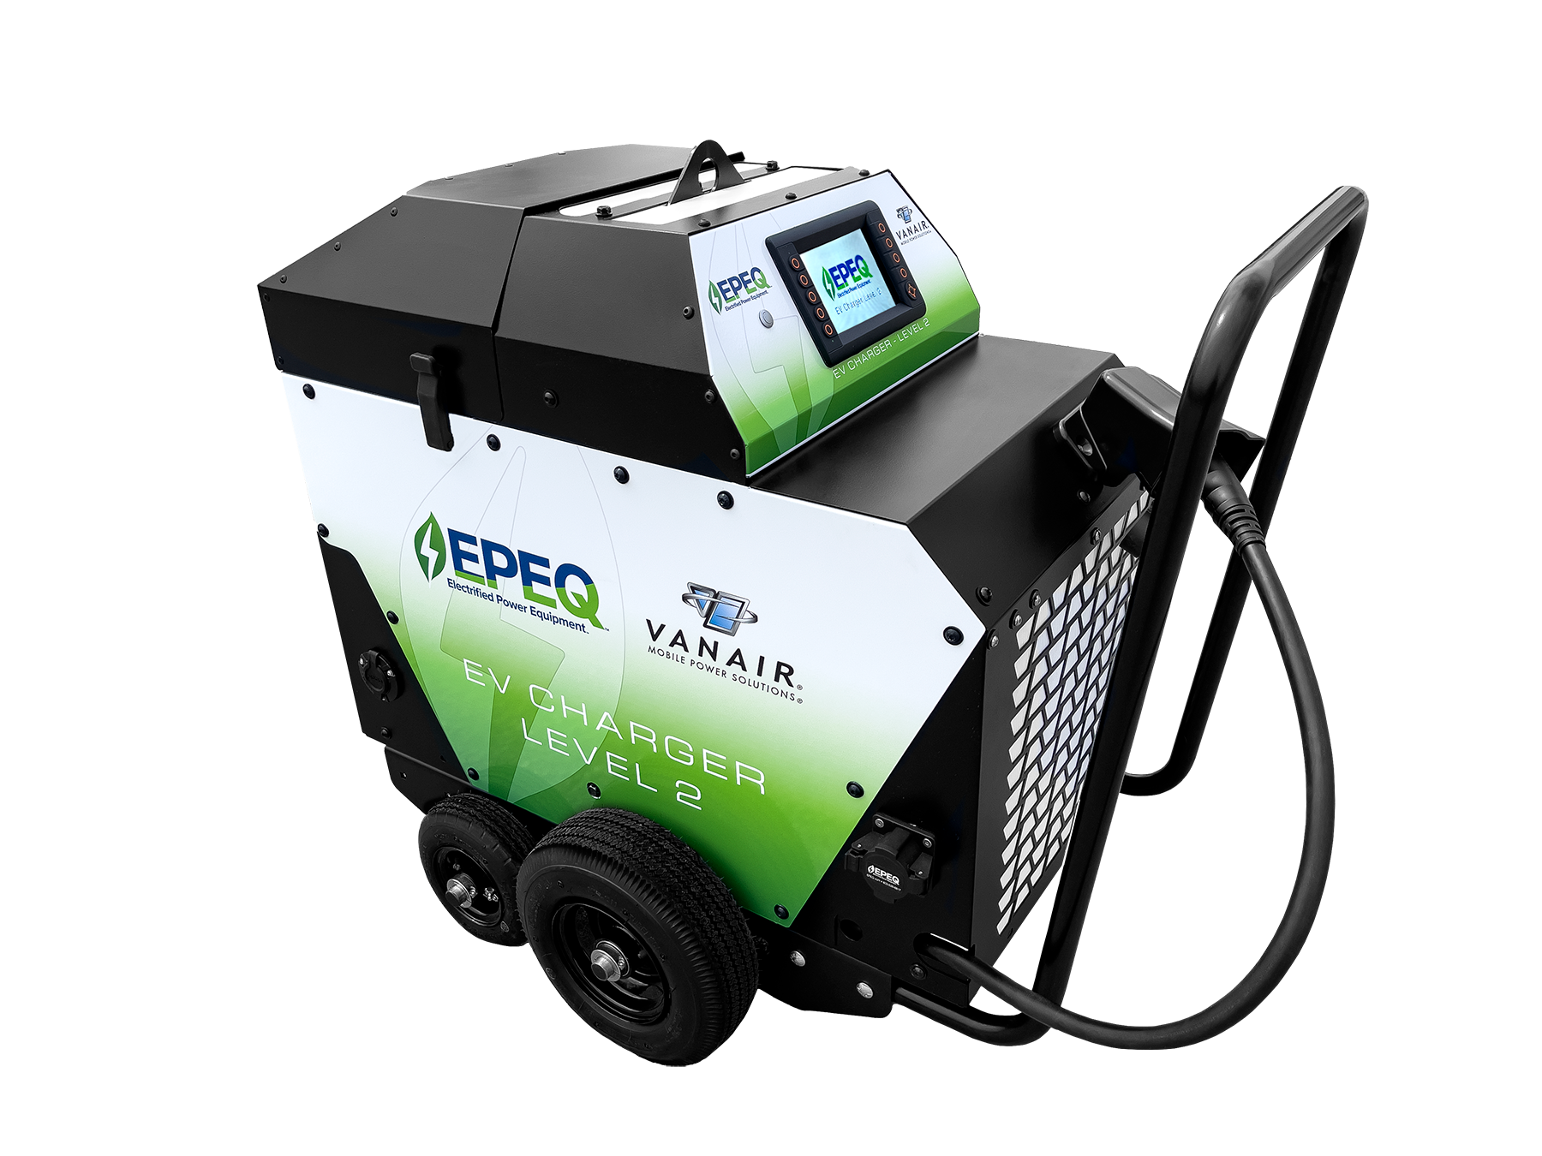
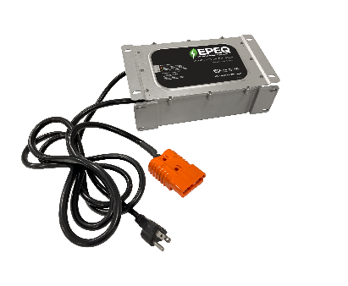
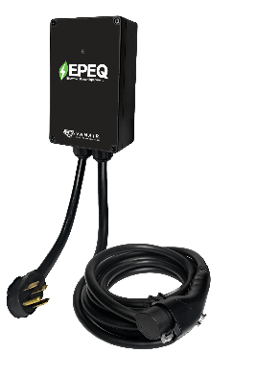
EPEQ® EV Charging Options
Level 1 Shore Power
Level 2 EV Charger
120V Charging
240V Charging
Level 3 and Mobile Options In Development
EPEQ® Electric Vehicle Charging is a new, innovative way to charge electric vehicles when away from a traditional, stationary EV charger:
Ability to charge an electric vehicle without the need for an additional internal combustion engine (I.C.E.)
(1) 48V batteries, 3kW inverter, and 25' cable
(2) 48V batteries, 10kW inverter, and 25' cable

Slide 15
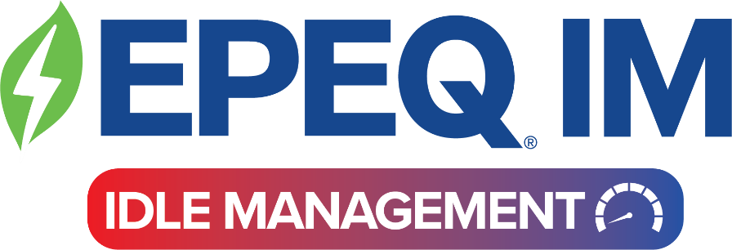
Idle mitigation refers to reducing or eliminating the amount of time that a vehicle spends idling or running while not in motion.

Slide 16
RADIOS
LAPTOPS & CAMERAS
Provides automatic idle mitigation while providing full mobile power capabilities.
AC ELECTRICAL EQUIPMENT
ALL OEM LOADS
LIGHTS
AUXILIARY AC & HEAT

Slide 17
What triggers the EPEQ® Idle Management System to restart?
HOST VEHICLE BATTERY LEVEL
STATE OF CHARGE OF AUXILIARY BATTERY –
I.E. ELiMENT™ BATTERY
OTHER CUSTOM INPUTS
Notes:
Cab temperature is possible but rare and custom not standard

Slide 18
Miles
Minutes
One hour of idle time is equivalent to:
30 miles of driving
These are known as “ghost miles”.
(Source: Clean Cities)

Slide 19
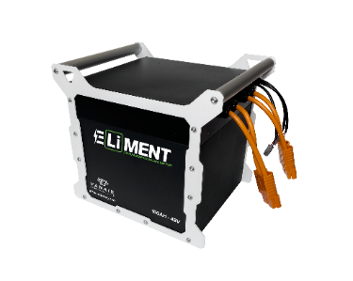
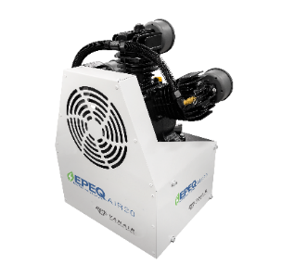
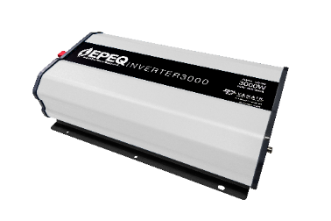
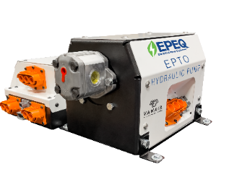
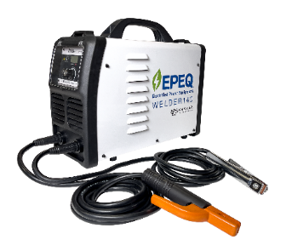
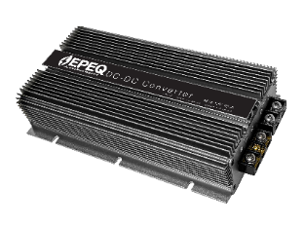
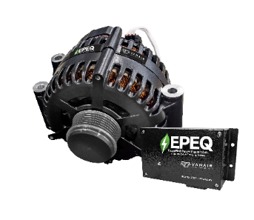
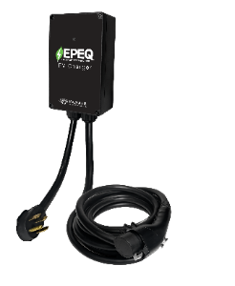
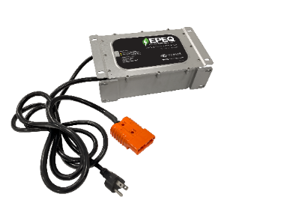
EPEQ® IM
IS SCALABLE
WITH ALL
EPEQ®
EQUIPMENT

Slide 20
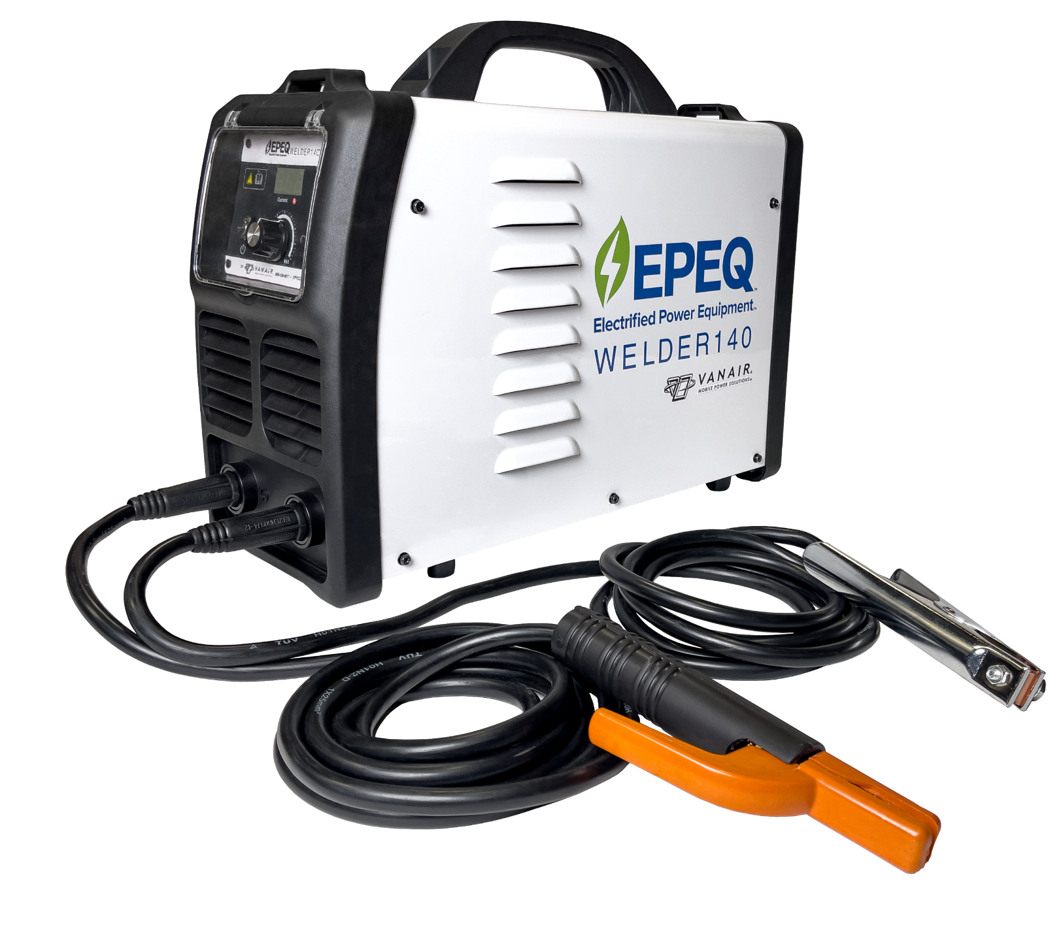
Additional EPEQ® Options: Lithium-ion Welder – No Cords to Plug In!
EPEQ® WELDER140
CC welding capabilities
140 Amp stick welder
Lithium battery-powered
Portable, with the ability to carry the entire welder and cables
User-friendly for fast repair jobs
Duty cycle: 20% @ 140A; 50% @110A; 100% @ 80A
Lightweight, only 34 lbs.
18.3”L x 7.6”W x 14.9”H
Notes:
The lithium powered welder contains its own internal battery, which means the entire 33.7lb unit can be carried right next to the project, without the need to carry heavy cables. This is a great option for those that need to do light welding in the field.
The Vanair® EPEQ™ 140A Welder combines the flexibility of lithium-powered welding with Vanair’s long history of providing top-level welding capabilities. The ability to carry the entire welder and cables (34 lbs. total weight) right next to the equipment being worked on, makes the EPEQ™ Welder extremely user-friendly for those fast repair jobs.

Slide 21
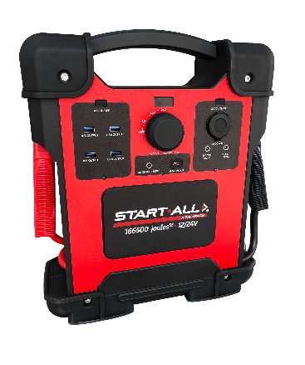
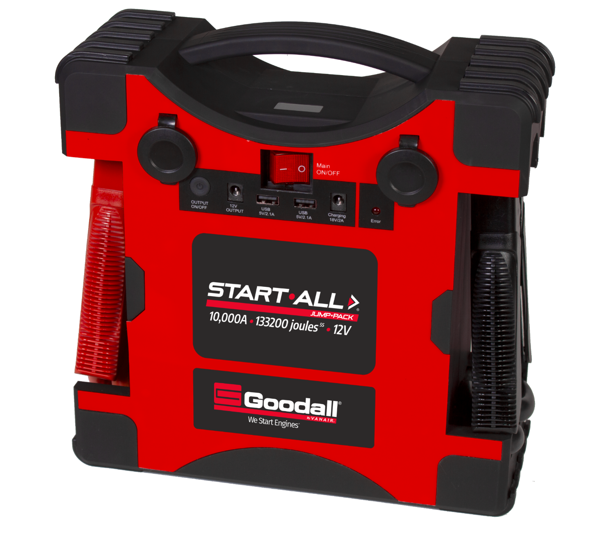
Engine Starting
NEW 12/24V Start•All Jump•Pack®
Only 18 lbs.!
Start•All Jump•Pack® 12V Vehicle Starting
Up to 10,000A of instantaneous jump-starting power
Start up to 16L Class 8 vehicles
Lithium-ion Cobalt battery
Protect•All® internal safeties
Weighs < 12 lbs.
2500A and 5000A models available
Notes:
With all of the focus of EV and the future of fleet – we can’t overlook the millions of combustible vehicles still in fleets and on the road. Our 12lb lithium jump pack easily stores when not needed, but provides power to jump start up to 16L class 8 vehicles!

Slide 22
Install Photos
03

Slide 23
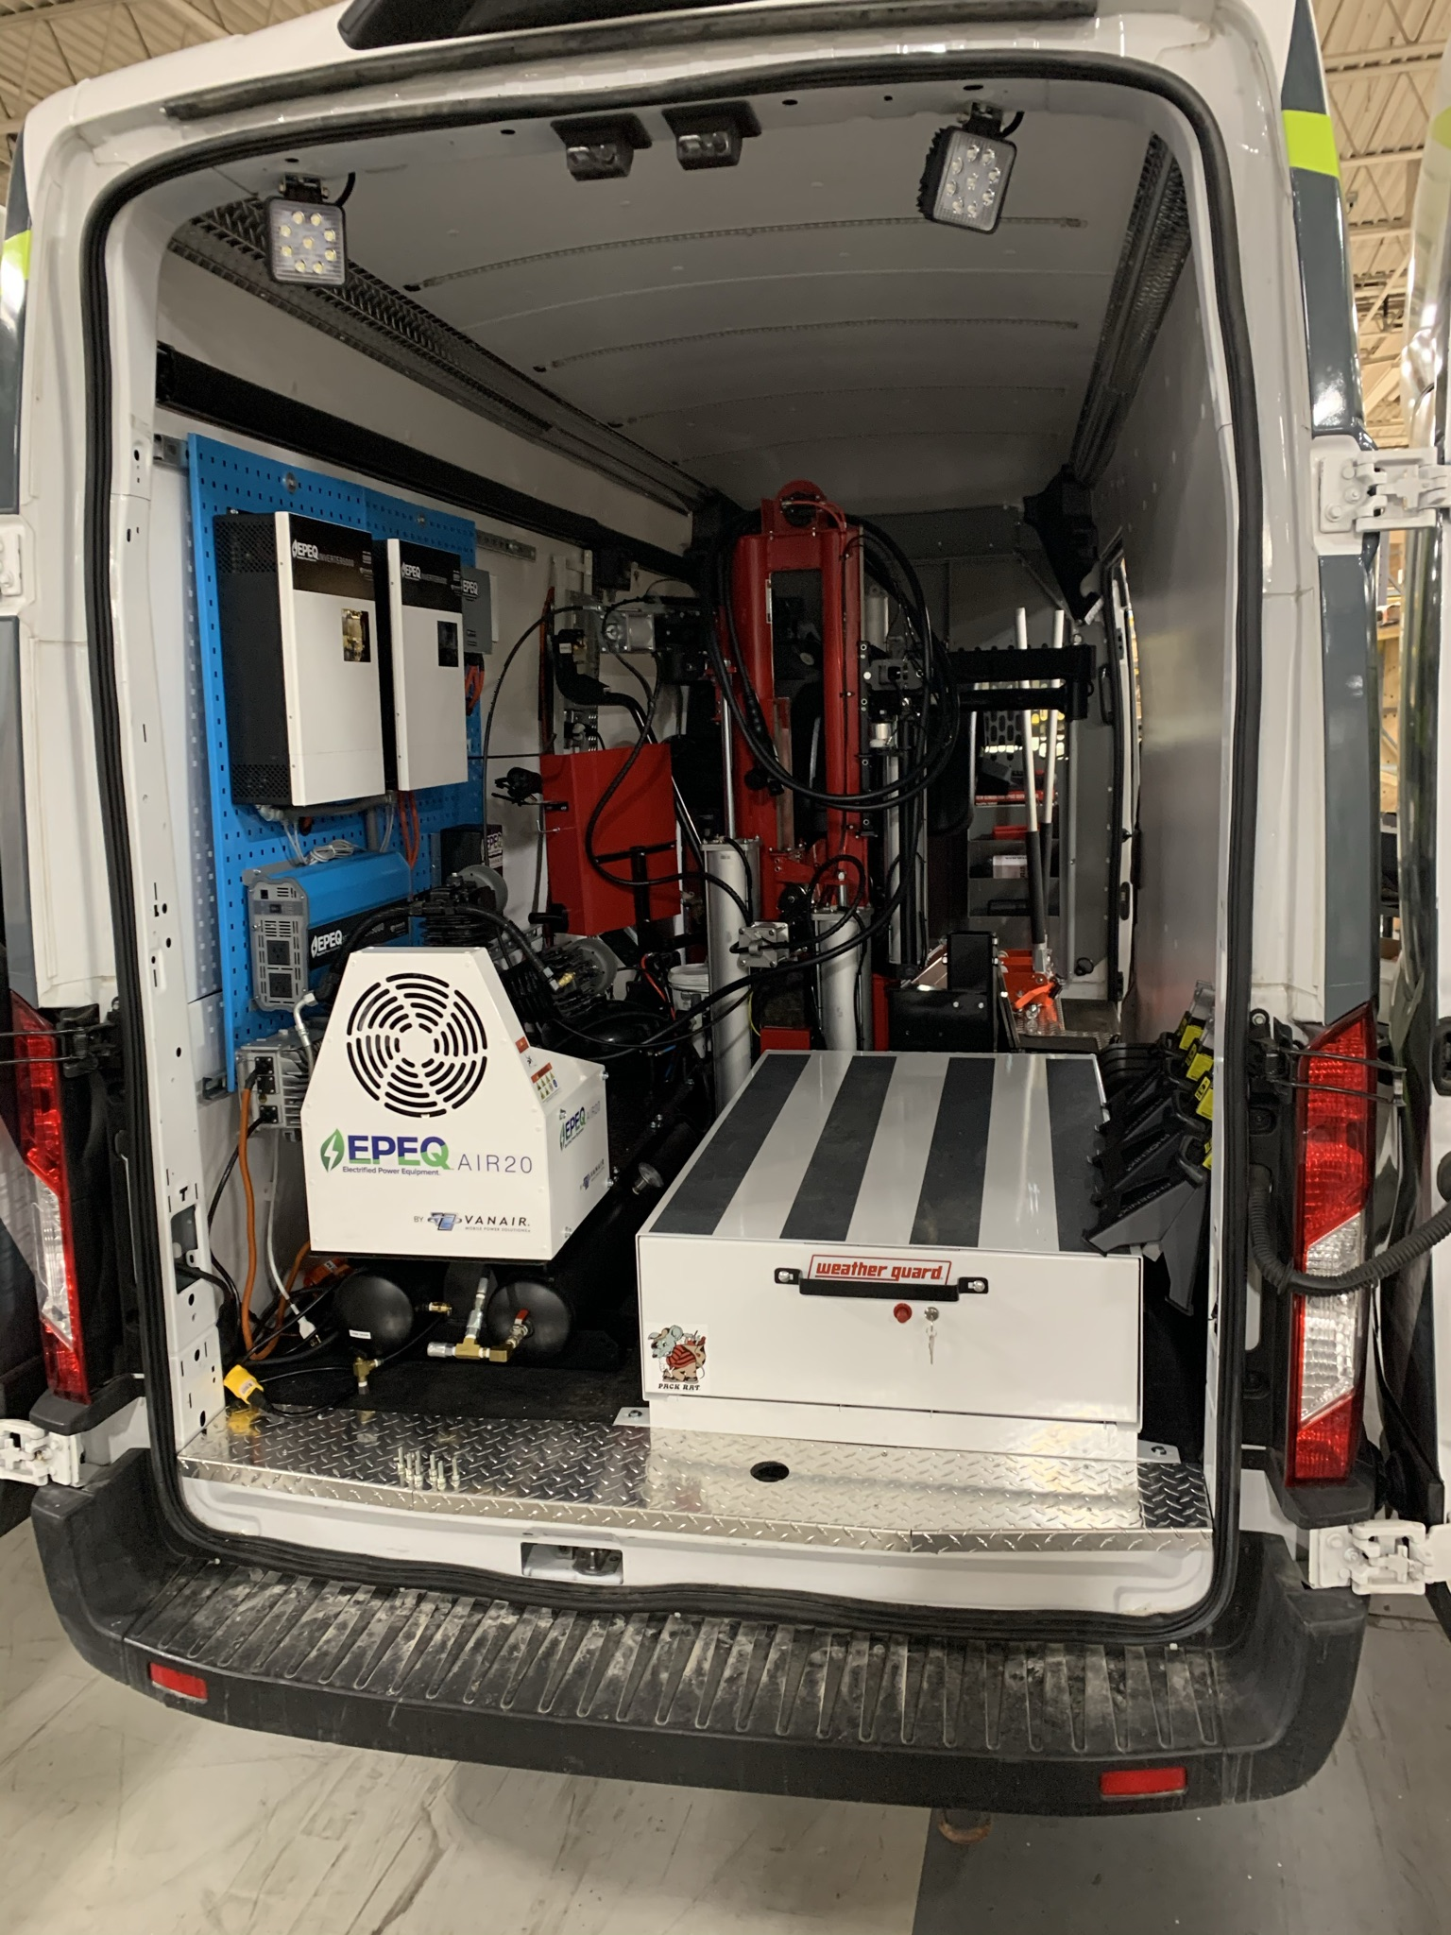
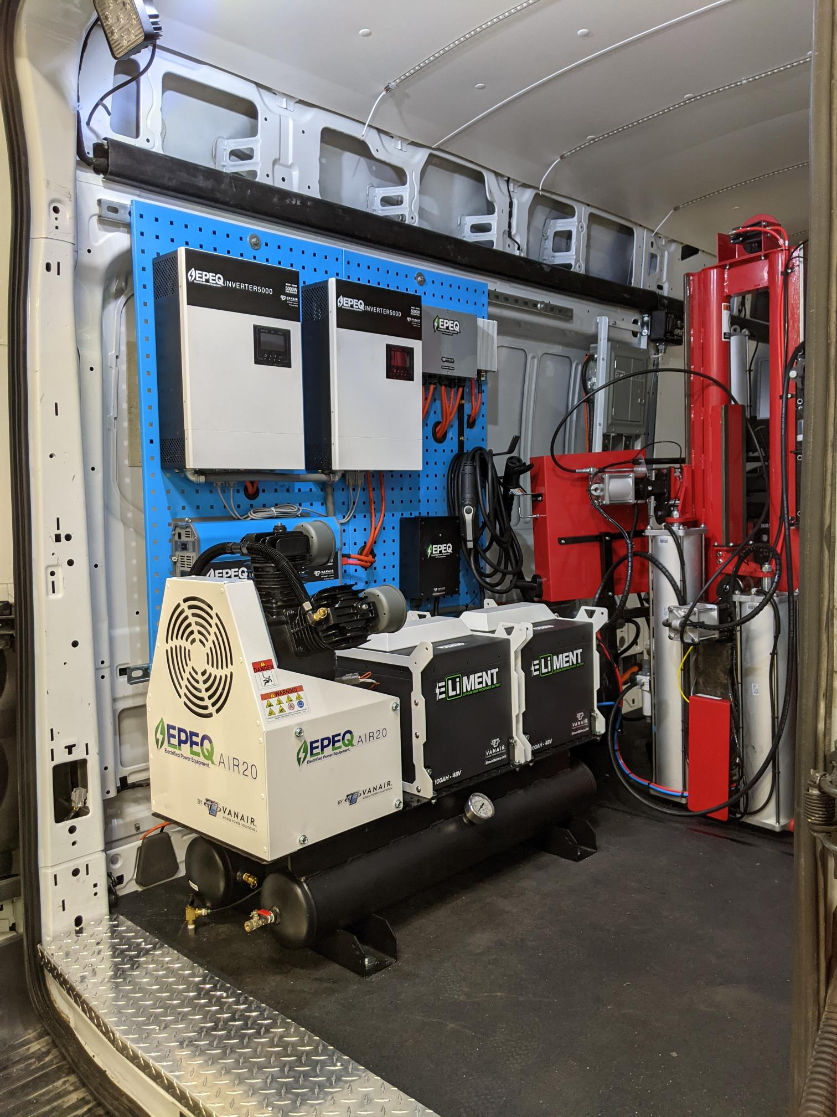
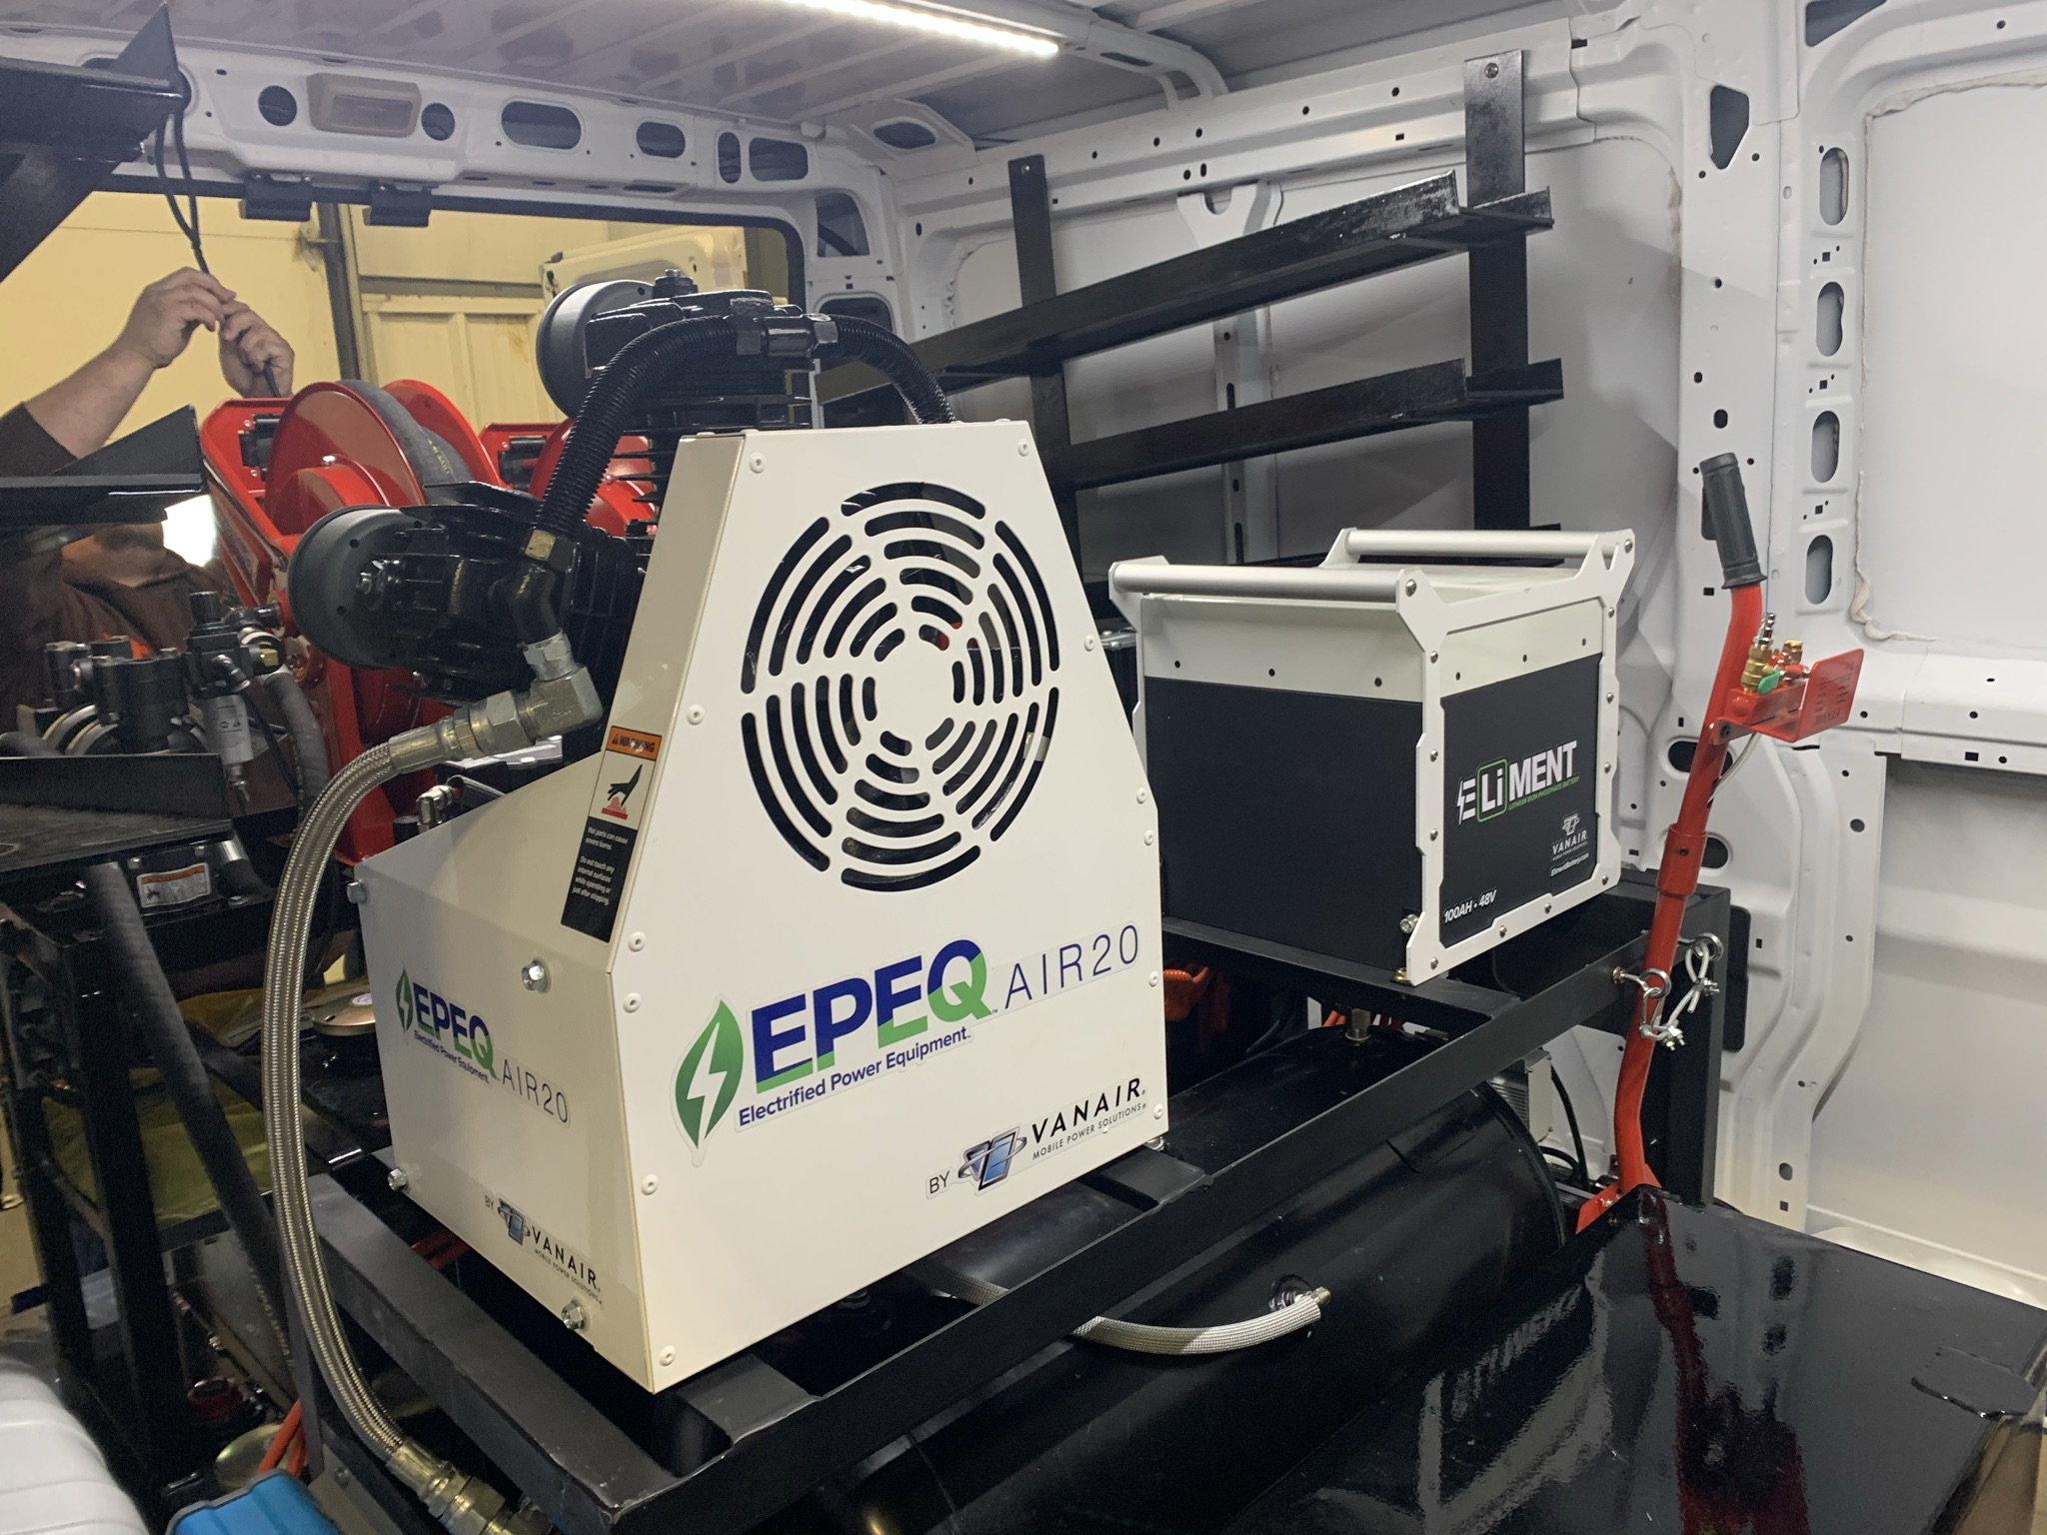
EPEQ® in Action!
Notes:
The lithium powered welder contains its own internal battery, which means the entire 33.7lb unit can be carried right next to the project, without the need to carry heavy cables. This is a great option for those that need to do light welding in the field.
The Vanair® EPEQ™ 140A Welder combines the flexibility of lithium-powered welding with Vanair’s long history of providing top-level welding capabilities. The ability to carry the entire welder and cables (34 lbs. total weight) right next to the equipment being worked on, makes the EPEQ™ Welder extremely user-friendly for those fast repair jobs.

Slide 24
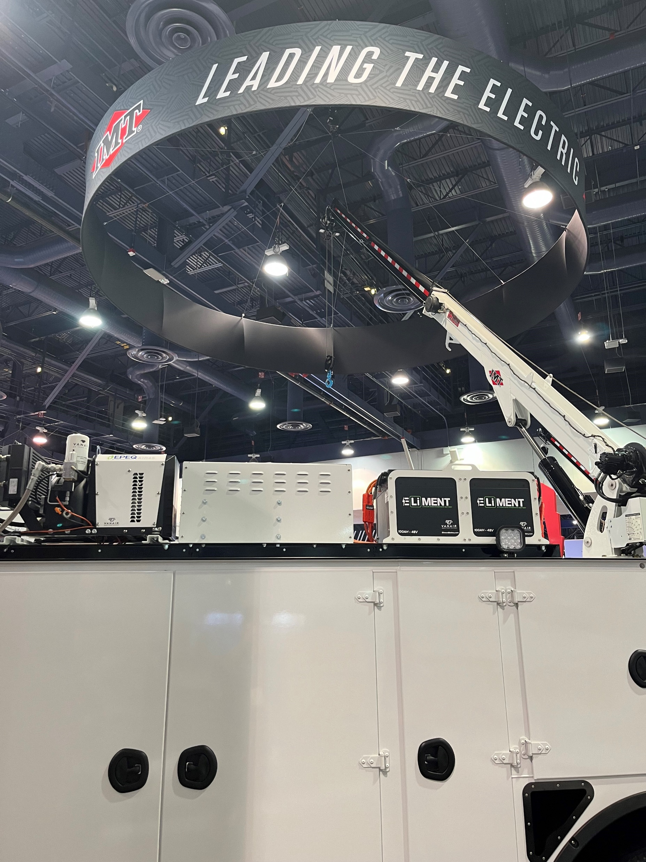
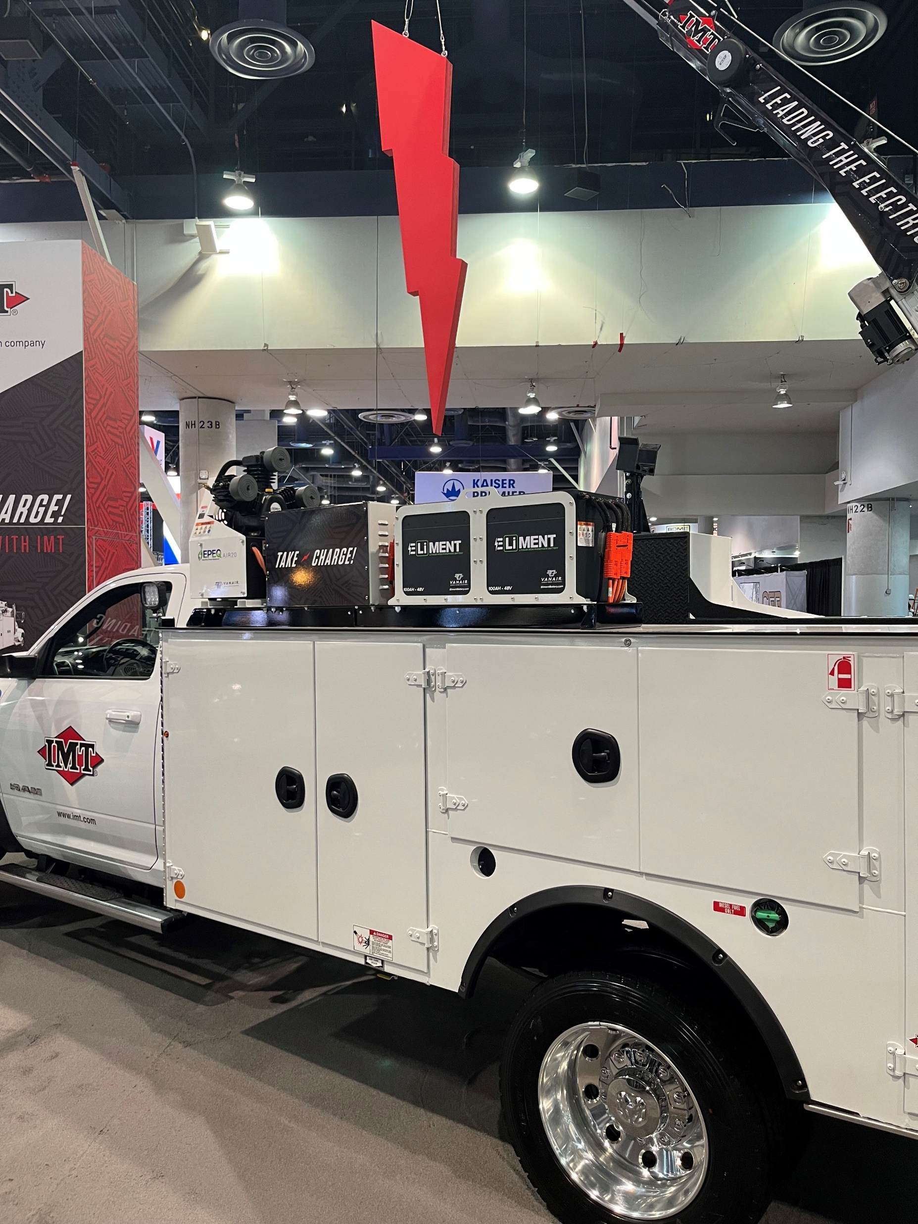
EPEQ® in Action!
Notes:
The lithium powered welder contains its own internal battery, which means the entire 33.7lb unit can be carried right next to the project, without the need to carry heavy cables. This is a great option for those that need to do light welding in the field.
The Vanair® EPEQ™ 140A Welder combines the flexibility of lithium-powered welding with Vanair’s long history of providing top-level welding capabilities. The ability to carry the entire welder and cables (34 lbs. total weight) right next to the equipment being worked on, makes the EPEQ™ Welder extremely user-friendly for those fast repair jobs.

Slide 25
Thank you for your time!
vanair.com /

